Slide 1
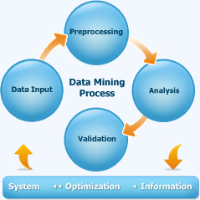
Click to edit poster title
University
logo
Your name • Your affiliation • Your email address
Introduction
Experiments
Results/Findings
Set the context for the work. Don’t make the reviewer guess what problem this work solves.
Outline the experiments or investigation
Findings: So what? Impact? What has been accomplished? Include some graphs, photos if you have
Problem description/research questions
Define the problems you are looking to solve using your research.
Credit Data
Web
Pages
If you have a graphic, it might be useful to include a subtitle such as this one to identify its relevance.
If you have a graphic, it might be useful to include a subtitle such as this one to identify its relevance.
Conclusions
Discovery
Methods
Here you state the results and conclusions of your project. Be brief and to the point.
Text
Messages
State briefly your methodology for answering your hypothesis/research question(s)
Airline
Data
References
If you have a graphic, it might be useful to include a subtitle such as this one to identify its relevance.
Put your collaborators and references here
Advisor: Dr. Hong Zhao, FDU

