Slide 1
IEEE San Diego Section
Awards Luncheon
January 21, 2023

Slide 2
Agenda
Welcome!
Awards Ceremony
Recognition of Past Section Chairs
Recognition of Past Officers
Installation of Incoming Officers
2022 Chair Remarks
Adjournment

Slide 3
IEEE San Diego Section in 2022
Nearly 4,000 Members
23 Chapters, Affinity Groups, and Student Branches
95 Events

Slide 4
APS/CASS/EDS/MTTS/SSCS
"Big" Chapter
San Diego Section Awards Luncheon, January 21st 2023
for outstanding IEEE San Diego Chapter
Notes:
Now we would like to reconginice Kathy Herring Hayashi, for her support in getting the IEEE San Diego Section our Very First IEEE Milestone. Well where do we begin, Kathy is been a super star here in the San Diego section, a few years ago her leadership was instreamental in staring our Woman in Enginnering group, she has since moved on to chair our consumer electronics chapter.

Slide 5
UCSD
San Diego Section Awards Luncheon, January 21st 2023
For outstanding IEEE San Diego Student Branch
Notes:
This next award goes to Qualcomm, which has been a long time partner of the IEEE San diego Section. From likely emplying the largetest perscentage of our local members, to contributing to the community, supporting stem projects, opening their doors and letting the IEEE use their world class facilitys for our events, not to mention partnering with us to erect our first IEEE Milestone and their main campus. The San Diego Section is greatful for all of their contributions. Accpeting this award is Seniro Vice President Ed Tiedemann, I understand that Ed also had a few words to say.

Slide 6
ATEC
San Diego Section Awards Luncheon, January 21st 2023
for outstanding support and service for IEEE events
Notes:
Our Next award going to Upkar Dhaliwal for his outstading leadership, for Chairing our successful Smart Tech Summit, for being a vice chair of the section, chairing our local EMBS chapter and overall commitment to our community.

Slide 7
Qualcomm
San Diego Section Awards Luncheon, January 21st 2023
for outstanding support and service for IEEE events
Notes:
This year we honering a chapter that has gone above & beyond in providing value to their members, and this year we are awarding the chapter of the year to the Computer Society. Can the chapter chair Charlie Bird please come up to accept this award.

Slide 8
Gabriel Alcala
San Diego Section Awards Luncheon, January 21st 2023
For outstanding leadership supporting the IEEE San Diego Section
Notes:
We would also like to honor a standout Affinity Interest Group, and the 2017 Affinity group of the year goes to the IEEE Consultants Network, which has bee nthe most active group in our section for sometime now and just a few months ago they celebrated their 25th anaversion of their first meeting which I was lucky enough to attend. Can their chair Alfonso Limon please come up the accept your award.

Slide 9
Douglass Evans
San Diego Section Awards Luncheon, January 21st 2023
For outstanding leadership supporting the IEEE San Diego Section
Notes:
I would like to recognize InterDigital Corporation for their their support of several San Diego chapters, Here to accept the this award is our very own Commination Socitey Chapter Chair Liangping Ma and B. K. Yi if you’re in attendance.

Slide 10
William Torre
San Diego Section Awards Luncheon, January 21st 2023
For outstanding leadership supporting the IEEE San Diego Section
Notes:
Our final award goes to Spawar for their contributions to the several of our chapters, including, Antenna’s & Propogation, Photonics, Robotics, Microwave Theiroy, and support to our student branches. Here to Accpet the award is Doug Evans, one of our Executivme committee members and ()

Slide 11
Theresa Burke
San Diego Section Awards Luncheon, January 21st 2023
For outstanding leadership supporting
San Diego Section and WIE activities
Notes:
Our next Award goes to HP Inc. and spacifily the Rancho Bernordo Campus, they have been extreammply genourus in hosting and sponcoring local ieee activinges .Accepting this award is Leszek Langiewicz,

Slide 12
Zhensheng Zhang
San Diego Section Awards Luncheon, January 21st 2023
For outstanding leadership supporting the IEEE San Diego Section
Notes:
Next I would like to Bring of Grant Schmidbauer and anyone else from NEMKO, they were nominated for providing techinal speakers & hosting in their Carlsbad Facility

Slide 13
Hua Zhu
San Diego Section Awards Luncheon, January 21st 2023
For outstanding service supporting San Diego Section as Section Treasurer
Notes:
Next I woudl like to acknolge TUV Sud America and spacificly the lab in Sorrento valley for their contributions to the local EMC & product safety chapters, Accepting this award is William W

Slide 14
Lai Xu
San Diego Section Awards Luncheon, January 21st 2023
For outstanding leadership service to the IEEE San Diego Section as Section Secretary
Notes:
Now I would like to bring up Nicole Harris( and anyone else from Advanced Test Equipment they were extreammply helpful in letting the Local IEEE use its facicly and overall supporting the technical communitly

Slide 15
Kathy Hayashi
San Diego Section Awards Luncheon, January 21st 2023
For outstanding leadership supporting the IEEE San Diego Section

Slide 16
Kathleen Kramer
San Diego Section Awards Luncheon, January 21st 2023
For outstanding leadership supporting the IEEE San Diego Section
Notes:
I would like to bring Up Yongxin Zhang to accept this award for his leadership in establishing our Big Data Science & Engineering Special Interest Group.

Slide 17
Jian-Feng Shi
San Diego Section Awards Luncheon, January 21st 2023
For outstanding leadership supporting the IEEE San Diego Section
Notes:
We would like to recognize Colement University for parting with the seciont in hositng our first ever smart tehc summit. Here to accept the award is.

Slide 18
Michelle Thompson
San Diego Section Awards Luncheon, January 21st 2023
For outstanding service supporting San Diego Section as Section Chair
Notes:
Our Next awards goes to ScaleMatrix which let us use their facitliys several times in the past years. Here to accept the award is ()

Slide 19
Recognition of Past Section Chairs
PAST CHAIRS
IEEE was founded in 1963 through the merger of AIEE and IRE.
We honor and thank the following previous San Diego Section Past Chairs
Notes:
And now, can the incoming officers & out going officers please come up when called for a quick group picture .

Slide 20
Incoming Officers
Position: | Thank you!
Director of Region 6 | Kathy Hayashi
Chair | Michelle Thompson
Double Junior Past President | Zhensheng Zhang
Member-At-Large | Gabriel Alcala
Member-At-Large | Richard Doyle
Member-At-Large | Theresa Hache
Member-At-Large | Larry Hamerman
Member-At-Large | Kathleen Kramer
Member-At-Large | William Torre
Secretary | Lai Xu
Treasurer | Hua Zhu
Vice Chair Programs | Fred Raddatz
Vice Chair Publicity | Vaishnav Srinivas
Vice Chair | Mike Bistric
Notes:
And now, can the incoming officers & out going officers please come up when called for a quick group picture .

Slide 21
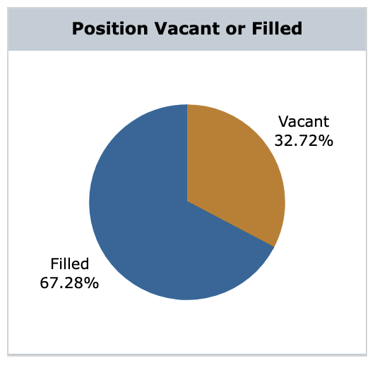
2023 Section Chair Remarks
Michelle Thompson
Notes:
And now, can the incoming officers & out going officers please come up when called for a quick group picture .

Slide 22
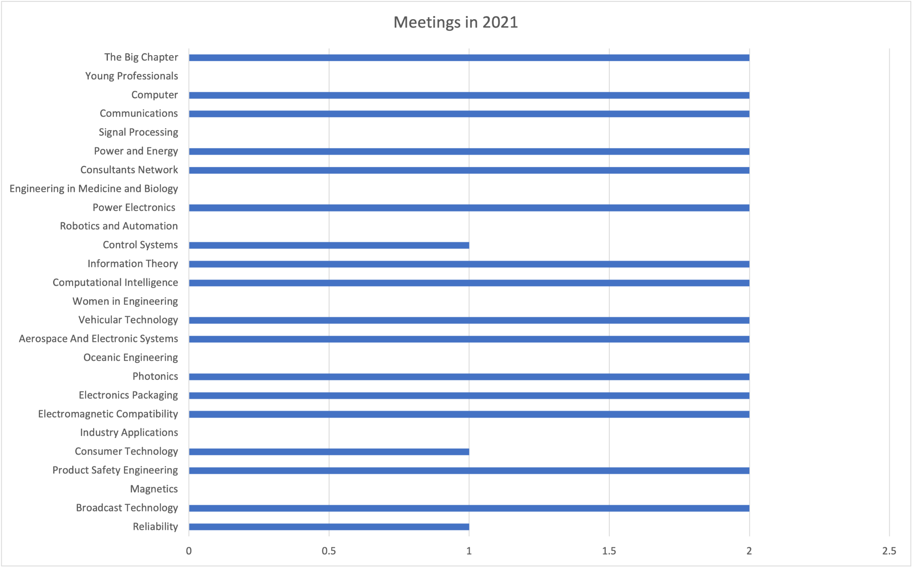

Slide 24

Immediate Needs
Chapter Health
Which chapters need leads?
Nominate someone new! We’ll help them be successful!
Broadcast Technology (has no one and is so lonely)
Signal Processing (thought we got this one?)
Communications (has Vice Chair but not a Chair?)

Slide 25
1) Chapter Meetings in Recovery
2) Chapter Chair Positions Filled
3) More Section Volunteers
Improvements are Real!
All of this happened because of your hard work.

