Slide 1
IEEE-USA 2023 Congressional Visits Day (CVD)
March 13, 2023
Walt Downing, Government Activities Coordinator

Slide 2
Congressional Visits Day (CVD)

Slide 3
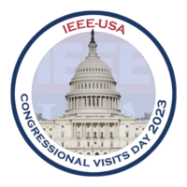
About IEEE-USA’s CVD (4-5 April 2023)
https://ieeeusa.org/public-policy/cvd/
CVD 2023 will be In-Person on Capitol Hill
Registration https://ieeeusa.org/public-policy/cvd/registration/
Deadline for registration is 17 March 2023
Schedule
March, Virtual Training Sessions Livestreamed and Recorded
April 4, Afternoon in-person training session and public policy briefing
April 5, Meetings with Legislators and/or Staff on Capitol Hill
Funding
There is no cost to participate in the CVD meetings.
Participants must make their own travel arrangements and cover expenses.
Region 5 is budgeting $5,000 to subsidize up to 10 participants @ $500/person
Dress Code
April 4th Training – Business Casual
April 5th Legislative Meetings – Business Professional Attire

Slide 4
Basic Rules for Participants
https://ieeeusa.org/public-policy/cvd/
First-time CVD participants are encouraged to attend the online training sessions that will be scheduled prior to April 4th. Experienced CVD participants are invited to attend. These training sessions will be recorded and made available to all participants.
IEEE-USA will schedule all meetings with Representatives, Senators, and/or their staff.
Soapbox Consulting will assist IEEE-USA in meeting scheduling.
Meetings will comprise teams of IEEE members from the same Congressional Districts.
The exact schedule of meetings will be determined by the availability of the Congressional member or staff.
Participants must notify IEEE-USA immediately if they are unable to attend a scheduled meeting. Contact Kayla Henneberry (k.henneberry@ieee.org) Phone: 202-530-8356

Slide 5
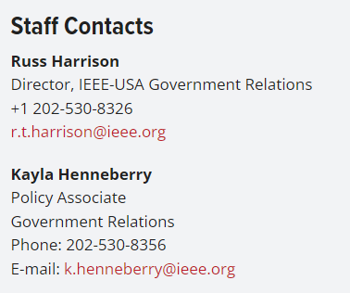
For Additional Information Concerning IEEE-USA

