Slide 1
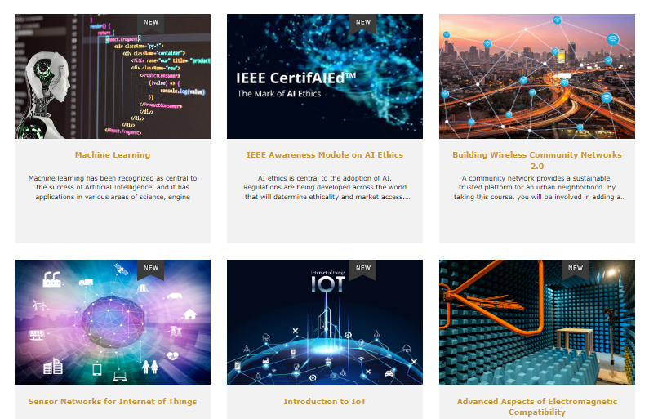
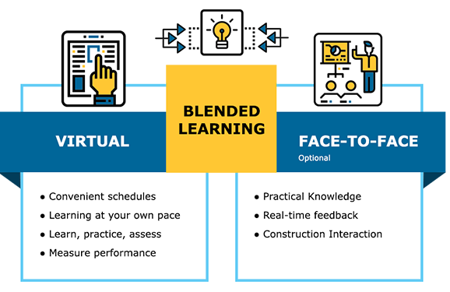
FREE BLP VIRTUAL INTERACTIVE COURSES FOR UP TO 500 TEMS MEMBERS
BLP PORTAL
https://blended-learning.ieee.org/Portal/
REGISTRATION SITE TO REQUEST FREE COUPONS https://forms.gle/4anE3quGW4s2nv7GA

