Slide 1
CHIPS:An Unprecedented Opportunity What This Program Means
IEEE Northern VA Chapter Presentation
9/20/23
Patrick Henry Library, Vienna, VA
Dr. Mike Fritze
Trusted Strategic Solutions

Slide 2
Dr. Mike Fritze: Quickie Bio
From Techno-Nerd to Policy Wonk……
30+ years of experience
Current independent consultant supporting multiple clients
Focus on USG/DoD Microelectronics Strategy
Secure guaranteed access, innovation outreach, USG working with industry, technology transition of USG-funded efforts, PPP Consortia
Techno Experience
USC-ISI (2010-2015)
DARPA MTO (2006-2010)
MITLL (1995-2006)
Policy Experience
Potomac Institute for Policy Studies (2015-current)
TSS (2022- current)
Education:
B.S. Physics: 1984
Lehigh University,
Bethlehem, PA
PhD Physics: 1991
Brown University
Providence, R.I.

Slide 3
Trusted Strategic Solutions
MISSION
Simplify Technology for a complex world
We work with commercial, civil and national security entities, providing the foresight and expertise that ensure safety, time savings and financial protections
VISION
We aspire to make sure the nation and its allies are never dependent on adversaries for technology
VALUES
Mastery – we believe lessons learned and knowledge acquisition allows for the best solutions
Discretion – we believe in partnerships built on mutual trust
Accountability – we believe we are personally accountable for the work we deliver
Credibility – we believe our reputation is of utmost importance

Slide 4
CHIPS Legislation Background & Timeline
Dec 2020: Authorized as part of 2021 NDAA
Dept of Commerce, Dept. of Defense, Dept of State
Target domestic manufacturing of semiconductors
For US economic competitiveness and national security
CHIPS Appropriations Efforts
Provided appropriations to implement authorized plans
Senate passed “USICA” (US Innovation and Competition Act) in June 2021 ( 68 – 32 ) Bipartisan
Late January 2022 House passes “America Competes” Act (222 – 210 )
Reconciliation Process took time
CHIPS & Science Act of 2022
Signed by POTUS Aug 9, 2022

Slide 5
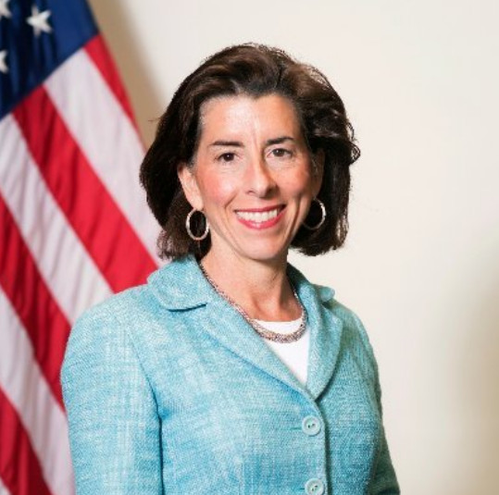
Legislation Informed By:
Executive Order 14017, “America’s Supply Chains,” (2/21)
Engaged broadly with 15 stakeholders to inform a 100-day review of the supply
chains for semiconductor manufacturing and advanced packaging
DOC RFI (3/22)
“Notice of Request for Public Comments on Risks in the Semiconductor Supply Chain,” 86 Federal Register 53,031 (Sept. 24, 2021), www.federalregister.gov/d/2021-20348
Over 250 responses; Plus workshops & listening sessions
Sec Raimondo (DOC) Speech (2/23/23)
“The CHIPS Act and a Long-term Vision for America’s Technological Leadership”
“This money will incentivize companies to manufacture semiconductors here on American soil”
Did this program enable us to build a reliable and resilient semiconductor industry that protects America’s technological leadership for the coming decades?
Where we good stewards of taxpayer dollars ?

Slide 6
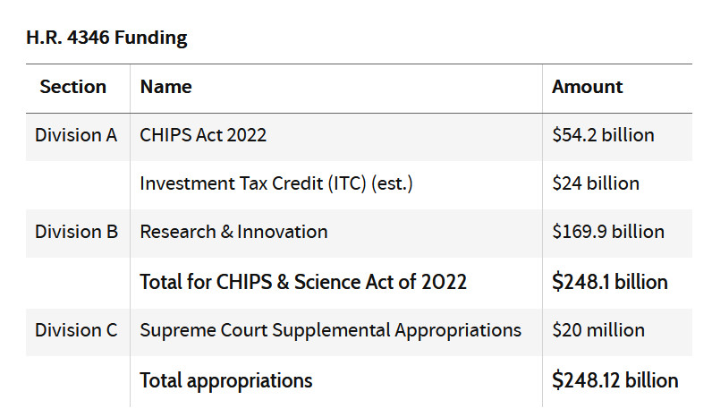
CHIPS and Science Act Overview
Authorizes a total of $280 billion to boost domestic research and manufacturing of semiconductors. Only Div. A has been appropriated.
$200 billion
$280 billion
$280 billion

Slide 7
CHIPS Appropriations: What we will focus on
Investment Tax Credit:
$24 B
Source: John VerWay, CSET Policy Brief, 1/23

Slide 8
CHIPS Appropriations: 5-year period
9902
9906
Incentives ($39 B)
R&D ($11B)
DOD Commons ($2B)
Fab A
Fab B
NSTC
NAPMP
Manuf. USA
Hub A
Core Fab A
Pack./Test A
Pack./Test B
NIST Metrology
Hub B
Core Fab B
EDA A
EDA B
Currently in Source Selection
Expected contracts by Aug ‘23
NSTC formation in progress:
WP Vision Out
New independent PPP
Run by non-govt CEO
1st NoFo Out:
Tranche 1 (Feb) : Fabs
Tranche2 (Spring): Mat. Suppliers, Equipment
Tranche3 (Fall): R&D Facilities
Consortium management firm

Slide 9
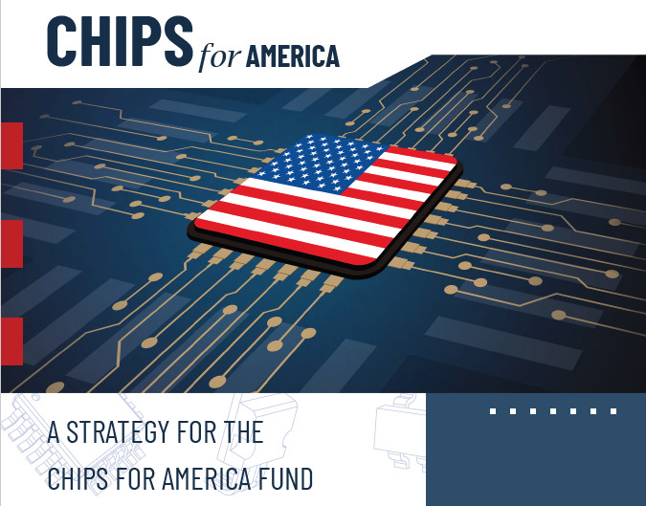
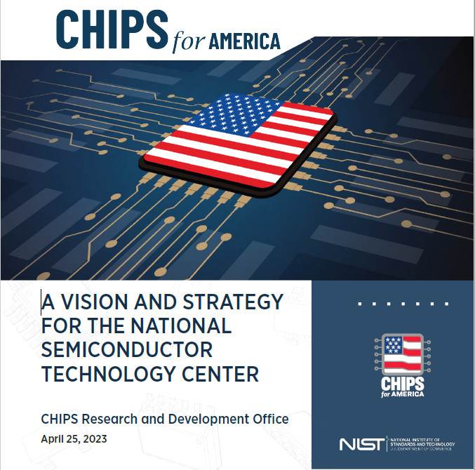
CHIPS Legislation: Comments
Coordination of various efforts with multiple departments will be important
DOC, DOD, State, DOE, etc
Multiple Tech Hubs ( DOC Incentives, NSTC PPP, DoD Commons, etc)
Execution mechanisms also important
Grants vs Contracts
Clawback provisions to discourage bad behavior (ie PRC investments, stock buys, etc)
Potential use of DOD Title III authorities
Mechanisms for Execution (chips.gov website)
CHIPS for America Office Leadership Team
CHIPS Execution Steering Council
DOC Industrial Advisory Board (R&D Part)
DOC Strategy Document (9/22)
DOC NSTC WP Vision (4/23)
Selection Committee for NSTC Trustee Board (6/23)
MOU with DoD (7/23)
NSTC Joint Statement (8/23)
DOC: 9/2022
DOC: 4/2023

Slide 10
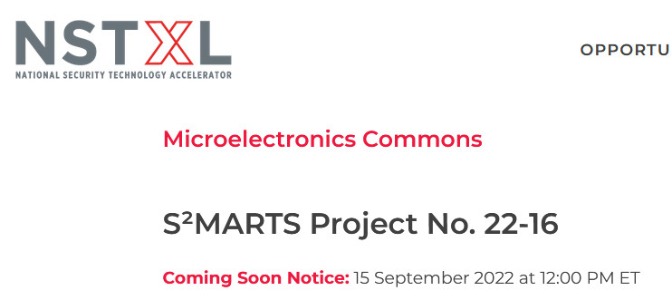
DOD CHIPS Commons Solicitation
DoD specific “Lab to Fab” prototyping
Multiple Research Hubs and Fab Cores structure
Source Selection Now: Results imminent

Slide 11
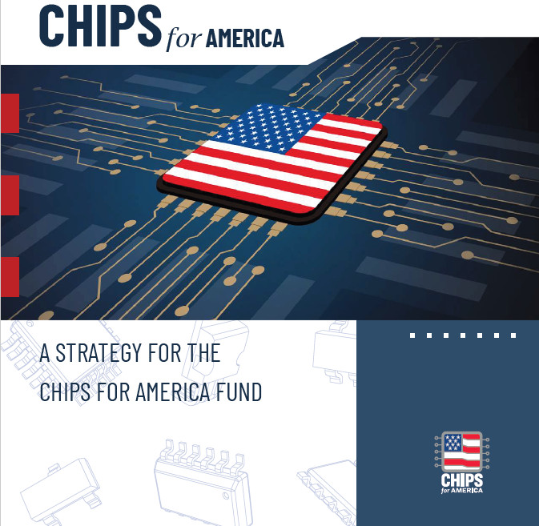
DOC CHIPS References
Sept. 2022
See CHIPS.gov website

Slide 12
DOC CHIPS News
Industrial Advisory Council Meeting: June 6, 2023 Madison Hotel DC
Brief-outs of 4 WGs: Technology Challenges,
Org Structure & PPP,
Sequencing,
Workforce
Recommendations issued
7/21/23: Jay Lewis joins R&D office providing executive leadership for NSTC
9/23 end: Trustee board for NSTC will be appointed. Will then choose CEO

Slide 13
NSTC WP Highlights: Operating Structure
Independent, Non-USG run PPP

Slide 14
NSTC WP Highlights: Program Coordination

Slide 15
DOC Nofo Program Priorities

Slide 16
Execution Plans for CHIPS For America: Leadership Team
National Economic Council: Ronnie Chatterji
Chief economist at DOC
DOC CHIPS Program Office (9902 Incentives): Michael Schmidt
Senior Advisor, Treasury Dept.
Senior Advisor: Todd Fisher (Interim; NIST)
Program Director for the American Rescue Plan Funds at the Economic Development Administration (EDA),DOC
DOC CHIPS R&D Office (9906 R&D): Dr. Lora Weiss Director
Manages IAC
Senior Council to DOC Secretary for CHIPS Implementation: Donna Dubinsky
Serial entrepreneur and CEO of Palm Computing and then Handspring
Senior Advisor to DOC Secretary for CHIPS Implementation: J.D. Grom
Performed the duties of the Assistant Secretary for Legislative & Intergovernmental Affairs, DOC
DoD Commons Lead: Dr. Dev Shenoy , OSD(R&E) PD Microelectronics
MOU Interface with DoD: Laura Taylor-Kale, OSD(A&S) ASD Industrial Base Policy

Slide 17
CHIPS Implementation Steering Council: Executive Order 14080 “Implementation of the CHIPS Act of 2022”
Assistant to the President for Economic Policy Brian Deese (Co-Chair)
Assistant to the President for National Security Affairs Jake Sullivan (Co-Chair)
Assistant to the President for Science and Technology Arati Prabhakar (Co-Chair)
Secretary of Treasury Janet Yellen
Secretary of Commerce Gina Raimondo
Director of National Intelligence Avril Haines
Director of the Office of Management and Budget Shalanda Young
Administrator of the Small Business Administration Isabel Guzman
Director of the National Science Foundation Sethuraman Panchanathan
Deputy Secretary of State Wendy Sherman
Deputy Secretary of Defense Kathleen Hicks
Under Secretary of Energy for Science and Innovation Geri Richmond
Senior Advisor to the President for Public Engagement Keisha Lance Bottoms
Principal Deputy National Cyber Director Kemba Walden
Director of the Department of Labor’s Good Jobs Initiative Katelyn Walker Mooney
Chief Economic Advisor to the Vice President Deanne Millison
White House Coordinator for CHIPS Implementation Ronnie Chatterji
Met 10/7/22:
Need for coordination
Protect US taxpayer
Workforce issues
Geopolitical competition
& NatSec
Strategic Capability/Capacity
Sustaining investments
Whole of USG approach

Slide 18
CHIPS Industrial Advisory Committee (IAC)
U.S. Department of Commerce Appoints First Members to Industrial Advisory Committee
FOR IMMEDIATE RELEASE
Thursday, September 29, 2022
Office of Public Affairs
publicaffairs@doc.gov
The recently established committee will advise on CHIPS for America's R&D efforts.
The U.S. Department of Commerce today announced the appointment of 24 members to the Industrial Advisory Committee (IAC), an advisory body that will provide guidance to the Secretary of Commerce on a range of issues related to domestic semiconductor research and development in support of CHIPS for America. The Committee will not participate in selecting recipients of federal financial assistance, including the manufacturing incentives program.

Slide 19
My thoughts on CHIPS……..
DOC Incentives (9902)
Which parts of supply chain to focus on ?
Fab, Packaging/Test, Other ?
Clawback provision details
Compensation, stock-buybacks, China investments
Profit sharing, etc
Access guarantees
Political influence in process
Should be fair competitive process
Defendable against protests
GOALS:
Level playing field wrt. subsidies ( ie 15 % range)
Move the needle on domestic fab %
Strengthen weak parts of US supply chain
Help create new market for secure ME
Must work BOTH capability and demand sides
to be successful

Slide 20
My thoughts on CHIPS……..
DOC R&D (9906)
R&D organizational structure
NSTC PPP, NAPMP, Manuf. USA
NSTC: Create new impartial non-USG run PPP
Fiduciary board of trustees
Light touch coordination w/ USG
Robust Access infrastructure
Design Gateway (shared)
Silicon Aggregation (shared)
Research directions
Post physical scaling (ie het. Integration, Customization, etc)
Appeal to large member companies
System company need opportunities
Accessible to Universities, startups and small companies
GOALS:
Create new domestic prototyping capabilities
Create robust access infrastructure
Develop post-Moore technologies
Work together with allies
Sustainable business model
Transition to domestic manufacturing

Slide 21
My thoughts on CHIPS……..
DOD Commons
University-led Hubs
Earlier TRL Work focus
Role of Core Fabs
Prototype Hub concepts
Level of emphasis here
Transition of Hub results
DOC CHIPS + Commercial Fabs
GOALS:
Explore DoD-specific ME concepts
Create new domestic prototyping capabilities
Transition to commercial production
New RFI Out: 5/17/23
Request for Information - DoD Design to Transition Accelerator
The Office of the Under Secretary of Defense for Research and Engineering (OUSD(R&E)) and the Office of the Under Secretary of Defense for Acquisition and Sustainment (OUSD(A&S)) are seeking information from the domestic microelectronics community to inform objectives for a DoD Design to Transition Accelerator (D2TA) (Figure 1) focused on leveraging commercial activities for microelectronics technology transitions (TRL 4-8) into DoD programs of record.

Slide 22
BACKUPS

Slide 23
Key CHIPS Bill Details
DOC Manufacturing Incentives: $39 billion in financial assistance to build, expand, or modernize domestic facilities and equipment for semiconductor fabrication, assembly, testing, advanced packaging, or research and development, including $2 billion specifically for mature semiconductors. Within the incentive program, up to $6 billion may be used for the cost of direct loans and loan guarantees.
Note:
$28 B for leading edge logic and memory chips
$10B has been reserved for mature and current generation chips

Slide 24
Key CHIPS Bill Details (Cont)
Investment Tax Credit (ITC)—$24 billion
At an estimated cost of $24 billion, the act also provides a 25% investment tax credit to companies that invest in semiconductor manufacturing. Based on a bipartisan bill known as the Facilitating American Built Semiconductors (FABS) Act, this credit covers both manufacturing equipment and constructing semiconductor manufacturing facilities.

Slide 25
Key CHIPS Bill Details (Cont.)
DOC Research and Development (“R&D”): $11 billion for DOC research and development.
DOC National Semiconductor Technology Center (“NSTC”): A public-private partnership to conduct advanced semiconductor manufacturing R&D and prototyping; invest in new technologies; and expand workforce training and development opportunities.
DOC National Advanced Packaging Manufacturing Program: A Federal R&D program to strengthen advanced assembly, test, and packaging (“ATP”) capabilities, in coordination with the NSTC.
DOC Manufacturing USA Semiconductor Institute: A partnership between government, industry, and academia to research virtualization of semiconductor machinery, development of ATP capabilities, and the development and deployment of training.
DOC Microelectronics Metrology R&D: A National Institute of Standards and Technology (“NIST”) research program to advance measurement science, standards, material characterization, instrumentation, testing, and manufacturing capabilities.

Slide 26
Key CHIPS Bill Details (Cont.)
CHIPS for America Defense Fund: $2 billion for the DoD to implement the Microelectronics Commons, a national network for onshore, university-based prototyping, lab-to-fab transition of semiconductor technologies—including DoD-unique applications—and semiconductor workforce training.
CHIPS for America Workforce and Education Fund: $200 million to kick start development of the domestic semiconductor workforce, which faces near-term labor shortages, by leveraging activities of the National Science Foundation.
CHIPS for America International Technology Security and Innovation Fund: $500 million to the DoS, in coordination with the U.S. Agency for International Development, the Export-Import Bank, and the U.S. International Development Finance Corporation, to support international information and communications technology security and semiconductor supply chain activities, including supporting the development and adoption of secure and trusted telecommunications technologies, semiconductors, and other emerging technologies.

Slide 27
Criteria for Evaluating Applicants
Increase scale and attract private capital. The goal is to increase the number and scale of US facilities and encourage large-scale investments with long-term impact and economic viability. Applicants will need to commit substantial private capital and are encouraged to explore creative financing structures.
Leverage collaborations to build out semiconductor ecosystems. Collaborations among industry, investors, customers, designers and suppliers are encouraged.
Secure additional financial incentives and support. Applicants will need to show that they will receive state or local incentives. Different types of incentives will count toward this requirement, but there will be a preference for incentive packages with the potential for spill-over benefits, that are performance-based, that have local support, and that maximize regional economic gains and competitiveness, not just benefit a single company.
Establish a secure and resilient semiconductor supply chain. Projects that focus on information security, data tracking and verification and those that address supply chain risks will be prioritized.
Expand the workforce pipeline to match increased domestic capacity workforce needs. The program will be seeking creative recruitment and training efforts and those that are inclusive of populations that have been underrepresented in the industry. Partnerships among employers, training providers, workforce development organizations, labor unions, and others are encouraged. Programs providing paid training, experiential apprenticeships, and wraparound supports such as childcare and transportation are mentioned specifically.
Create inclusive and broadly shared opportunities for businesses. Plans that demonstrate how small and underrepresented businesses will be included in efforts supported by the CHIPS programs will be prioritized.
Financial considerations. Detailed project and company financial data will be reviewed, including plans to ensure the facility remains competitive and viable, an analysis of how the Investment Tax Credit will impact the project, and other considerations.

Slide 28
CHIPS & SCIENCE ACT: Research and Innovation Piece $200 B Only Authorized, Not Appropriated
National Science Foundation (NSF): Involves significant investments in science, including the development of an NSF Directorate for Technology, Innovation, and Partnerships to accelerate the development of national and economic security critical technologies. Additional investments will be made in basic research; building a science, technology, engineering, and math (STEM) workforce; building broad-based research opportunities; and expanding rural STEM education.11
Department of Commerce (DOC) Technology Hubs: The act directs the DOC to create 20 geographically distributed regional technology hubs that will focus on technology development, job creation, and expanding U.S. innovation capacity. Another project will be designed to support persistently distressed communities with economic development activities.12
National Institute of Standards and Technology (NIST) Authorization: This part of the act will advance research and standards development for industries of the future. This will include quantum information science, artificial intelligence, cybersecurity, advanced communications technologies, and semiconductors. Other components seek to support small- and medium-sized manufacturers with cybersecurity, workforce training, and supply chain resiliency. The act also seeks to promote competitiveness in international standards.12
National Aeronautics and Space Administration (NASA) Authorization: Provides authorization for the Moon-to-Mars Exploration Campaign, including the return of America to the moon. Other programs seek to maintain the International Space Station through 2030, extend NASA’s enhanced-use lease authority, support NASA’s search for life beyond Earth, advance U.S. aeronautics leadership, and enhance NASA’s technology, infrastructure, and workforce. The act also invests in ensuring planetary defense, including protecting Earth from asteroids and comets.13
Research Security to Protect Federal Investments in the U.S. R&D Enterprise: This legislation requires the NSF to maintain a Research Security and Policy Office to identify potential security risks, conduct outreach and education to the research community, establish procedures and policies on research security for the Foundation for Energy Security and Innovation at the Department of Energy (see below, under “Additional Department”), and conduct risk assessments of applications and disclosures. The act further prevents federal research agencies from participating in foreign talent recruitment programs.14
Department of Energy (DOE): Reauthorizes fundamental research and development activities performed by scientists at the DOE, the National Laboratories, universities, and private companies to advance our understanding of the atom, the cell, the Earth’s systems, and the universe.15
Additional DOE Science and Innovation Provisions: Establishes a Foundation for Energy Security and Innovation at the DOE to foster partnerships among government, industry, startups, and outside funding organizations to increase funding opportunities from the private sector, accelerate commercialization of technologies, and provide workforce training in energy security and innovation fields.16

Slide 29
Industrial Advisory Committee
Mike Splinter (Chair), General Partner, MRS Business and Technology Advisors
Susan Feindt (Vice-Chair), Fellow, Director of Physical Technology Strategy, Analog Devices
James Ang, Chief Scientist, Pacific Northwest National Laboratory
Daniel Armbrust, Founder/Chief Executive Officer, Silicon Catalyst
Susie Armstrong, Senior Vice President of Engineering, Qualcomm
Ahmad Bahai, Chief Technology Officer, Texas Instruments
Bill Chappell, Vice President of Technology, Microsoft
Michael Fritze, Vice President of Microelectronics Policy, Potomac Institute for Policy Studies
Charles Gray, Vice President of Digital Systems Technology, Ford Motor Company
Carol Handwerker, Reinhardt Schuhmann, Jr. Professor of Materials Engineering & Professor of Environmental and Ecological Engineering, Purdue University
Deirdre Hanford, Chief Security Officer, Synopsys
Rajarao Jammy, Chief Technology Officer, MITRE Engenuity

Slide 30
Industrial Advisory Committee
Ken Joyce, Executive Vice President, Brewer Science
Ann Kelleher, Executive Vice President of Tech Development, Intel Corporation
Mukesh Khare, Vice President, IBM Research
Meredith LaBeau, Chief Technology Officer, Calumet Electronics
Tsu-Jae King Liu, Dean of the College of Engineering, University of California Berkley
Om Nalamasu, Chief Technology Officer, Applied Materials
Debo Olaosebikan, CEO and Founder, Kepler Computing
Alex Oscilowski, President, TEL America
Willy Shih, Robert and Jane Cizik Professor of Management Practice in Business Administration, Harvard Business School
Brandon Tucker, Chief Workforce Development Officer, Washtenaw Community College
H.S. Philip Wong, Willard R. and Inez Kerr Bell Professor in the School of Engineering, Stanford University
Anthony Yen, Vice President of Technology and Director of ASML Technology Center

Slide 31
Here is a summary of TSS. Feel free to use what you want.
Trusted Strategic Solutions, LLC (TSS) is dedicated to addressing the constantly evolving challenges in the field of microelectronics. By providing strategic recommendations to the US government and the semiconductor industry, we aim to mitigate the current situation and ensure that microelectronics can support both traditional and non-traditional applications. Our team is actively engaged in supporting multiple interagency efforts to meet the nation's current and future microelectronics requirements.
As global threats continue to evolve, strategic planning is crucial for ensuring the availability, sustainability, security, and qualification of microelectronic components for mission systems. TSS is collaborating closely with the US government and the semiconductor industry to develop effective strategies that can overcome these challenges. We are committed to providing comprehensive solutions that address the needs of our clients and contribute to the advancement of microelectronics technology.

