Slide 1
Analyzing Time-to-Event Data:
A Comparison Between Reliability and Survival Methods
Jian Cao, PhD
(jian.cao@jmp.com)
02.07.2024

Slide 2
What They Do
Survival Analysis
Estimate and compare survival curves;
Assess treatment effects and the effects of other covariates;
Identify the risk factors that affect survival;
Predict survival times and probabilities.
Reliability Analysis
Construct failure probability plots;
Predict failure probabilities and times for use conditions through accelerated life testing;
Analyze degradation data to determine product reliability;
Model recurrence data from repairable systems to assess reliability growth.
Notes:
In clinical research the event is death, relapse or development of a new disease

Slide 3
What’s in Common
Both analyze the time-to-event data known as the failure time in reliability and survival time in clinical trials and epidemiology research;
The response measurement is the duration of time until an event occurs.
Events in reliability: product failures, repairs, degradation.
Events in clinical trials: disease, death, relapse, etc.
Notes:
In clinical research the event is death, relapse or development of a new disease

Slide 4
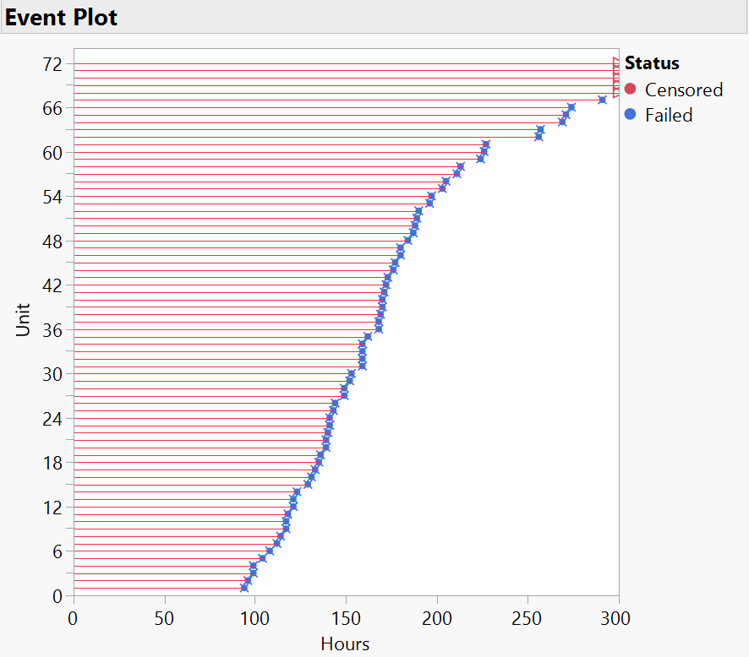
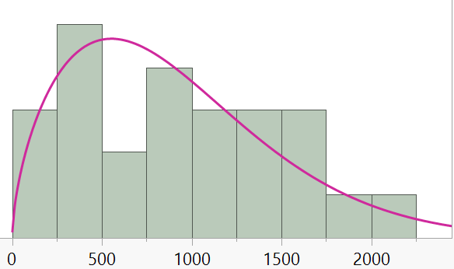
What’s in Common (cont’d)
Distinguishing features of time-to-event data:
Skewed
Censored
Statistical methods for TTE data need to account for not only whether an event occurred, but also when that occurred.
Notes:
In clinical research the event is death, relapse or development of a new disease

Slide 5
Major Differences
Methods for reliability and survival data analysis share the key principals, but their analytical approach and focus are different.
Reliability analysis often employs parametric methods;
Survival analysis in medical research favors non-parametric methods.
Ex. Accelerated Failure Time Model vs Cox’s Proportional Hazards Model.

Slide 6
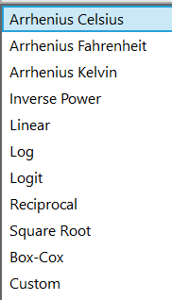
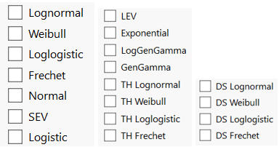
Parametric Distributions Used Extensively in Reliability Analysis
Probability distributions used for plotting the failure time curves in JMP:
An accelerated failure time model not only assumes a parametric distribution but often transforms the acceleration factor.

Slide 7
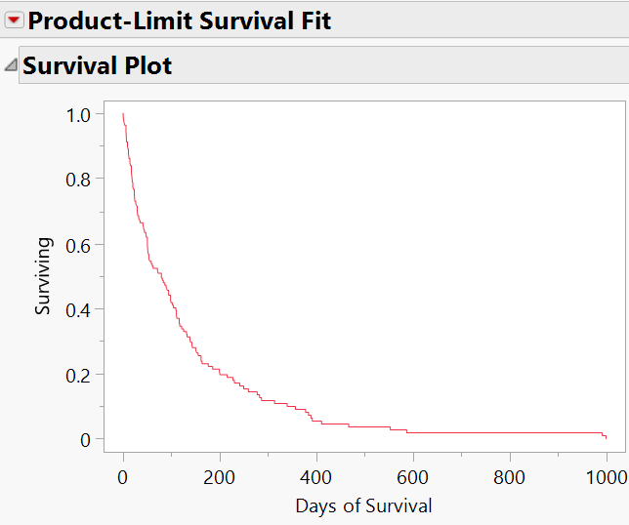
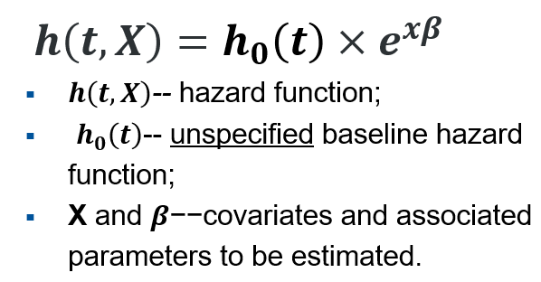
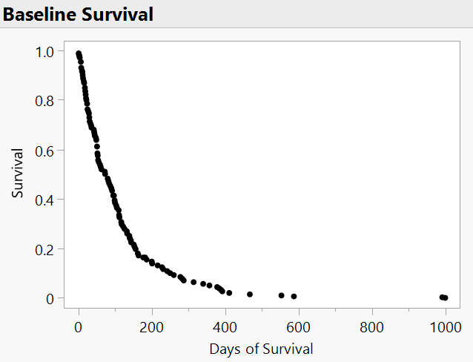
Non-parametric/semi-parametric Methods Favored in Clinical Data Analysis
Use the Kaplan-Meier Estimator (aka Product-Limits Estimates ) to plot the survival curves.
Cox’s Proportional Hazards Model doesn’t assume any specific form for the baseline survival/hazard function; it only specifies the relationship between the hazards and covariates.

Slide 8
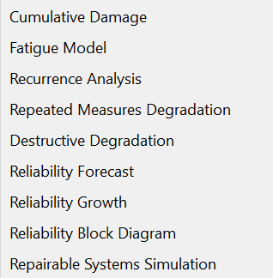
Other Differences
Many specialized methods have been developed for reliability applications:
The primary focus of the survival analysis in medical science is estimate the treatment effect and identify risk factors.
Survival models have been adopted in marketing research (e.g., customer retention) and socials science.
For details see Reliability and Survival Methods (jmp.com)

Slide 9
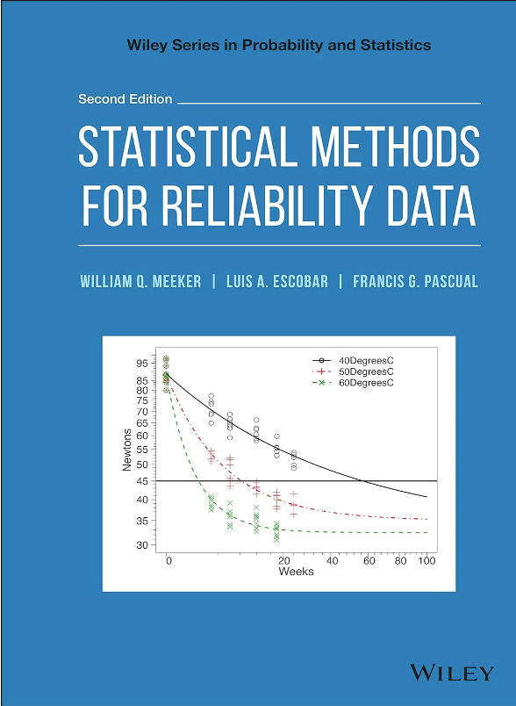
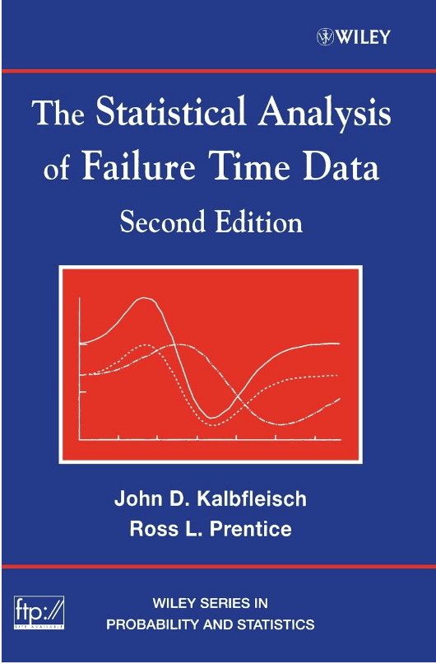
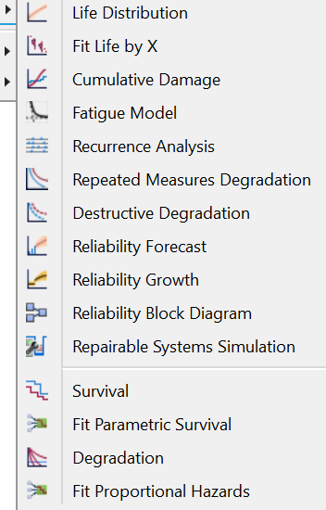
Resources
Reliability and Survival in JMP

