Slide 1
Regression and Time Series Mixture Approaches to Predict Resilience
Priscila Silva
PhD Candidate
Lance Fiondella
Associate Professor
Department of Electrical & Computer Engineering
University of Massachusetts Dartmouth
Technical Meeting
IEEE Boston/Providence/New Hampshire Reliability Chapter
March 2024

Slide 2
Objective
In this talk
Definitions of resilience
Limitations of resilience metrics
How to characterize resilience in terms of detrimental and restorative factors
How to track and predict system resilience
The benefits of system resilience modeling

Slide 3
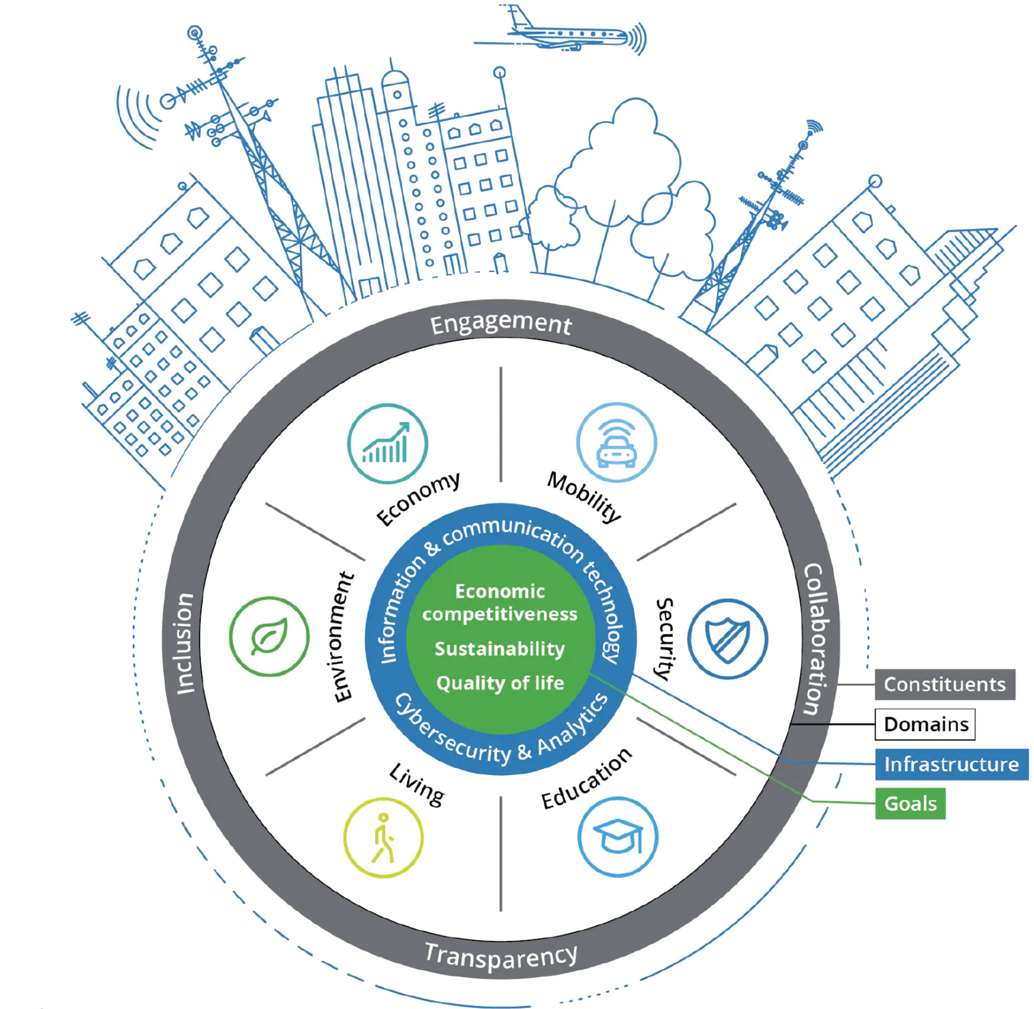
Introduction
System Resilience
Prepare, absorb, recover, and adapt from failures
Level of goal achievement
Applicable to various domains
Engagement
Communication
Inclusion
RESILIENCE
Collaboration
Constituents
Domains
Cybersecurity
Infrastructure
Goal
Transparency

Slide 4
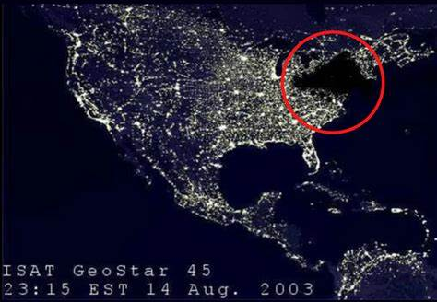
Motivation
Lack of resilience is dangerous
Northeast blackout of 2003: software errors
20% of the electrical service reduced
45 + 10 million people in the US + CAN affected
$4 - $10 billion of financial losses
Mortality rate increased 28%

Slide 5
Motivation
Lack of resilience is dangerous
Unemployment rate of 2020 in the US: COVID-19
22.4 million jobs lost in March of 2020
Gross Domestic Product decreased 32.9%
1,134,913 deaths

Slide 6
Reliability vs. Resilience
Reliability
Resilience
Negative Impacts
Start-Point
Event
Resilient System
Performance $P(t)$
Minimum Performance
Normal Functionality
Degraded Functionality
Non-Resilient System
Time $(t)$

Slide 7
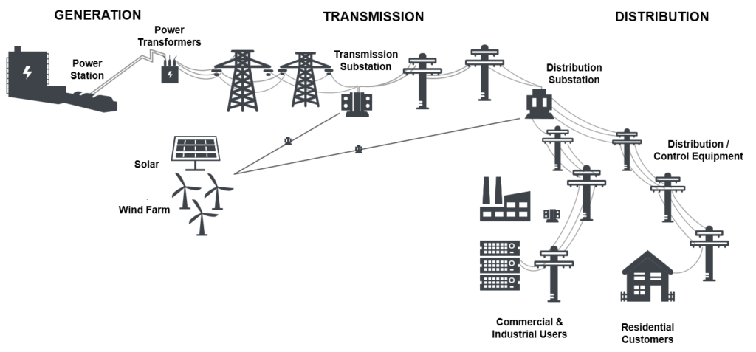
Reliability vs. Resilience
How would you measure the reliability and resilience of a power grid?
Reliability: the frequency of power outages
Resilience: how quickly the grid can recover from a blackout

Slide 8
Reliability vs. Resilience
MTTF: Mean Time to Failure
MTTR: Mean Time to Repair
MTBF: Mean Time Between Failures
MTBF
MTTF
MTTR
MTTF
Reliability
Normal Functionality
Diagnose
Repair
Normal Functionality
Maintaining continuous operation
First
Failure
Begin
Repair
End
Repair
Second
Failure
RESILIENCE
MTD
RPO
RTO
RPO
Disaster
Recovery
Data
Lost
Expected
Downtime
Data
Lost
RPO: Recovery Point Objective
RTO: Recovery Time Objective
MTD: Maximum Tolerable Downtime
Responding to unforeseen events
First
Failure
Expected
Recovery
Required
Recovery
Second
Failure
Backup
Backup

Slide 9
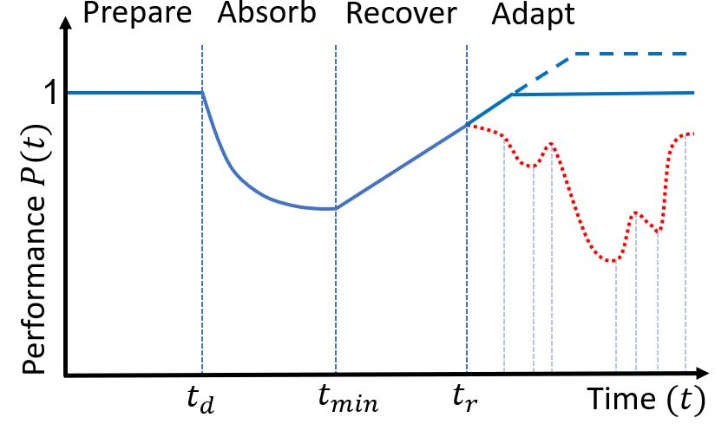
Resilience Curve
Common resilience metric
Performance Preserved
Performance Lost
$$R\left(t_{r}\right)=\int_{t_{h}}^{t_{r}}{P\left(t\right)}dt$$
Conceptual resilience curve
Disaster Resilience: A National Imperative. Washington, D.C.: The National Academies Press, Washington, D.C. (2012).
Real world disaster management does not look like a textbook curve

Slide 10
System Performance
Performance is domain dependent
Generalized as the level of goal achievement of task or system
Performance changes over time
$$P\left(i\right)=P\left(i−1\right)+∆P(i)$$
$P\left(i\right) =$ performance in present time interval $i$
$P\left(i−1\right)=$ performance in previous time interval $\left(i−1\right)$
$∆P\left(i\right)=$ change in performance (assumed I.I.D.)

Slide 11
Resilience Modeling Approaches
Modeling change in performance ($∆P$)
Regression Models
Multiple linear regression (MLR), (MLRI), and (PR)
$${∆\hat{P}\left(i\right)}_{MLR}=β_{0}+\sum_{j=1}^{m}{β_{j}{ X}_{j} (i)}$$
$m=$ number of covariates
$β_{0}=$baseline change in performance
$β_{j}=$ coefficients of disruptions and activities
$X_{j}=$covariates driving degradation/recovery
$ℓ =$ number of lags
Time Series Models
Multivariate Vector Auto-Regressive (MVAR), and (MVARMA)
$${∆\hat{P}\left(i\right)}_{MVAR}{=β}_{0}+\sum_{k=1}^{ℓ}{β_{k}P(i−k)}+\sum_{j=1}^{m}{\sum_{k=1}^{ℓ}{β_{j(ℓ+k)}{ X}_{j} (i−k)} }$$

Slide 12
Mixture Resilience Models
Modeling change in performance ($∆P$)
Multiple linear regression and Multivariate Vector Auto-Regressive (MLR-MVAR)
$${∆\hat{P}\left(i\right)}_{MLR−MVAR}=β_{0}+\sum_{j=1}^{m}{β_{j}{ X}_{j} (i)}+\sum_{k=1}^{ℓ}{φ_{k}P(i−k)}+\sum_{j=1}^{m}{\sum_{k=1}^{ℓ}{φ_{j(ℓ+k)}{ X}_{j} (i−k)} }$$
MLR-MVARMA
MLRI-MVAR
MLRI-MVARMA
PR-MVAR
PR-MVARMA

Slide 13
Steps to Apply Resilience Models
1) Identify disruptive and restorative activities ${ X}_{j}$
2) Collect data for events and activities in each time interval
3) Estimate model parameters $β_{0}$ and $β_{j}$
Maximum Likelihood Estimation (MLE)
4) Validate the model with statistical measures
How well do the models track the available data (RMSE)?
How well do the models predicts future intervals (PRMSE)?
How well do the factors characterize changes in performance ($r_{adj}^{2}$)?
How much uncertainty is there in the model predictions?

Slide 14
Illustration: 1980 US Recession – Energy Crisis
Performance $P\left(i\right)$ is the number of employments in the US
Covariates are selected by forward/backward stepwise procedure
Covariates | Description | Covariates | Description
X1 | Treasury Yield Curve | X5 | Personal Consumption Expenditures
X2 | Industrial Production | X6 | S&P 500 Index Stock Market
X3 | Federal Funds Rate | X7 | Consumer Price Index
X4 | Mortgage Rate | X8 | Crude Oil Prices

Slide 15
Illustration: Computation Steps
11 Models were tested: 3 regressions, 2 time series, 6 mixture models
Different combinations of covariates and lags for each approach
4 data subsets were used for model fitting: 50%, 60%, 70%, 80%
Model fits and goodness-of-fit were computed
The best model fit from each approach for each subset considered is plotted against each other for analysis
The best model fit overall is picked for further analysis

Slide 16
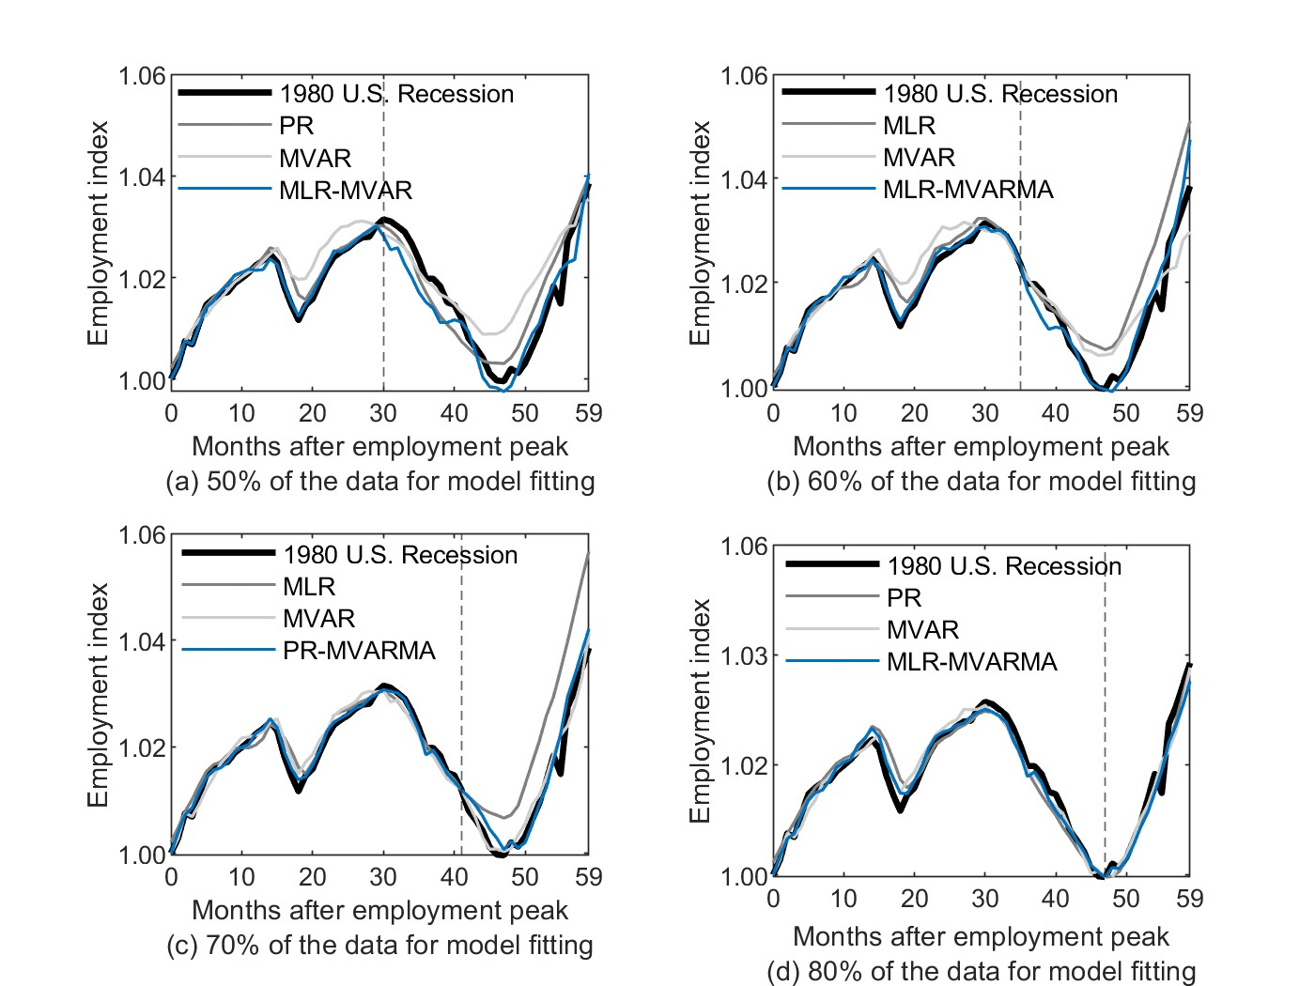

Slide 17
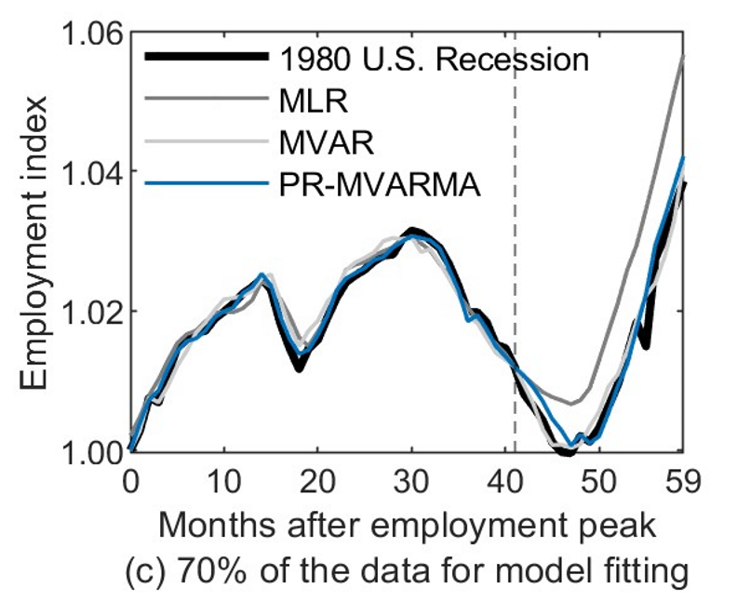
Illustration: Goodness-of-fit
Model | Covariates | Lags | Parameters | RMSE | PRMSE | $$r_{adj}^{2}$$
MLR | X8, X3 | 0 | 3 | 0.00524 | 0.00855 | 0.93122
MVAR | X8, X3, X5 | 4 | 17 | 0.00235 | 0.00240 | 0.92277
PR-MVARMA | X8, X3, X5, X2, X6, X4 | 1 | 21 | 0.00192 | 0.00231 | 0.98628

Slide 18
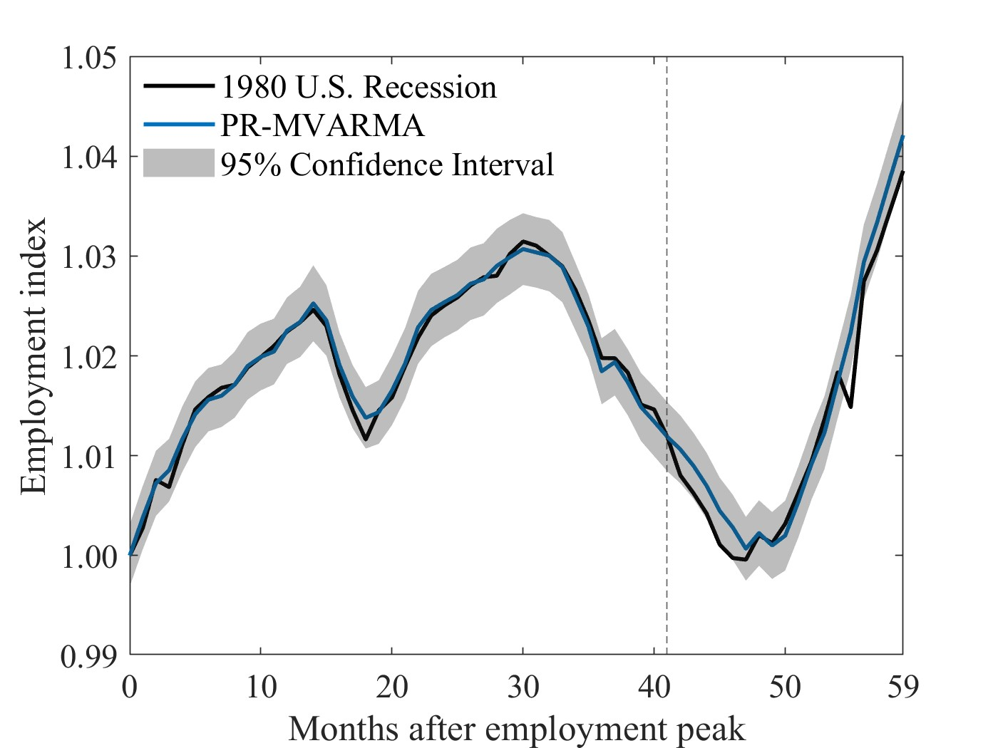
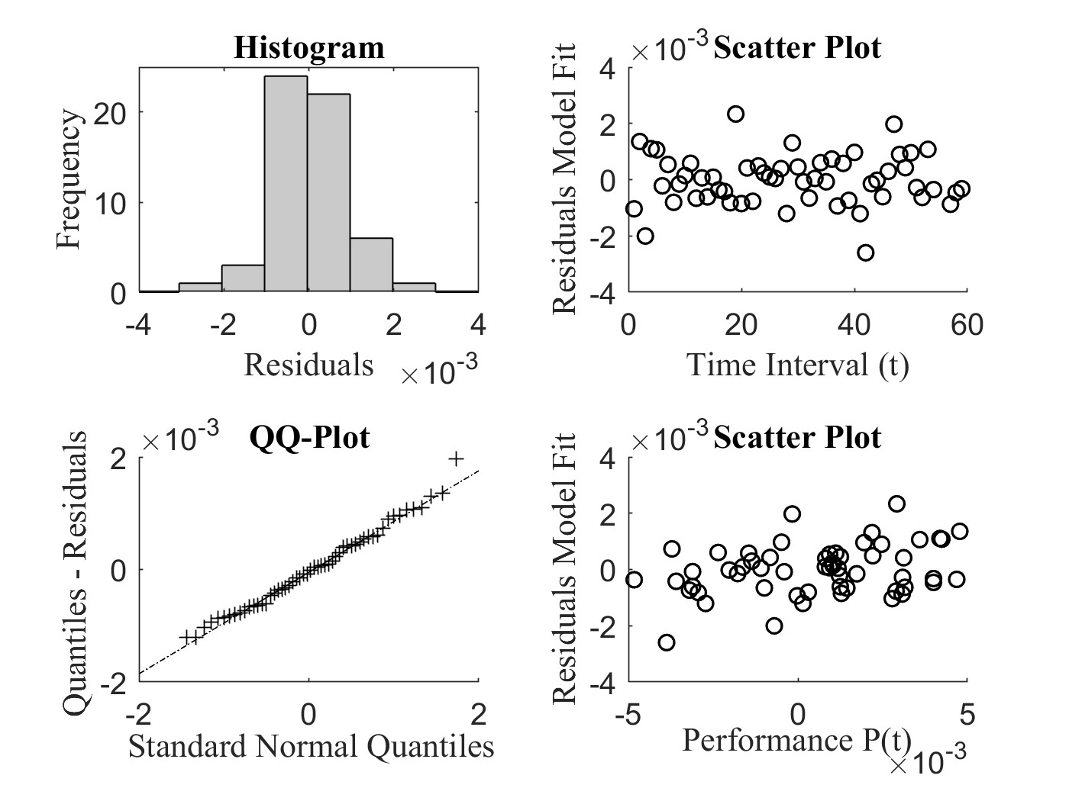
Illustration: Best Model Overall
Polynomial Regression and Multivariate Vector Auto-Regressive Moving Average (PR-MVARMA)

Slide 19
Illustration: Resilience Metrics
Metrics | Data | MLR | MVAR | PR-MVARMA
Performance Preserved | Actual Predicted Relative Error | 45.8167 45.7127 0.0022 | 45.8167 45.8556 0.0008 | 45.8167 45.8482 0.0006
Performance Lost | Actual Predicted Relative Error | 0.8054 0.8776 0.0896 | 0.8054 0.7718 0.0416 | 0.8054 0.8122 0.0083
Mixture Models closely approximate actual values of resilience metrics

Slide 20
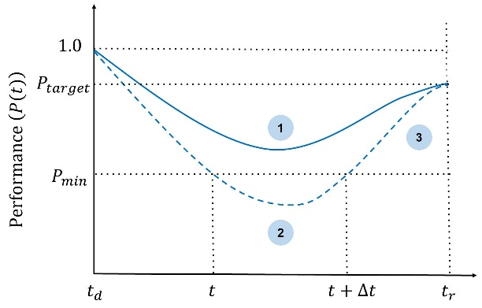
Research Questions
How to
1) preserve a specified level of performance?
2) ensure the duration of degraded performance is bounded?
3) rapidly and cost-effectively recover to a high level of performance?

Slide 21
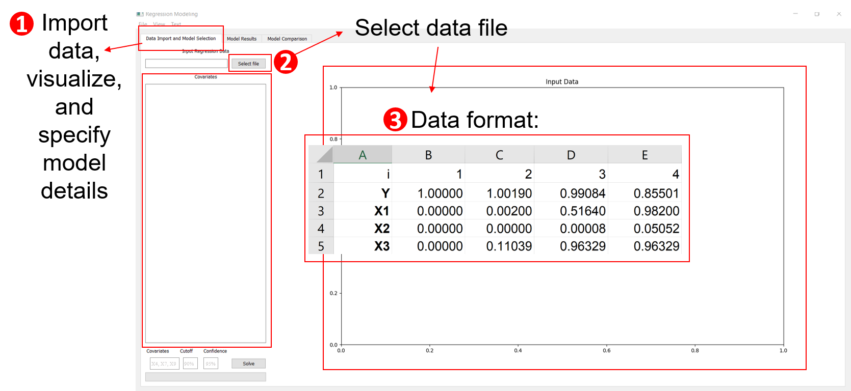
Predictive Resilience Assessment Tool (PSRAT) - In development

Slide 22
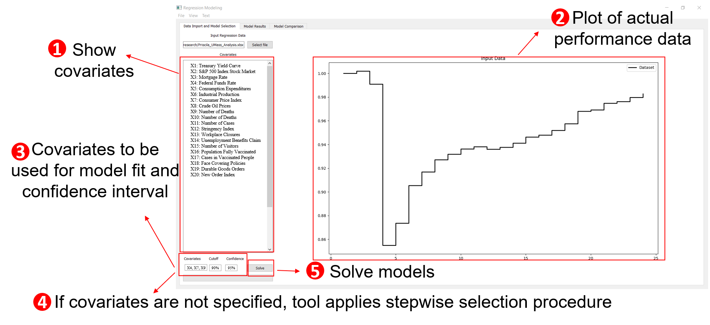

Slide 23
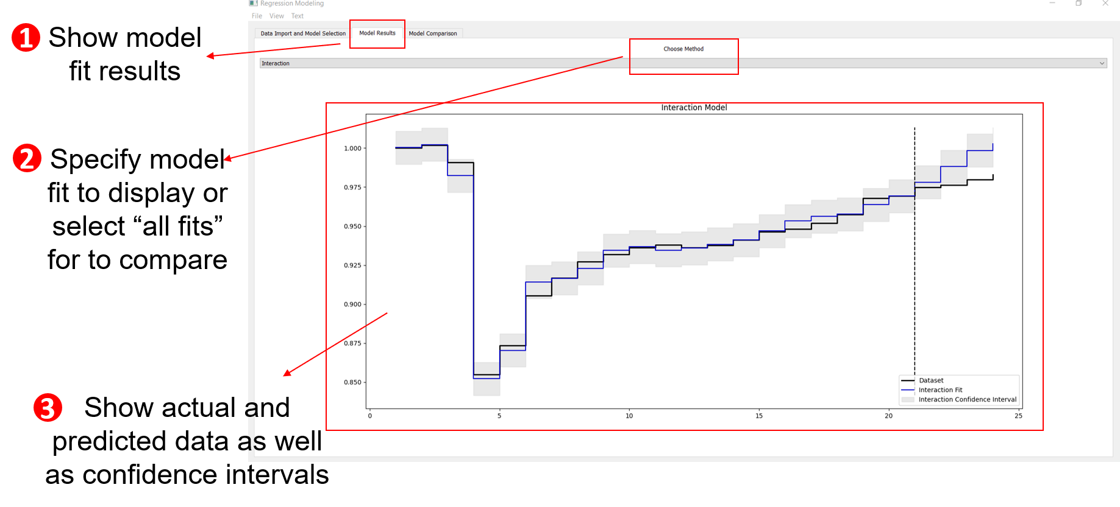

Slide 24
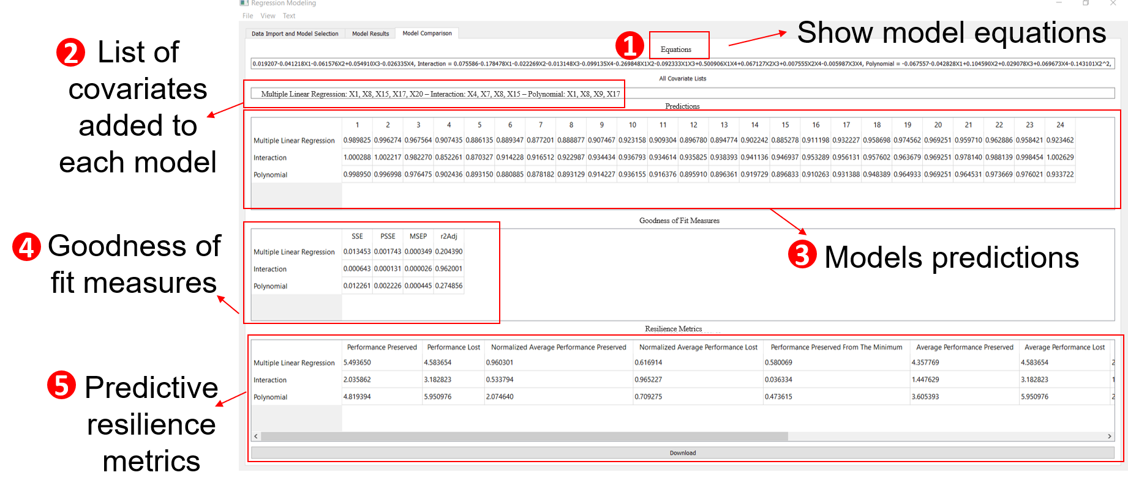

Slide 25
Take-Aways
From this talk, you should be able to
Distinguish the stages of system resilience
Identify disruptive events and restorative actions
Understand the theory of resilience modeling and how it can be used to track and predict system performance
Apply resilience tools with data
Select models through statistical inference

Slide 26
Thank You
Priscila Silva
psvila4@umass.edu
Lance Fiondella
lfiondella@umassd.edu
This research is supported by

