Slide 1
Space Frequency Block Coding – A Review of an Open Source Implementation
26 March 2024

Slide 2
Open Source Digital Radio IEEE Local Group
Open Research Institute hosting

Slide 3
Open Source Digital Radio
IEEE Local Groups: These are subject matter focused formal groups of IEEE
members at the local level. Local groups are typically organized by IEEE members
who share common interests. The groups serve a specific geographic region.
Local groups may focus on specific technical topics, career development,
networking, or social activities. They provide a way for members to connect with
peers in their local area and engage in activities tailored to their interests.
This group is about open source digital radio theory and techniques.
It has a strong relationship with the non-profit R&D firm Open Research Institute.
There are a multitude of other relationships and potential collaborations in the
San Diego area, as digital communications is a strength here in San Diego.
There has never been a better time to start a group like this.
This is the first of a series of opportunities to freely discuss tools, techniques,
designs, best practices, and much more in digital radio design, that will
simultaneously help open source efforts, along with directly supporting people in
their personal and professional development.

Slide 4
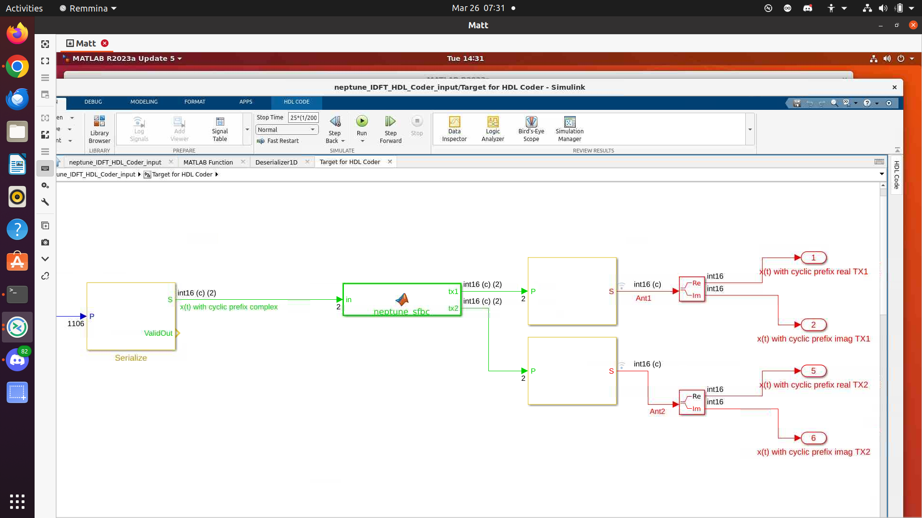
What are we talking about today?
SFBC

Slide 5
What is the Neptune Project?
FlexLink specification is based on LTE and is written by Andreas Schwartzinger of Rhode and Schwartz. It has a subcarrier spacing of approximately 20 kHz, several bandwidths, and quite a bit of configuration. The target frequency band is 900 MHz. It’s under active development and revisions can be found at
https://github.com/OpenResearchInstitute/Neptune/tree/main/FlexLink/docs
An open source OFDM physical layer link for drones and aerospace. The specifications are open and the designs from ORI are open source.

Slide 6
What is the Neptune Project?
Trueflight specification is based on 5G and is written by Andreas Schwartzinger of Rhode and Schwartz. It has a subcarrier spacing of approximately 20 kHz, several bandwidths, and quite a bit of configuration. The target frequency band is 5 GHz and above. It’s in very early development and the discussion of requirements and specifications can be found at
https://github.com/OpenResearchInstitute/Neptune/tree/main/Trueflight
An open source OFDM physical layer link for drones and aerospace. The specifications are open and the designs from ORI are open source.

Slide 7
Additional Specifications Welcome
Amateur radio has frequency bands from VLF to 240 GHz with generous transmit power privileges. One size does not fit all.

Slide 8
1) Document
2) Model
An accessible article about SFBC in general and the use case and design decisions on this particular implementation has been drafted and this draft in the vTools media section for review. These slides will be there too.
The model is a custom MATLAB function enclosed in a Simulink block, part of a Simulink model of the transmitter for the Neptune Project.
We intend to use MATLAB HDL Coder to produce open source HDL code for this OFDM communications design.
The use case for Neptune is drones, aerospace, and terrestrial deployments at 5 GHz and above.

Slide 9
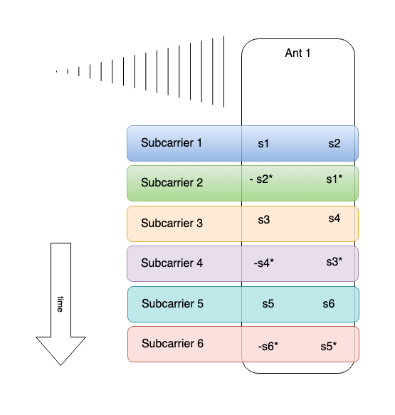
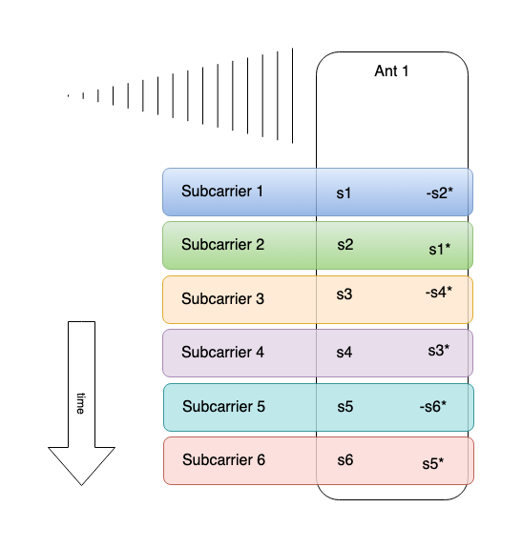
STBC vs. SFBC

Slide 10
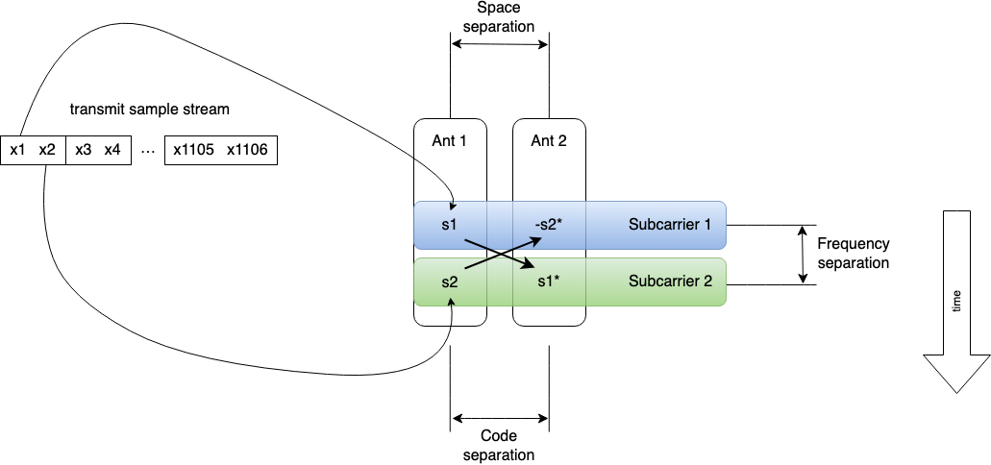

Slide 11
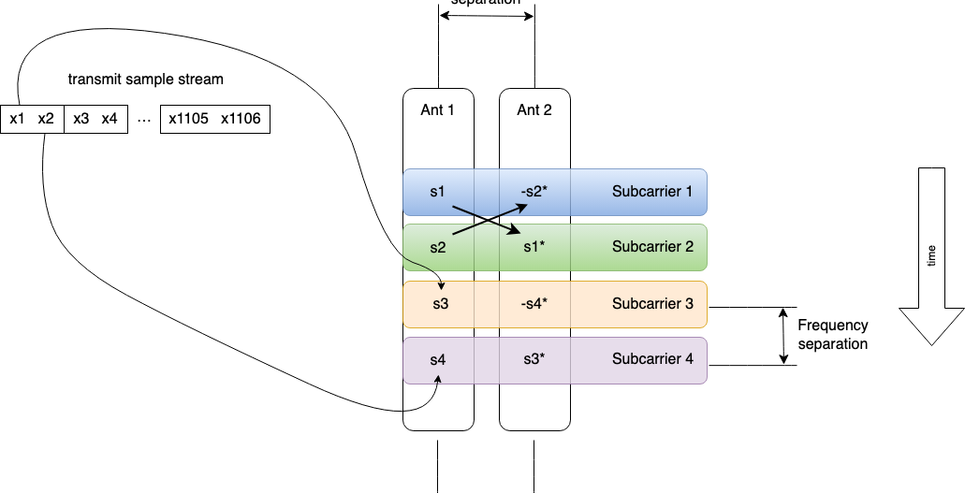

Slide 13
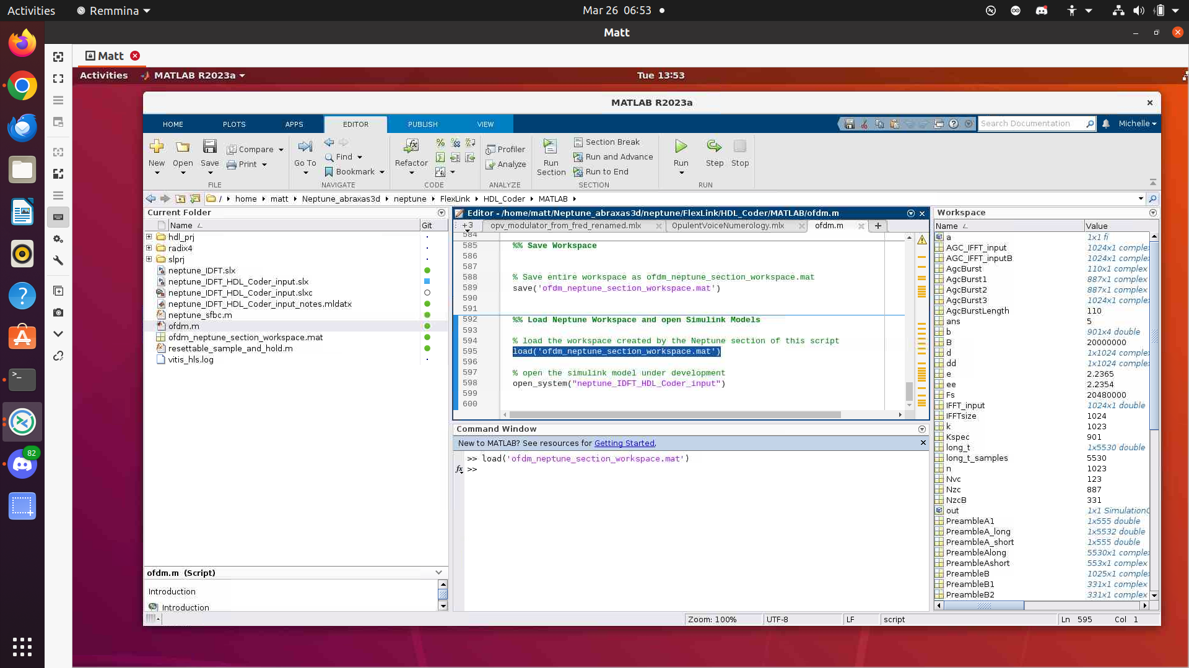

Slide 14
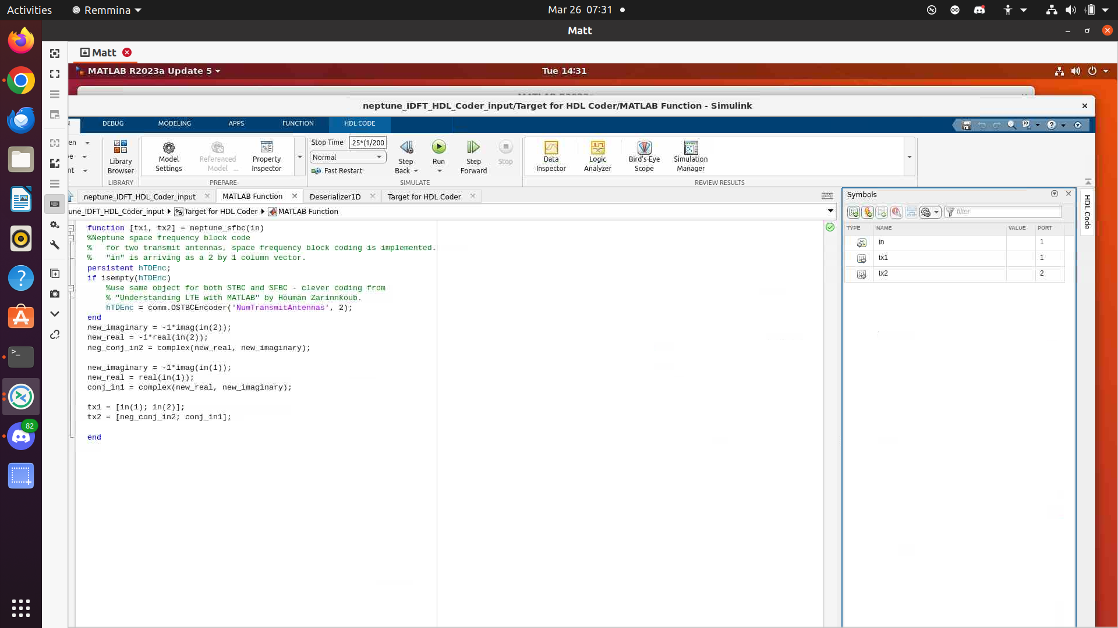

Slide 15
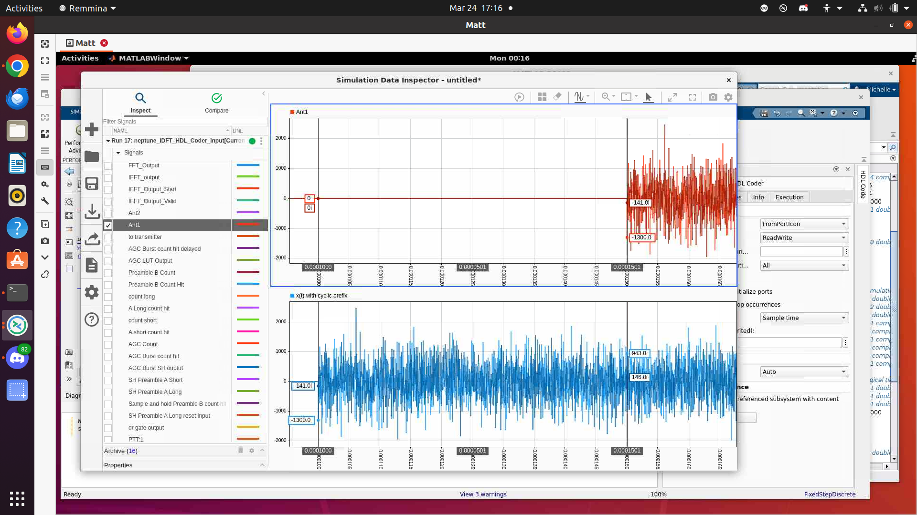
50 uS latency

Slide 17
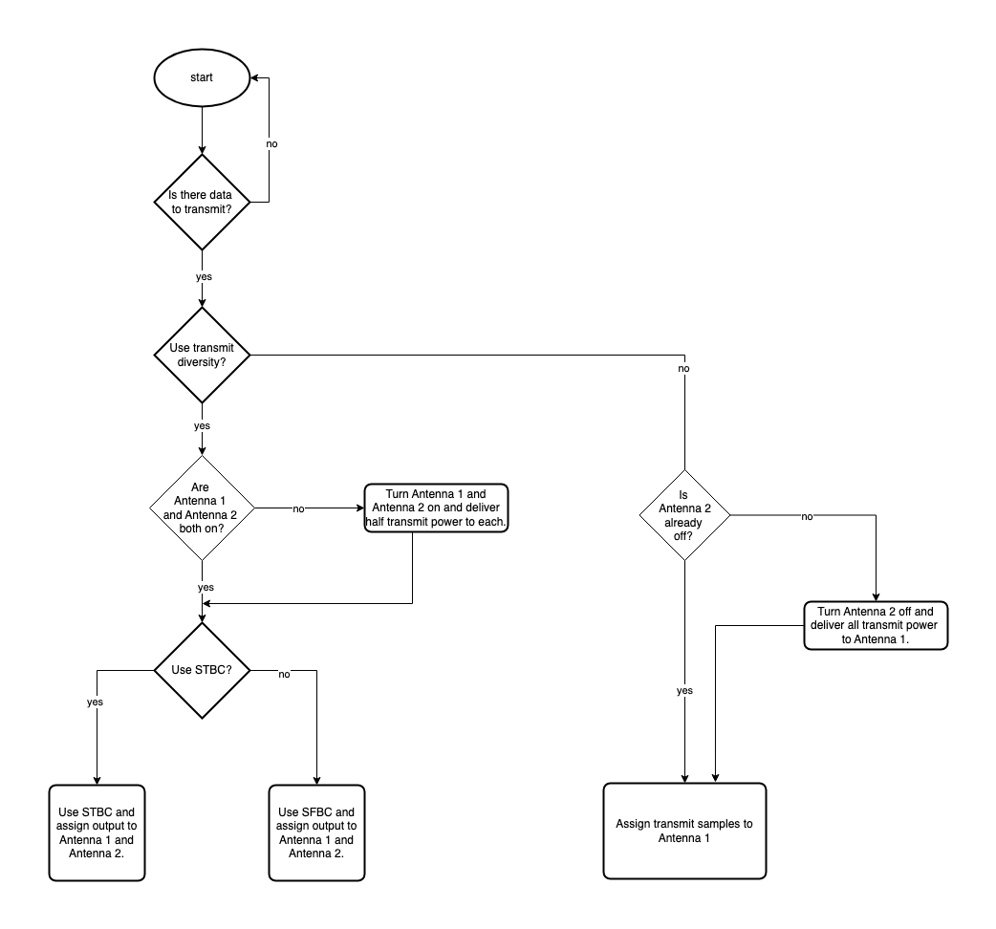
1) Educational Value
2) Diversity Diversity
3) Signal Obfuscation?
4) Flexible receiver
architecture

