Slide 1
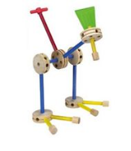
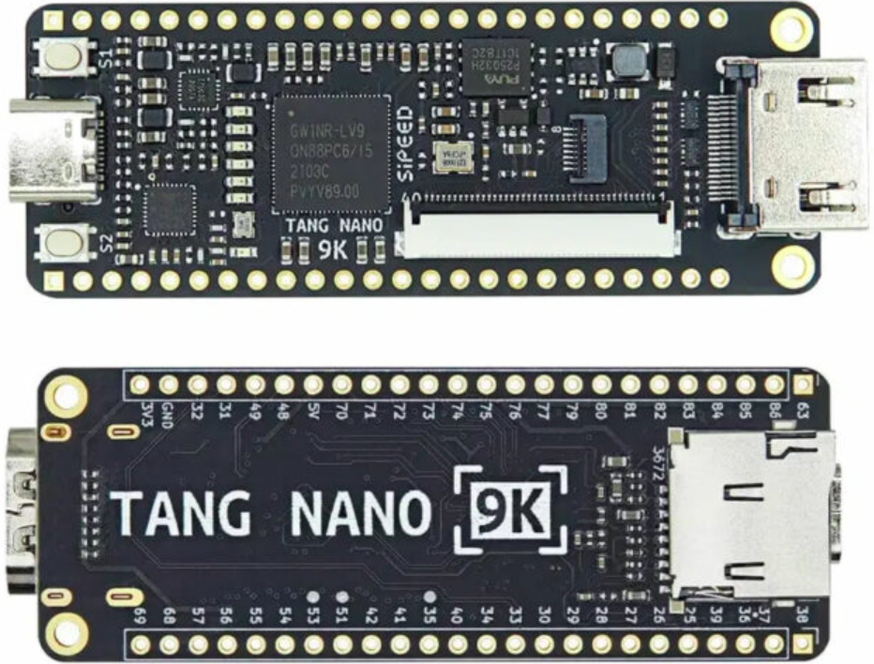
IEEE LMAG show & tell
Jim Brakefield, IEEE LoneStar section
The $20 FPGA kit with updates & other choices

Slide 2
Full $20 FPGA Kit
VHDL and Verilog for operating the TM1638 display board available at:
https://github.com/zpekic/Sys_TM1638
https://github.com/alangarf/tm1638-verilog
Notes:
Both flat cable connectors & HDMI connector accessible. Breadboard scored with knife and split allowing access to more breadboard rows. Top power buss rotated 180 degrees and shifted to align with DIP switch pins. Adhesive breadboard backing exposed and mounted on piece of wood. Rubber bands used to hold display board & dress the jumpers.

Slide 3
Tang nano 20K gaming kit
https://www.amazon.com/GW2AR-18-Computer-Debugger-Multiple-Emulator/dp/B0C5XLBQ6C
https://github.com/sipeed/TangNano-20K-example
Notes:
Tang Nano 20K FPGA RISC-V Dev board with gaming controllers $54.34 Compare to $300-$500 MiSTer Gamming Console. Add wireless keyboard for full IO. RISC-V mode supports Linux.

Slide 4
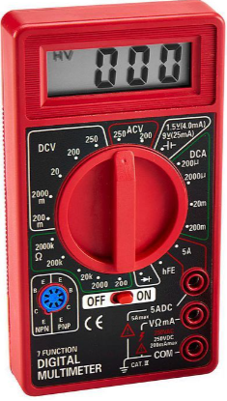
Other favorites
Multi-meter (Harbor Freight) free with purchase, now $7
Also:
Hammer (from 1969)
Shovel (probably 1984)
Cordless drill-screwdriver-
impact drill

Slide 5
$20 Tang nano kit and other choices
Tang nano 9K 1.6GB disk space Boolean board 32GB disk
$11-$20 $74 (educational price)
Some user wiring & soldering Spartan 7 50K LUT FPGA
“young” FPGA tools Mainstream tools
Needs case for transport Save the box it came in
DIP switches Slide switches
Tang nano 20K gamer 1.6GB disk MiSTer gamer 15GB disk
$25-$54 $300-$500
Some assembly Ready to use
“young” FPGA tools Mainstream tools
Gaming, RISC-V dev kit Hundreds of video games
Add wireless keyboard DE10 nano 110K FPGA $190
Notes:
Tang Nano 20K FPGA RISC-V Dev board with gaming controllers: https://www.aliexpress.us/item/3256805394833478.html
DE10 nano board: https://www.terasic.com.tw/cgi-bin/page/archive.pl?Language=English&CategoryNo=165&No=1046#contents
Boolean board: https://www.realdigital.org/hardware/boolean Digital Designer for schmatic to VHDL/Verilog: https://github.com/hneemann/Digital/

Slide 6
The $20 FPGA Kit agenda
To make the FPGA experience available to all
Very few FPGA boards for under $20
The Tang 9K Nano board has:
8,640 LUTs HDMI connector
SD card slot 8MB DRAM
$11 price tag: https://www.aliexpress.us/item/3256803617679773.html
The FPGA Boot-Camp grant requirements:
10+ slide switches 10+ LEDs
6+ seven-segment digits 4+ push buttons
USB download 20K LUTs
Video out Under $100 board
Students keep their FPGA board Schematic-to-VHDL
Notes:
The LUT count, DRAM and SD card slot means that the board can be used for soft core processors such as 6502, Z80, AVR etc. The SD card can be used as a disk file device supporting an operating system. https://www.cnx-software.com/2022/01/17/tang-nano-9k-fpga-board-can-emulate-picorv32-risc-v-soft-core-with-all-peripherals/

Slide 7
The $20 FPGA Kit agenda
The Tang 9K FPGA board does not have:
7-segment digits
Only two push buttons
No slide switches
Use add-on components:
Display board $2.90
DIP switch $0.88
Solderless breadboard $6.69 for 4
Male-female jumper wires $1.95 for 40
https://github.com/jimbrake/20-dollar-FPGA-kit
A DIY PCB for mounting the parts eliminates breadboard and jumper wires, allows use of slide switches
Notes:
The pro-rata cost of the breadboard and DIP switch drop in quantity to approximately $1.70 for a total kit price of $18.51. In very large quantities further reductions possible. The goal here is an under $20 kit price so almost any student or any school can afford a kit(s). The single kit price with some extra parts is $25.64 plus shipping and taxes.

