Slide 1
Florida Council Report
Canaveral Section
13-SEPT-2024 https://webinabox.vtools.ieee.org/wibp_home/index/R30507
Dr. Paul Nyffenegger
Chair, Canaveral Section
paulnyffenegger@IEEE.org

Slide 2
2024 Section Officers Elected
Chair- Dr. Paul Nyffenegger (PaulNyffenegger@IEEE.org)
Vice Chair- Vince Socci (socci@IEEE.org)
Secretary- Vacant
Treasurer- Bill Nutter (william.t.nutter@ieee.org)
Membership Dev– Macaulay Osaisai (mosaisai@ieee.org)
Student Activities– Dr. Mevlut Guvendik (guvendikm@easternflorida.edu)
Awards– Greg O’Neill (gregoryoneill8029@att.net)
PACE- Vince Socci
CCTS Representative- Macaulay Osaisai
Life Member Affinity Group Chair – Macaulay Osaisai
Life Member Affinity Group Vice – Ron Jakubouski
Notes:
Elections were held at our December Excom.

Slide 3
Recent Meetings Held
Meetings held since last FL-Council
    June 27 Excom (in Rockledge)
    August 22 Excom (in Cocoa Beach)
    No meetings in July
Meetings planned (events on a separate page)
            26 Sept. Excom
            24 Oct. Excom (Titusville)
            21 Nov. Excom
            14 Dec. Annual Meeting (joint with LMAG)
Notes:
meetings held are about 60% as compared to 2017

Slide 4
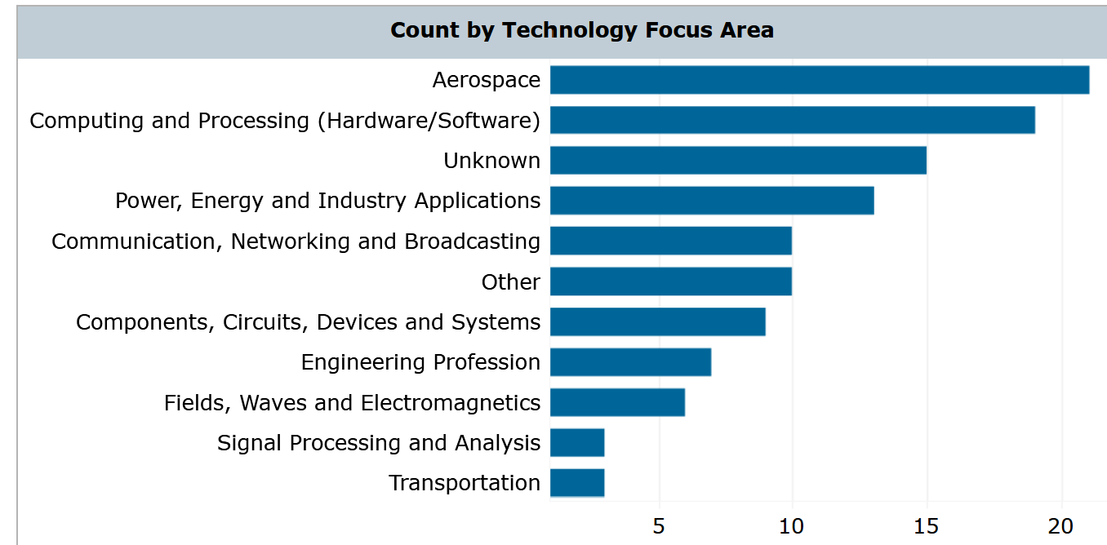
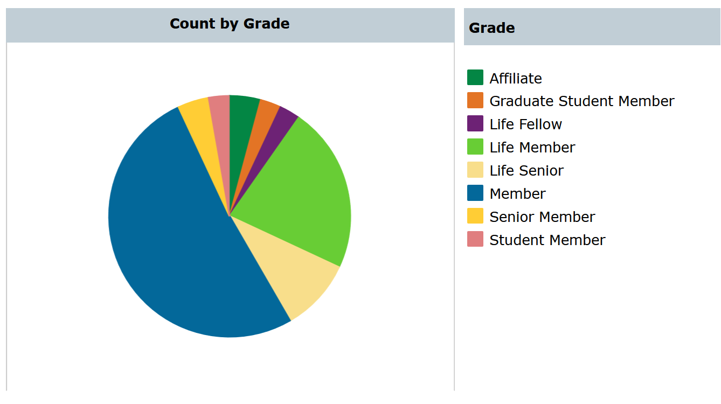
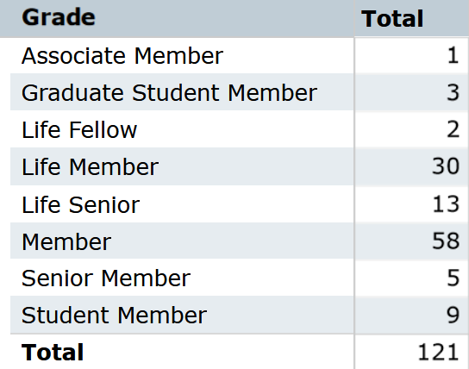
Current Membership
  121 Total Members
  Down from 135 DEC last year
  ?? in arrears
  (cannot access)
Notes:
Current membership diversity as of August 2024

Slide 5
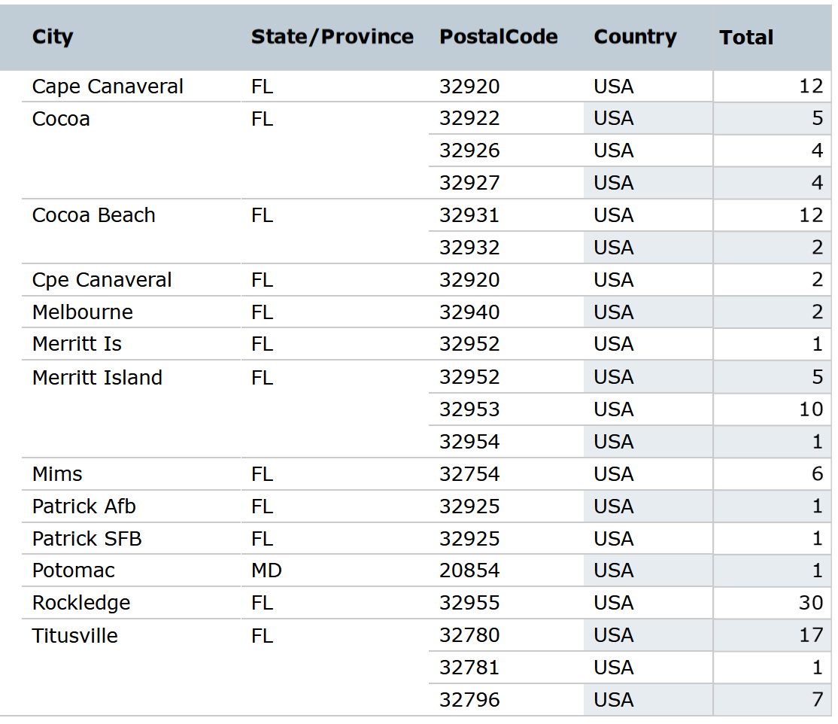
Geographical Distribution
Notes:
Current membership diversity as of August 2024

Slide 6
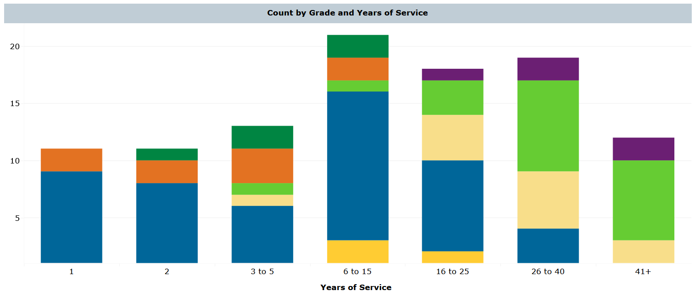
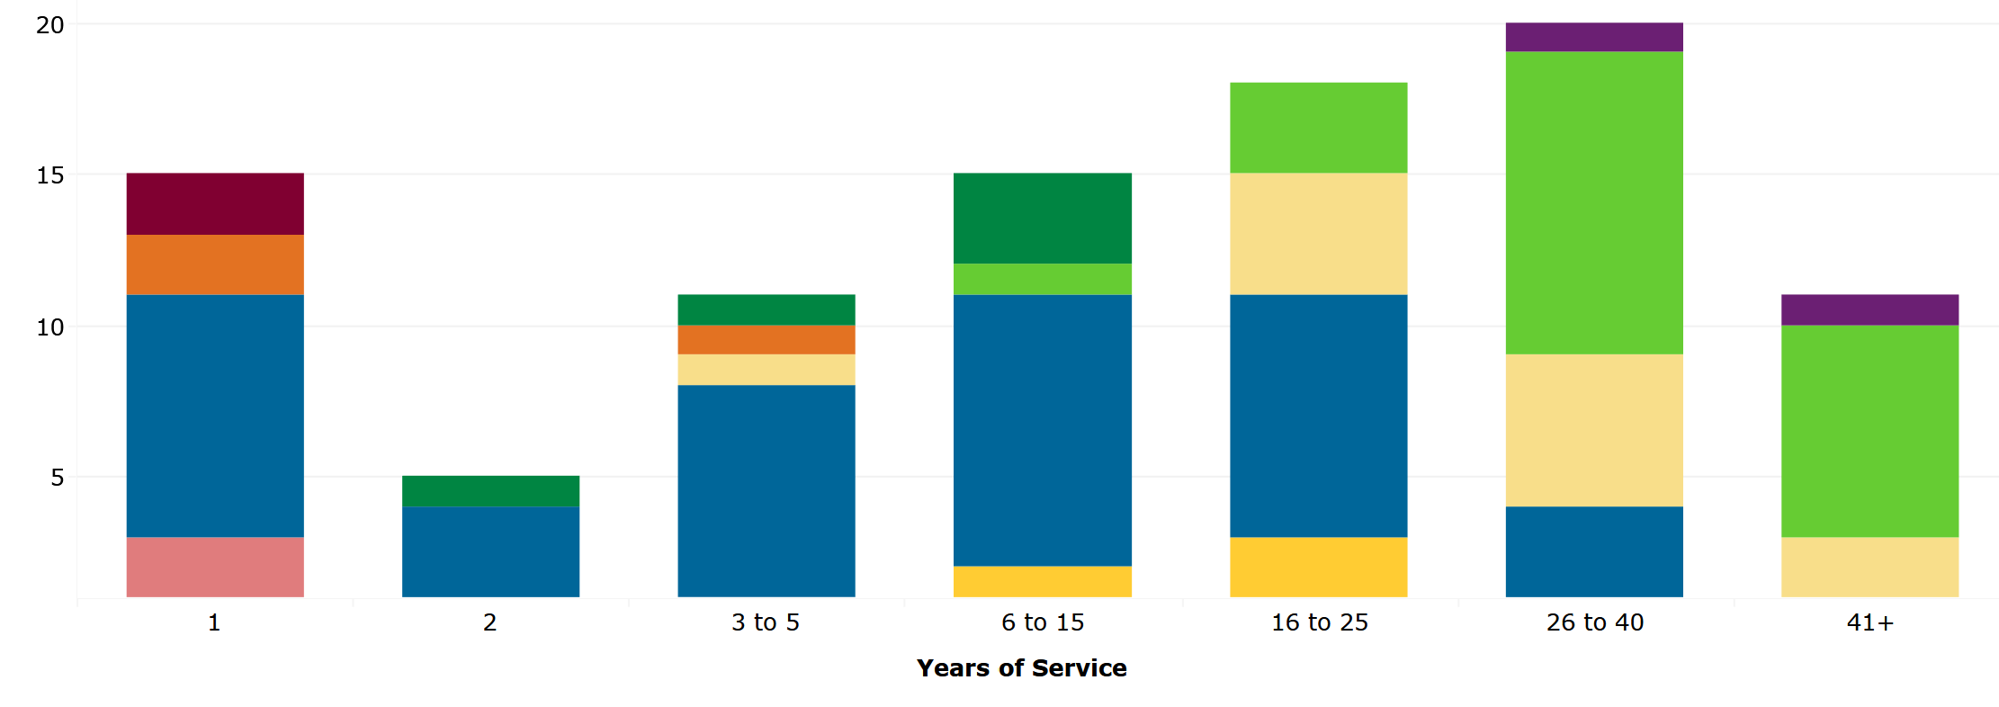
December
August

Slide 7
Section Events:
Melbourne Section co-sponsors our events and vice-versa. Canaveral participates in other organization’s events. Usually one or two section members per event.
                Canaveral Council of Technical Societies events
                Space Visions Symposium (Early May 2024, http://sfo.org/publications/)
                Technical/Social Events (Engineers Week, etc.)
                First Robotics Space Coast Showdown (21 Sept.)
                Ham Radio Training and Licensing Course (21 Sept.)
                Melbourne Section Intepro Systems (25 Sept.)
                Melbourne Section/Canaveral Section (05 Oct.)
                SmallSat Education Conference 2024 (Consortium) (26-27 Oct)
                Vince-Socci (Canaveral VC /PACE) is planning a multi-day STEM program this fall (Rocket Recorder)
Notes:
meetings held are about 60% as compared to 2017

Slide 8


