Slide 1
Attack-Resilient Cyber-Physical Systems
Fanxin Kong
Assistant Professor
Jan 30, 2020
Department of Electrical Engineering and Computer Science

Slide 2
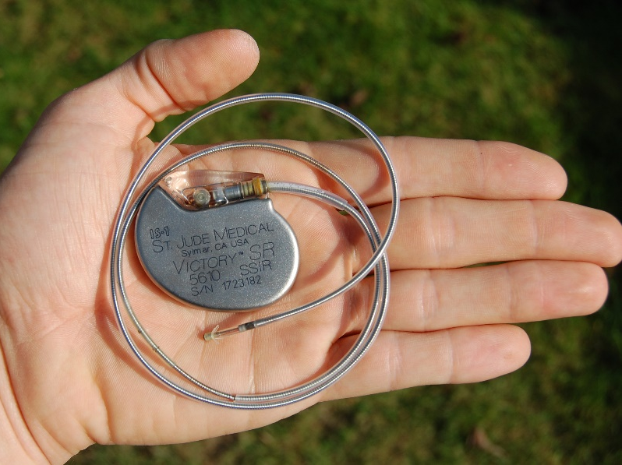
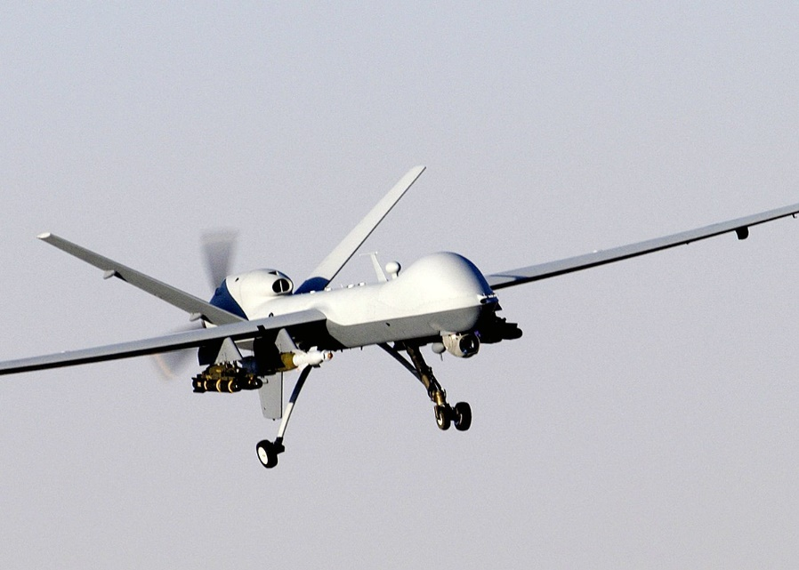
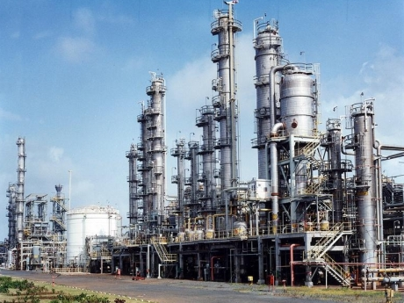
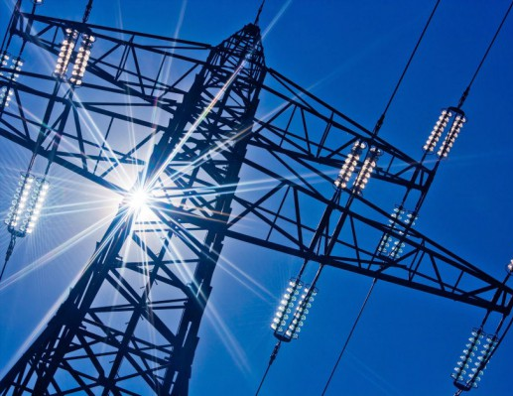
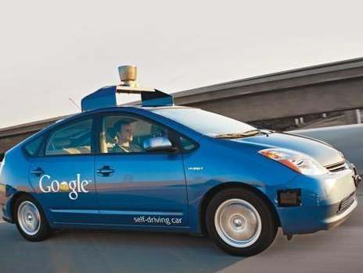
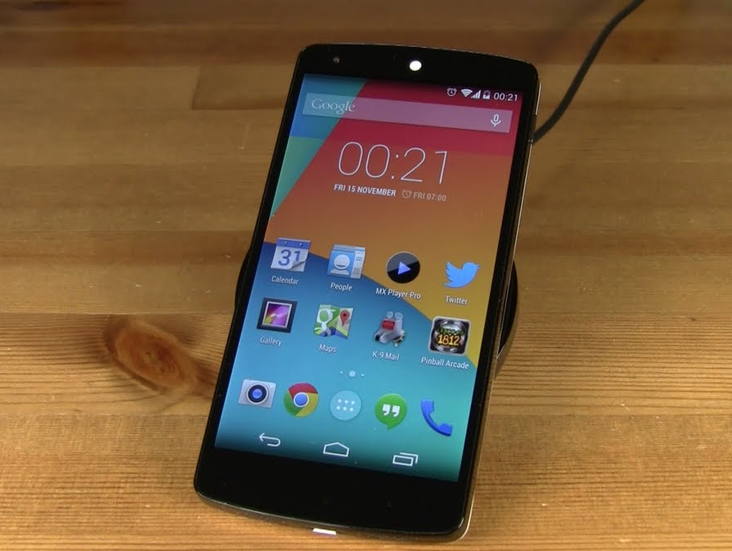
Cyber-Physical Systems
Computation
Cyber
Physical
Information
Communication
Systems
Control
We are living in a Cyber-Physical System world!
Department of Electrical Engineering and Computer Science
2

Slide 3
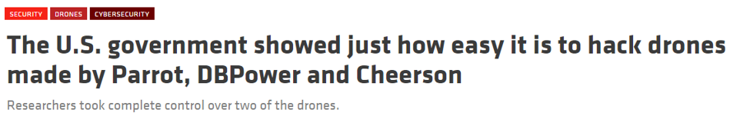



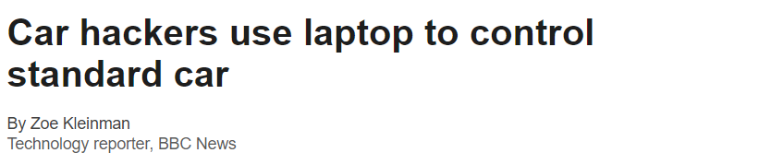


Cyber-Physical System Attacks
Attacks on Drones and Automobiles
Attacks on Power Systems
Department of Electrical Engineering and Computer Science

Slide 4

CPS Attack Surfaces
Cyber attack surfaces
  e.g., communication, networks, computers, ...
Environmental attack surfaces
  e.g., GPS signal, electro-magnetic interference, ...
Physical attack surfaces
  e.g., locks, casings, cables, …
Human attack surfaces
  e.g., phishing, blackmail, …
Department of Electrical Engineering and Computer Science

Slide 5
What is CPS security?
A CPS attack whose goal is to (negatively) affect the interaction between a CPS and the physical world
-- Originates through any attack surface
CPS security concerns the development of technologies for defending against CPS attacks
-- Prevention from attacks
-- Detection of CPS attacks
-- Reaction to attack effects
Department of Electrical Engineering and Computer Science

Slide 6


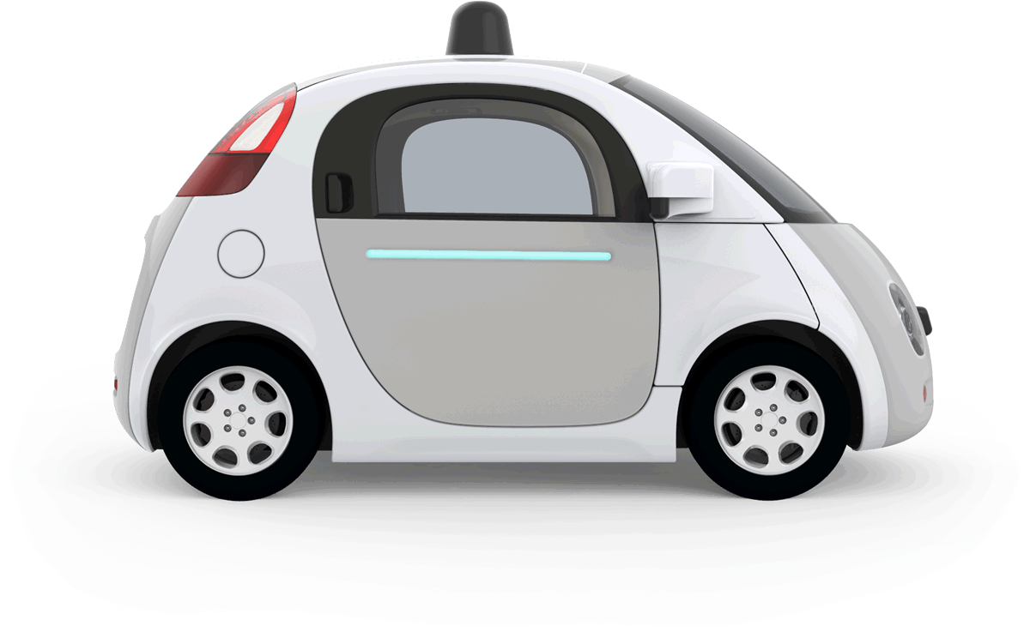
What we study and why?
Target: Sensor Attacks
Physical system
The attacker can arbitrarily change sensor measurements
- environmental attack surfaces
- cyber attack surfaces
Malicious
signals
Sensor
Actuator
Malicious
packets
Network
Controller
30mi/h
100mi/h
Department of Electrical Engineering and Computer Science

Slide 7
What we study and why?
Target: Sensor Attacks
Physical system
The attacker can arbitrarily change sensor measurements
- environmental attack surfaces
- cyber attack surfaces
Malicious
signals
Sensor
Actuator
Malicious
packets
Goal: Resilience
Network
To ensure control performance with sensor attacks
Controller
Department of Electrical Engineering and Computer Science

Slide 8
Background
What we study?
  Reaction to sensor attacks after detected
Why it is important and difficult?
  Cannot restart CPS arbitrarily
  Response taking CPS offline is inferior
  Need accurate and real-time reaction
  What if inadequate sensor redundancy
  …
Department of Electrical Engineering and Computer Science

Slide 9


How sensor attacks affect control?
$$\overline{x}$$
Controller
$$u$$
Sensor
Physical system
Actuator
A sensor attack or fault occurs
The input, i.e., estimation $\overline{x}$, incorrectly reflects the system’s physical state
3. The output, i.e., control input $u$, is misled
4. The actuator performs the misled actuation
5. The physical system drifts off
Department of Electrical Engineering and Computer Science

Slide 10


The core idea: Checkpointing and Recovery
$$\overline{x}$$
Controller
$$u$$
Sensor
Physical system
Actuator
Checkpointing: record states $\left(\overline{x},u\right)$ occasionally
Recovery: restore the system so that state estimations /predictions correctly reflect the system’s physical states
Department of Electrical Engineering and Computer Science

Slide 11


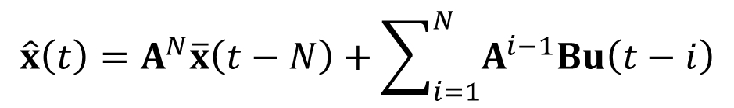

Roll-forward recovery
Rolling the system to the current time from a consistent cyber-physical state
Prediction using historical state checkpointed
Estimated state
$${\overline{x}}_{1}$$
$$t−N$$
$$t$$
A solution: model-based prediction
$$\hat{x}\left(t\right)=A^{N}\overline{x}\left(t−N\right)+\sum_{i=1}^{N}{A^{i−1}Bu\left(t−i\right)}$$
E.g.: linear time-invariant system
Department of Electrical Engineering and Computer Science

Slide 12





Which state is used for the recovery?
detection window
…
?
?
$$\overline{x}(t−N)$$
$$\overline{x}(t−2)$$
$$\overline{x}(t−1)$$
$$\tilde{x}(t)$$
used for recovery
pending detection
States that pass detection can be used for recovery
Attack detection usually has substantial delay
States during the detection interval may be incorrect
Department of Electrical Engineering and Computer Science

Slide 13

A sliding window-based protocol
detection window
?
?
…
?
?
deleted states
deleted states
buffered states
buffered states
the stored state
the stored state
Step 1: states are buffered, before passing the detection
Step 2: the state is stored, after passing the detection
Step 3: stored states are discarded, if no longer needed
Department of Electrical Engineering and Computer Science

Slide 14



The overall system design
Physical
system
$$\overline{x}(t)$$
checkpointing
YES
NO
attacked
recovered
YES
NO
?
recovery
prediction
$$\tilde{x}\left(t\right)$$
Controller
• Recovery-based control: predict future states based on the recovered state
time
$$\overline{x}$$
Normal operation
Recovery
Recovery-based
control

Slide 15


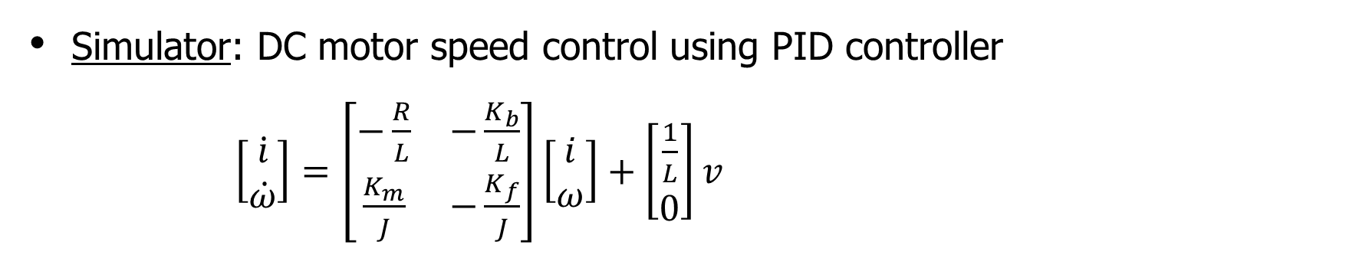
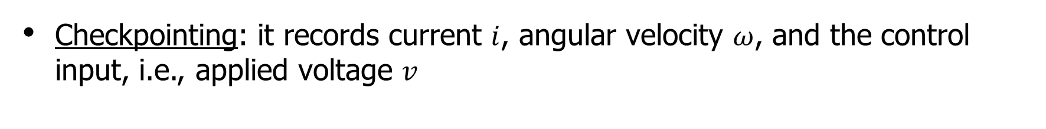
Case study 1: cruise control
Goal: to keep a vehicle travel at a constant speed
Simulator: DC motor speed control using PID controller
$\left[\begin{matrix}\dot{i} \\ \dot{ω}\end{matrix}\right]=\left[\begin{matrix}−\frac{R}{L} & −\frac{K_{b}}{L} \\ \frac{K_{m}}{J} & −\frac{K_{f}}{J}\end{matrix}\right]\left[\begin{matrix}i \\ ω\end{matrix}\right]+\left[\begin{matrix}\frac{1}{L} \\ 0\end{matrix}\right]v$
Checkpointing: it records current $i$, angular velocity $ω$, and the control input, i.e., applied voltage $v$
Attack: the attacker adds a value to speed sensor measurements during the attack interval
Department of Electrical Engineering and Computer Science

Slide 16
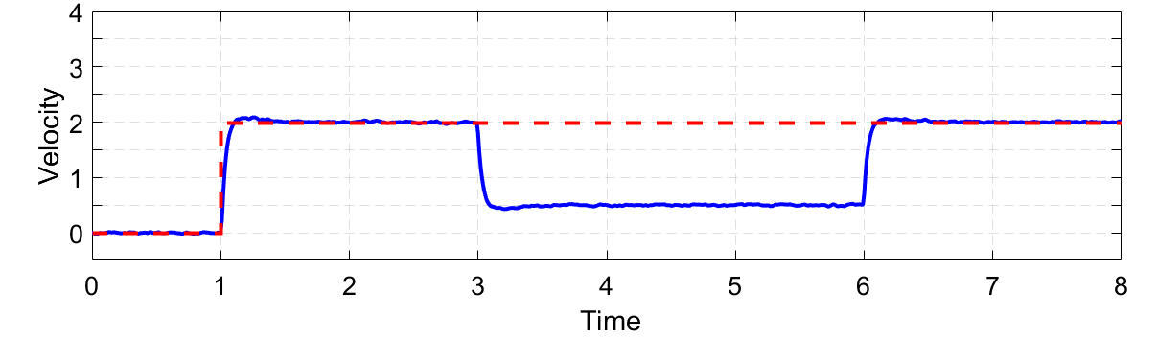
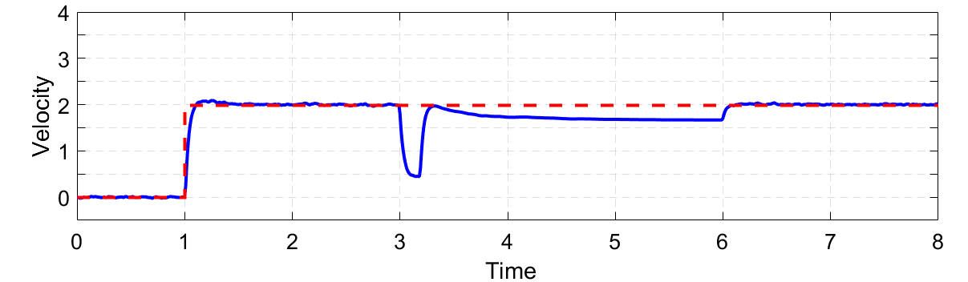

How well does it work?
attack
Actual speed is far from desired speed
large
no protection
attack
recovery
Actual speed is close to desired speed
small
with protection
--- desired speed
―actual speed
Department of Electrical Engineering and Computer Science

Slide 17
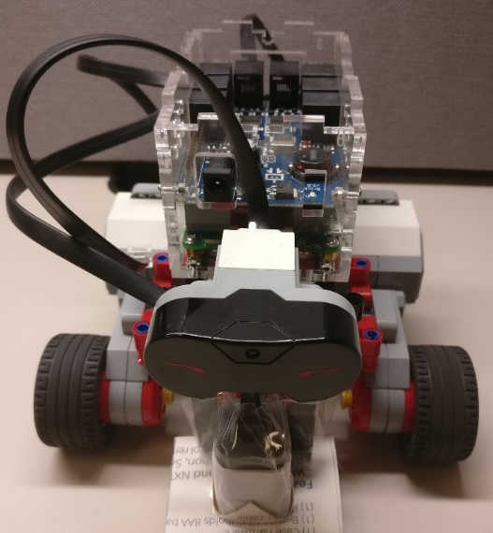
Case study 2: lane keeping
Testbed: an unmanned vehicle. Each front wheel is driven by a motor, and each motor has a speed sensor
Goal: to keep a vehicle travel in a straight line, i.e., the two front wheels have the same speed
Controller: a PID controller supervises and controls the speed difference of the two front wheels
Attack: the attacker modifies a speed sensor’s measurements to a constant value
Department of Electrical Engineering and Computer Science

Slide 18

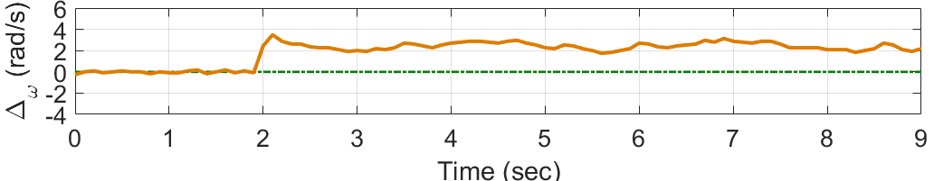
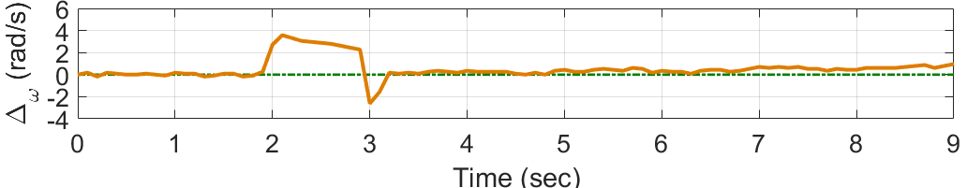


How well does it work?
No protection
speed
difference
large
The vehicle keeps turning
With protection
recovery
speed
difference
small
The vehicle travels almost straightly
--- desired $∆$
―actual $∆$
Department of Electrical Engineering and Computer Science

Slide 19
Conclusion
CPS Checkpointing and Recovery
  Exploiting historical data to restore system states
Thank You!
Q&A
Department of Electrical Engineering and Computer Science

