Slide 1
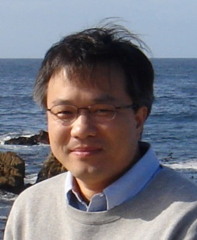
IEEE Distinguished Lecturer Yimin D. Zhang Temple University
Thursday
21 Nov 2024
6:00 PM MST
Sorensen Molecular Biotechnology
Building SMBB 2650, University
of Utah, Salt Lake City, UT
IEEE Communications Society
Spectrum Sharing for Joint Sensing and Communications
Dr. Yimin D. Zhang is an Associate Professor at the Dept, ECE, Temple University, Philadelphia, PA. B.Sc. degree from Xidian Univ., China, and Ph.D. degree from Univ. of Tsukuba, Japan. His research interests lie in statistical signal and array processing, machine learning, compressive sensing, information theory, convex optimization, and time-frequency analysis with applications to radar sensing, wireless communications, and satellite navigation.
Dr. Zhang is a Senior Area Editor for IEEE Trans. on Sig. Proc. and an Assoc. Editor for Sig Proc. He serves as a member of the Sig Proc Theory and Methods (SPTM) Tech. Committee and a member of the Integrated Sensing and Comm. (ISAC) Working Group of the IEEE Sig. Proc. Society, and a member of the ISAC Emerging Tech. Initiative of the IEEE Comm Society. He received the 2017 IEEE Aerospace and Electronic Systems Society Harry Rowe Mimno Award for article “Signaling strategies for dual-function radar communications: An overview” published in IEEE Aerospace and Elec. Systems Magazine. His publications also received the 2016 IET Radar, Sonar and Navigation Premium Award, the 2018 and 2021 IEEE Signal Processing Society Young Author Best Paper Awards, the 2019 IET Comms Premium Award, and the 2021 EURASIP Best Paper Award for Sig Proc. He is a fellow of IEEE, a fellow of SPIE, and a Distinguisher Lecturer of the IEEE Signal Processing Society.
Abstract: Spectrum sharing enables multiple categories of users to utilize the same frequency bands and is becoming increasingly important in addressing the growing congestion of spectral resources. Among different solutions, joint radar-communication (JRC) is a promising solution which integrates both radar sensing and wireless communication functions within shared platforms and frequency bands. In this talk, we first discuss signaling strategies in radar-centric JRC systems, focusing on the optimized design of adaptive beamformers and signal waveforms to embed digital communication data in radar functions. We then further explore in several directions, including effective information embedding using quadrature amplitude modulation (QAM) waveforms, antenna selection for complexity reduction, and resource optimization in distributed JRC systems. Additionally, we highlight recent advancements in JRC systems, such as reconfigurable intelligent surface (RIS)-aided JRC systems and reconfigurable beamforming for JRC leveraging deep learning techniques.
IEEE Utah Section Signal Processing and Communication Society Chapter

