Slide 1
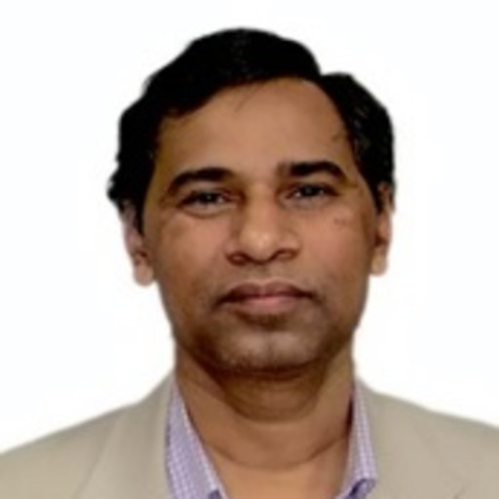
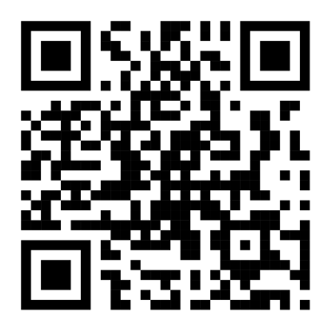
IEEE EDS Technical Talk
MOS Transistor Technology from Micro to Nano
Prof. Satyabrata Jit,
Professor,
Indian Institute of Technology BHU
Email: sjit.ece@iitbhu.ac.in
Date: 13th January, 2025, Time : 8-9:30 PM IST
Registration Link: https://docs.google.com/forms/d/1FyVUXx73lJgLqLfnBrs7T2wa6z-EBMmTVtxf0b2a-Ic/edit
Organised By:
Device simulation lab,
Dept. of Electrical Engineering. IIT Patna
Dr. Pramod Kumar Tiwari,
Dept. of Electrical Engineering.
IIT Patna
IEEE EDS Student branch
Chapter (SBC1459ID)

