Slide 1
GNN-RL: An Intelligent HPC Resource Scheduler
Presenter: Kyrian C. Adimora
Advisor: Dr. Hongyang Sun
Department of EECS, University of Kansas

Slide 2
Introduction

Slide 3
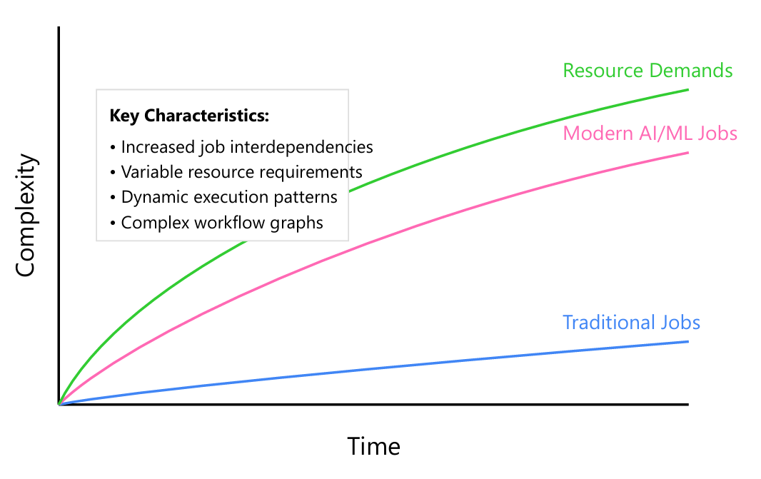
Motivation and Contributions
Motivation:
Challenge: Complex HPC workload management
Limitations of traditional scheduling approaches
Research Contributions:
Advanced Graph-based Scheduling Architecture
Dynamic Policy Learning Framework
Multi-objective Optimization
Empirical Validation

Slide 4
Complexity in Job Dependencies

Slide 5
GNN and RL components

Slide 6
GNN-RL Based architecture Overview

Slide 7
GNN Module

Slide 8
RL MOdule

Slide 9
GNN-RL Technical implementation details

Slide 10
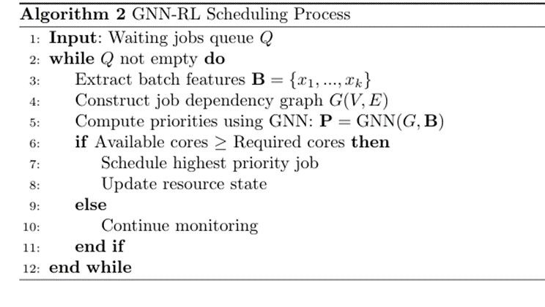
GNN-RL Feature processing pipeline

Slide 11
PPO algorithm framework

Slide 12
PPO algorithm implementation Details

Slide 13
GNN-RL training and inferencing process

Slide 14
GNN-RL SLURM Integration Framework

Slide 15
Dataset analysis

Slide 16
Model training and validation loss

Slide 17
RL Scheduling metrics analysis

Slide 18
Performance results on different workloads

Slide 19
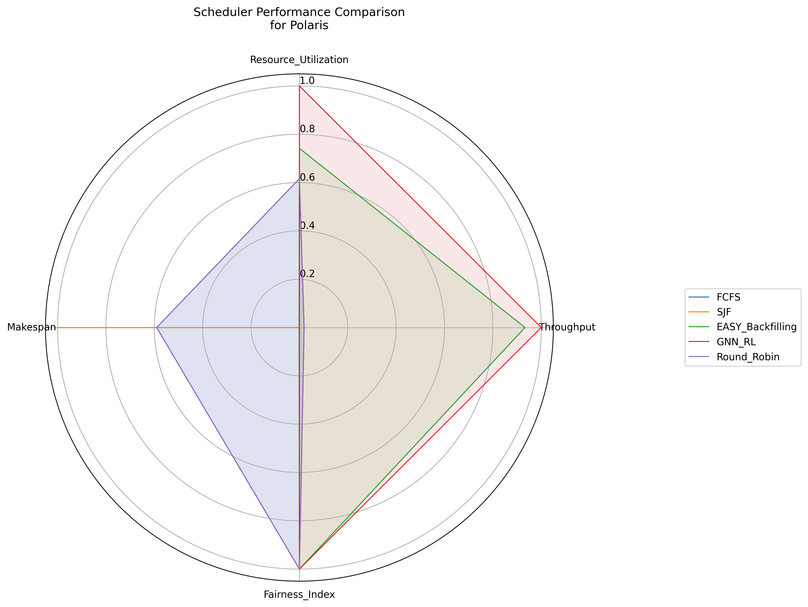
Polaris dataset: Performance Analysis

Slide 20
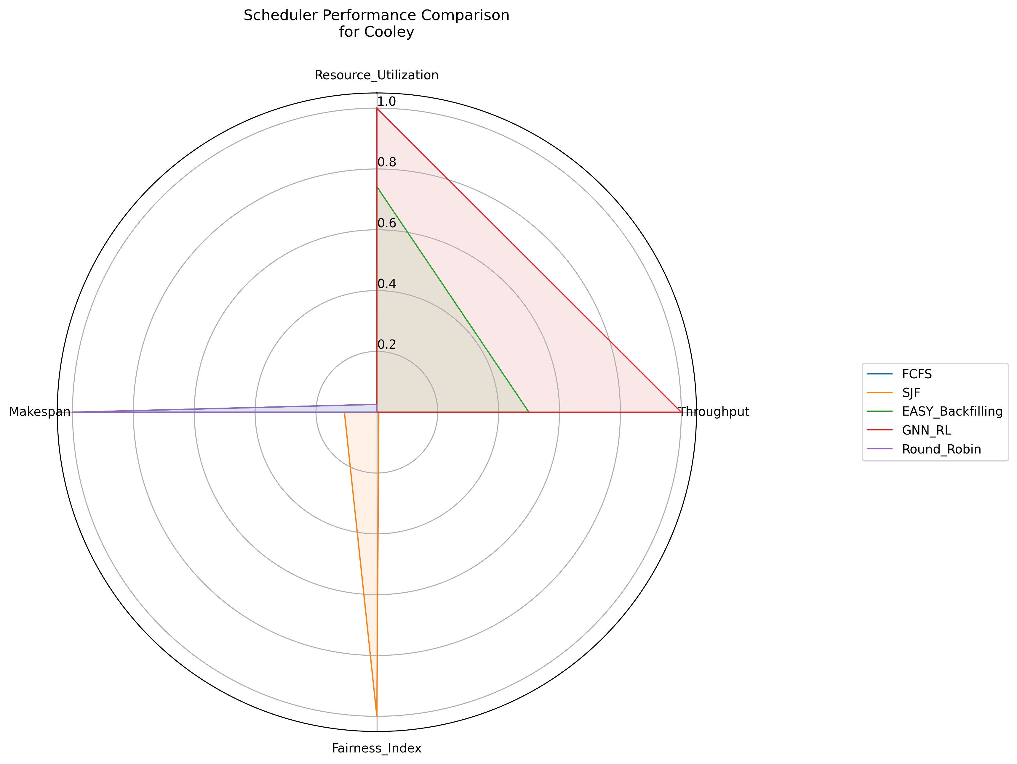
cooley dataset : Performance Analysis

Slide 21
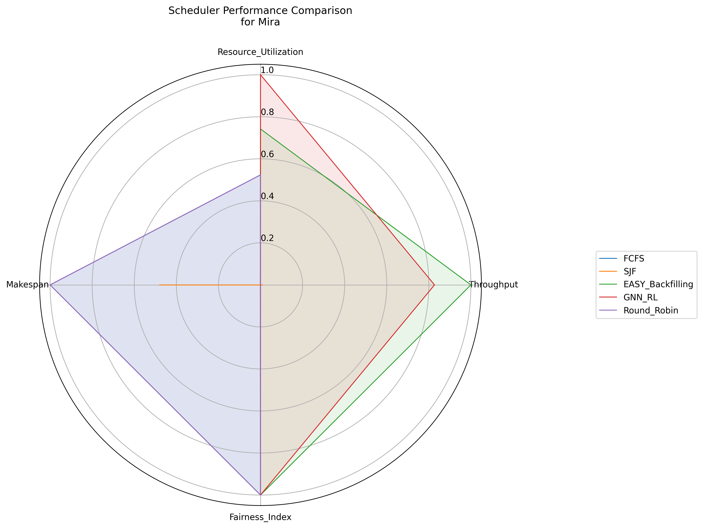
Mira dataset: performance analysis

Slide 22
Conclusion & Takeaways
The GNN-RL framework presented in this research represents a significant advancement in addressing the complex challenges of HPC workload management. The empirical validation across multiple ALCF dataset provides compelling evidence of the framework's effectiveness, with notable improvements in resource utilization, throughput, makespan, system fairness .

Slide 23
FUTURE WORK
Exploration of hybrid attention mechanisms for better workload pattern recognition
Development of multi-objective optimization frameworks incorporating energy efficiency

Slide 24
Thank you

Slide 25
QUESTIONS?

