Slide 1




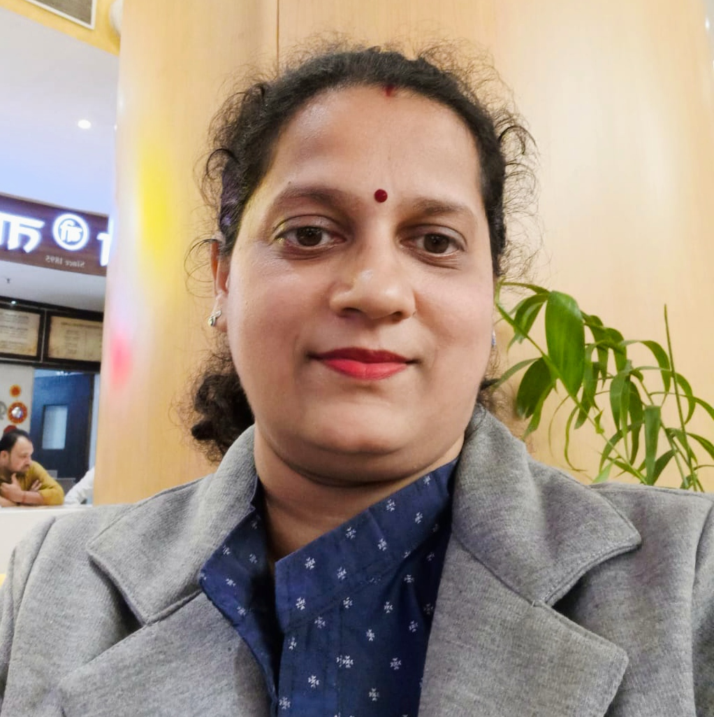


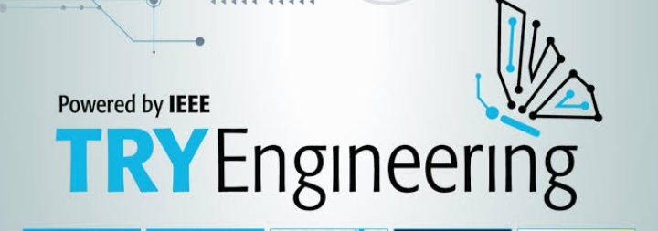
Night light implementation using Transistors and programming
Shravani Mathur
Associate Professor &
IEEE STEM Champion 2025
10:00 AM
School Bhopal
28 June 2025 (Sat)
IEEE Education Society Madhya Pradesh Section
https://ieeemp.org/

