Slide 1

Stability Modelling and Analysis of Converter Driven Power System
Bikash Pal
Professor, Imperial College London

Slide 2
Overview
Stability in recent context
Modelling
Analysis
Insight
Recommendations

Slide 3
Time Scales of Power System Dynamic Phenomena
Time scales for various classes of dynamic phenomena in power systems
electromagnetic phenomena
electromechanical phenomena
electromechanical transients enabled several simplifications in characterization and analysis of the related phenomena
Phasors approach

Slide 4
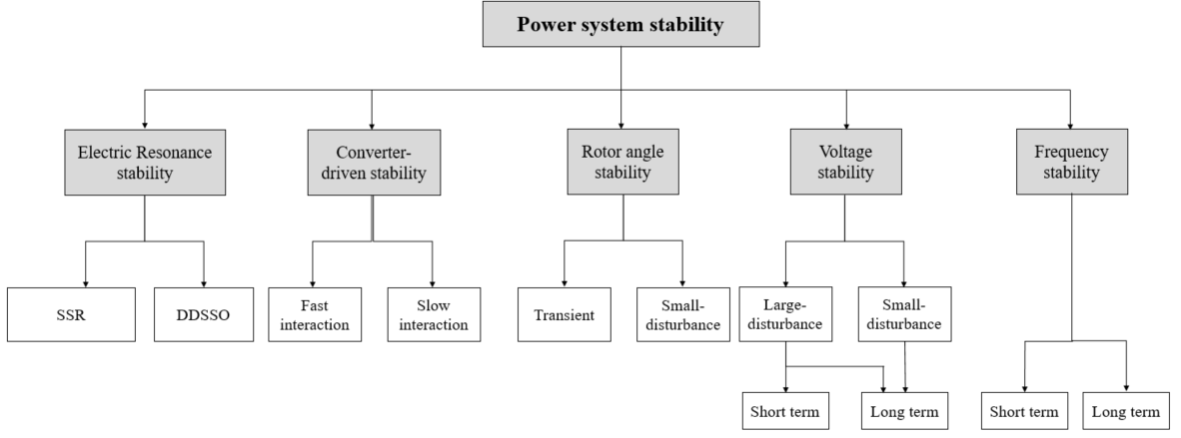
New classification diagram
Definition and Classification of power system stability
New (in)stability categories
motivated by the increasing use of converter-interfaced generators

Slide 5
Time-scale representation aspects
Definition and Classification of power system stability
Electromagnetic transient modeling required
Phasor domain modeling is appropriate

Slide 6
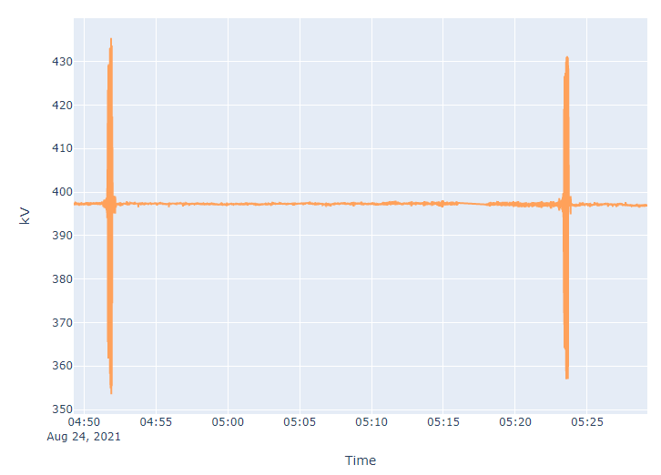
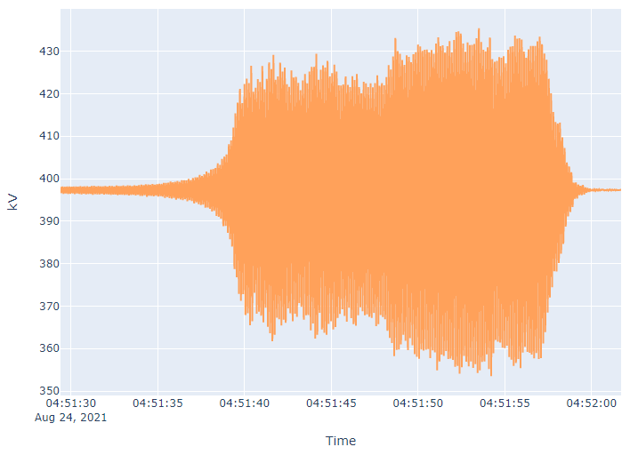
Recent incidence in UK Transmission
On 24/08/2021 severe voltage disturbances were observed on the SSEN-T and SPEN transmission systems.
Major disturbance lasted 20-25 seconds on two occasions, approx. 30 minutes apart
Investigation of available data suggests:
The oscillations with the largest magnitude were in the north of Scotland
The oscillations had a frequency of ≈8 Hz
Some Users tripped off during the disturbances

Slide 7
Impedance scanning
I_{inj, IBR}(ω)=Y_{IBR}(ω)V_{inj}(ω)
V_{inj}(ω)=Z_{IBR}(ω) I_{inj, IBR}(ω)
For strong grids, there is:
Z_{th}(ω)<<1/Y_{IBR}(ω)
Z_{th}(ω)Y_{IBR}(ω) <<1
I_{inj, grid}(ω) >>I_{inj, IBR}(ω)

Slide 8
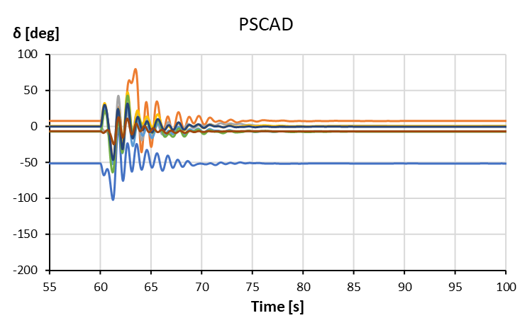
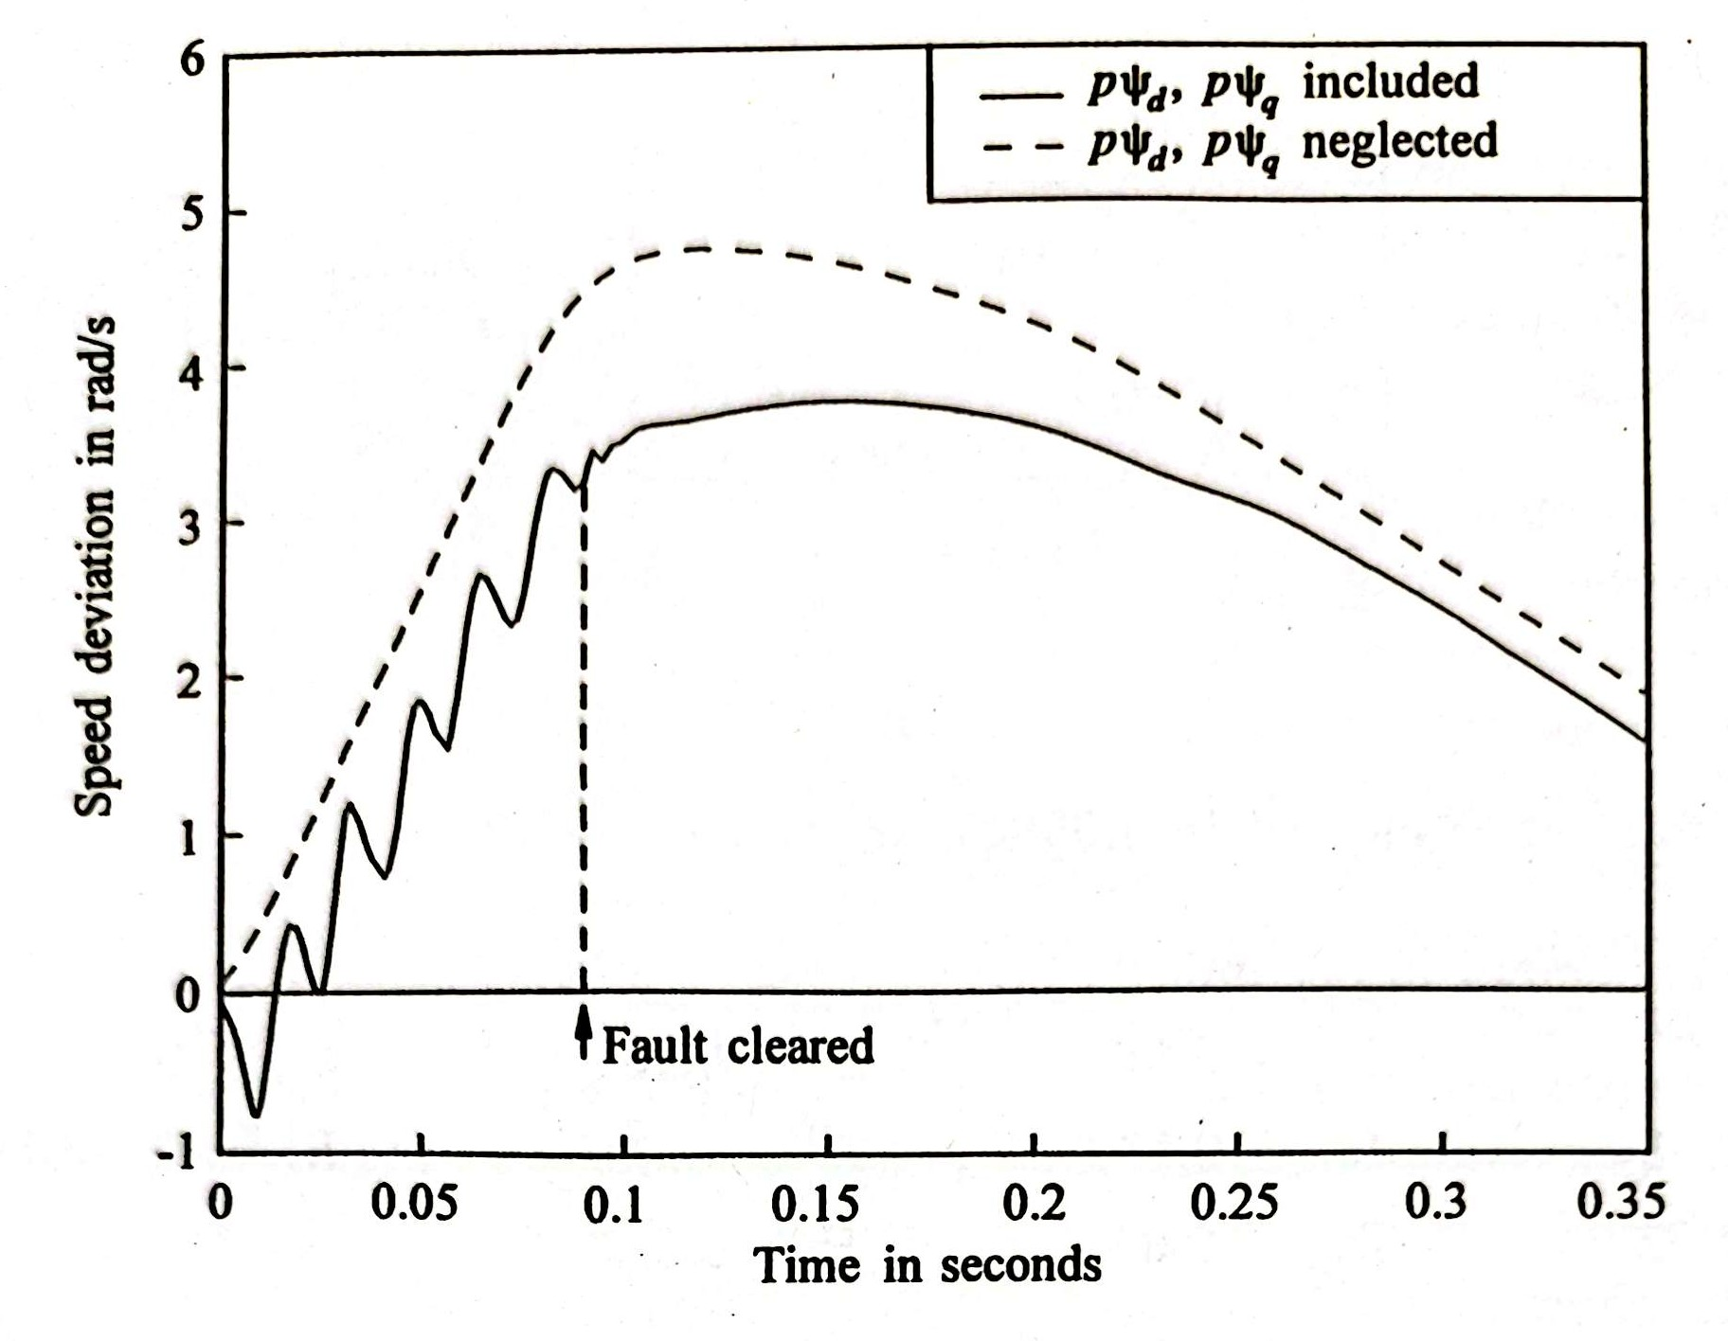
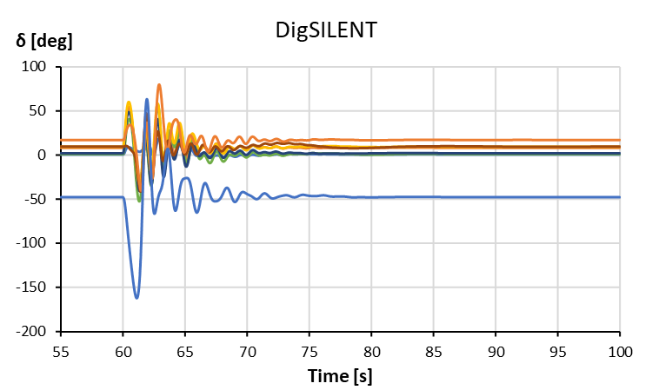
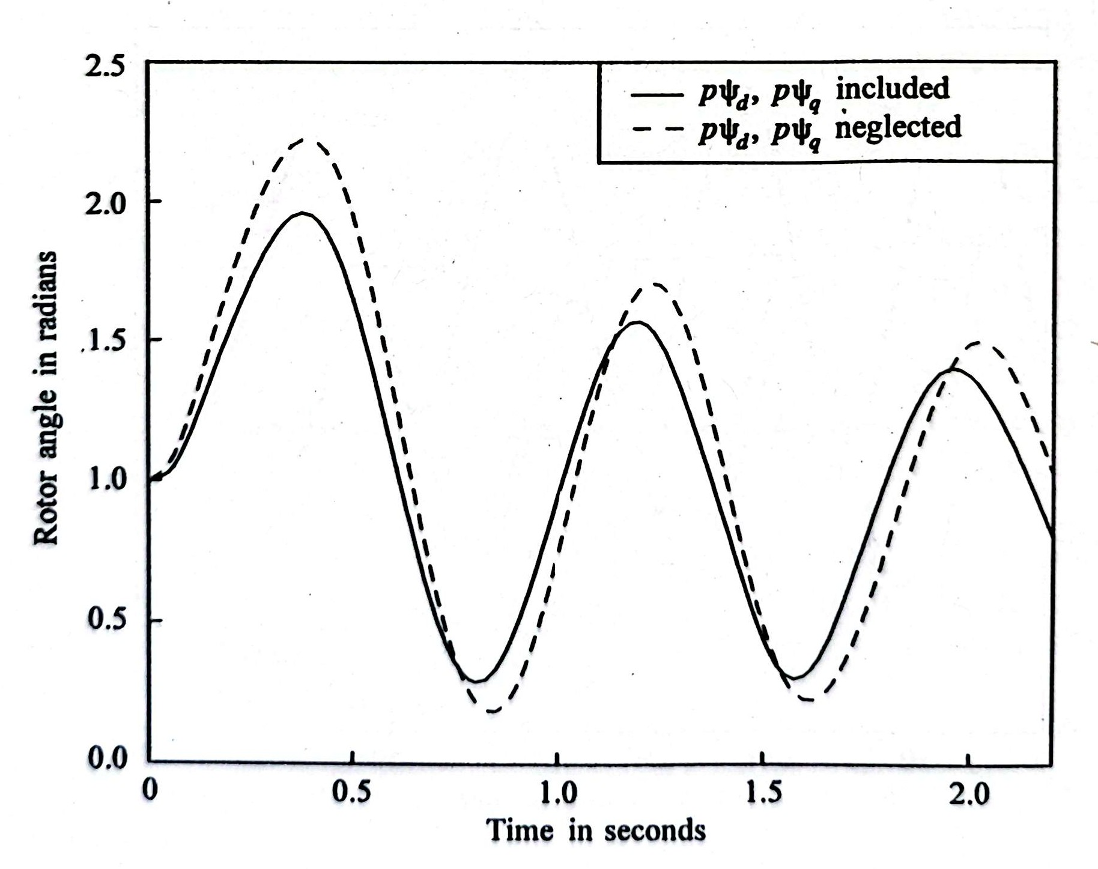
39 Bus system in PSCAD
Dynamic response for fault on Bus 16 cleared after 180 [ms]
@Kundur’s book
EMT simulation
~8 RPM
~20 deg
RMS simulation

Slide 9
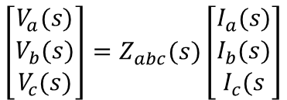


Impedance approach to stability modelling: frequency-domain
$$\left[\begin{matrix}V_{d}(s) \\ V_{q}(s)\end{matrix}\right]=\left[\begin{matrix}Z_{dd}(s) & Z_{dq}(s) \\ Z_{qd}(s) & Z_{qq}(s)\end{matrix}\right]\left[\begin{matrix}I_{d}(s) \\ I_{q}(s)\end{matrix}\right]$$
Real transfer functions
$$\left[\begin{matrix}V_{a}(s) \\ V_{b}(s) \\ V_{c}(s)\end{matrix}\right]=Z_{abc}(s)\left[\begin{matrix}I_{a}(s) \\ I_{b}(s) \\ I_{c}(s\end{matrix}\right]$$
Complex transfer functions
$$\left[\begin{matrix}V_{p}(s+jω_{i}) \\ V_{n}(s−jω_{i})\end{matrix}\right]=\left[\begin{matrix}Z_{pp}(s) & Z_{pn}(s) \\ Z_{np}(s) & Z_{nn}(s)\end{matrix}\right]\left[\begin{matrix}I_{p}(s+jω_{i}) \\ I_{n}(s−jω_{i})\end{matrix}\right]$$

Slide 10


Impedance approach
$$\left[\begin{matrix}V_{d}(s) \\ V_{q}(s)\end{matrix}\right]=\left[\begin{matrix}Z_{dd}(s) & Z_{dq}(s) \\ Z_{qd}(s) & Z_{qq}(s)\end{matrix}\right]\left[\begin{matrix}I_{d}(s) \\ I_{q}(s)\end{matrix}\right]$$
Real transfer functions
$$\left[\begin{matrix}V_{a}(s) \\ V_{b}(s) \\ V_{c}(s)\end{matrix}\right]=Z_{abc}(s)\left[\begin{matrix}I_{a}(s) \\ I_{b}(s) \\ I_{c}(s\end{matrix}\right]$$
$$\left[\begin{matrix}1 & −j \\ 1 & j\end{matrix}\right]$$
$${\left[\begin{matrix}1 & −j \\ 1 & j\end{matrix}\right]}^{−1}$$
Complex transfer functions
$$\left[\begin{matrix}V_{p}(s+jω_{i}) \\ V_{n}(s−jω_{i})\end{matrix}\right]=\left[\begin{matrix}Z_{pp}(s) & Z_{pn}(s) \\ Z_{np}(s) & Z_{nn}(s)\end{matrix}\right]\left[\begin{matrix}I_{p}(s+jω_{i}) \\ I_{n}(s−jω_{i})\end{matrix}\right]$$

Slide 11
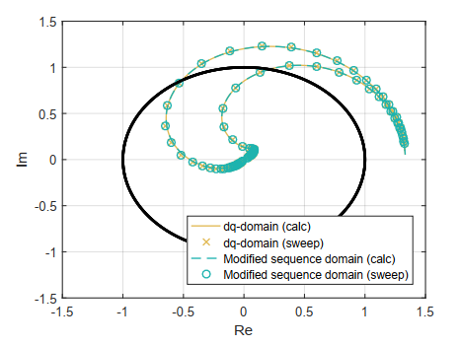

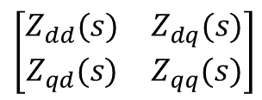
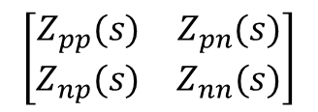
Objective
Measure
Use for stability
Limitation
Complex transfer functions
Limited to only a single converter to infinite-bus scenario
$$\left[\begin{matrix}Z_{pp}(s) & Z_{pn}(s) \\ Z_{np}(s) & Z_{nn}(s)\end{matrix}\right]$$
Real transfer functions
$$\left[\begin{matrix}Z_{dd}(s) & Z_{dq}(s) \\ Z_{qd}(s) & Z_{qq}(s)\end{matrix}\right]$$
$$\begin{matrix}\dot{x}=Ax+Bu \\ y=Cx+Du\end{matrix}$$
System identification problem is “not trivial”

Slide 12




Impedance estimation
Real transfer functions
$$\left[\begin{matrix}V_{d}(s) \\ V_{q}(s)\end{matrix}\right]=\left[\begin{matrix}Z_{dd}(s) & Z_{dq}(s) \\ Z_{qd}(s) & Z_{qq}(s)\end{matrix}\right]\left[\begin{matrix}I_{d}(s) \\ I_{q}(s)\end{matrix}\right]$$
$\left[\begin{matrix}Z_{dd}(s) & Z_{dq}(s) \\ Z_{qd}(s) & Z_{qq}(s)\end{matrix}\right]=\left[\begin{matrix}V_{1d}(s) & V_{2d}(s) \\ V_{1q}(s) & V_{2q}(s)\end{matrix}\right]$ ${\left[\begin{matrix}I_{1d}\left(s\right) & I_{2d}\left(s\right) \\ I_{1q}\left(s\right) & I_{2q}\left(s\right)\end{matrix}\right]}^{−1}$
Test 2
$$\left[\begin{matrix}V_{2d}(s) \\ V_{2q}(s)\end{matrix}\right]=\left[\begin{matrix}Z_{dd}(s) & Z_{dq}(s) \\ Z_{qd}(s) & Z_{qq}(s)\end{matrix}\right]\left[\begin{matrix}I_{2d}(s) \\ I_{2q}(s)\end{matrix}\right]$$
4 unknowns
At least 2 measurements tests
Test 1
2 equations
$$\left[\begin{matrix}V_{1d}(s) \\ V_{1q}(s)\end{matrix}\right]=\left[\begin{matrix}Z_{dd}(s) & Z_{dq}(s) \\ Z_{qd}(s) & Z_{qq}(s)\end{matrix}\right]\left[\begin{matrix}I_{1d}(s) \\ I_{1q}(s)\end{matrix}\right]$$
G. Francis, R. Burgos, D. Boroyevich, F. Wang and K. Karimi, "An algorithm and implementation system for measuring impedance in the D-Q domain," 2011 IEEE Energy Conversion Congress and Exposition, Phoenix, AZ, 2011, pp. 3221-3228, doi: 10.1109/ECCE.2011.6064203.

Slide 13
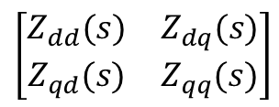
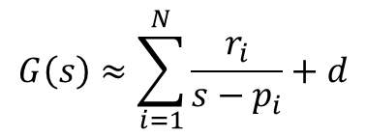

Impedance estimation: approximation
Real transfer functions
$$\begin{matrix}\dot{x}=Ax+Bu \\ y=Cx+Du\end{matrix}$$
$$\left[\begin{matrix}Z_{dd}(s) & Z_{dq}(s) \\ Z_{qd}(s) & Z_{qq}(s)\end{matrix}\right]$$
$$G\left(s\right)≈\sum_{i=1}^{N}{\frac{r_{i}}{s−p_{i}}+d}$$
4 unknowns
Vector fitting
At least 2 measurements tests

Slide 14
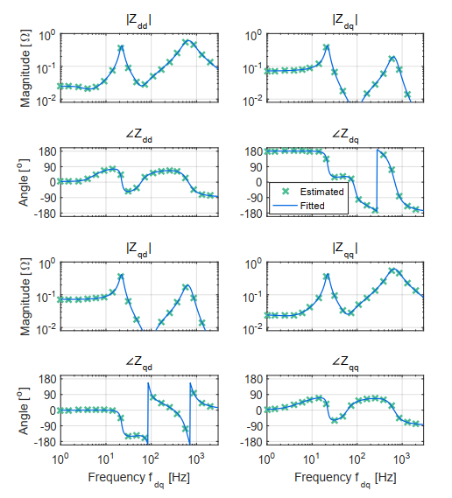
Impedance estimation: Vector fitting
Example: average model of VSC with PLL and current control
A. Rygg and M. Molinas, "Apparent Impedance Analysis: A Small-Signal Method for Stability Analysis of Power Electronic-Based Systems," in IEEE Journal of Emerging and Selected Topics in Power Electronics, vol. 5, no. 4, pp. 1474-1486, Dec. 2017

Slide 15
Impedance estimation: Vector fitting
Example reproduced in PSCAD: average model of VSC with PLL and current control
measurements
fitting

Slide 16
Impedance estimation: Vector fitting
Example reproduced in PSCAD: average model of VSC with PLL and current control including delay
measurements
fitting

Slide 17
Impedance estimation: Vector fitting
Example: MMC STATCOM with detailed control structure
measurements
fitting

Slide 18
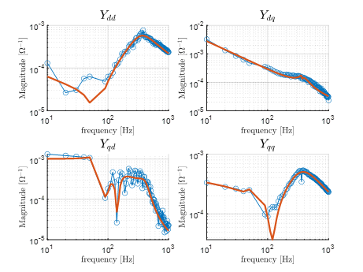
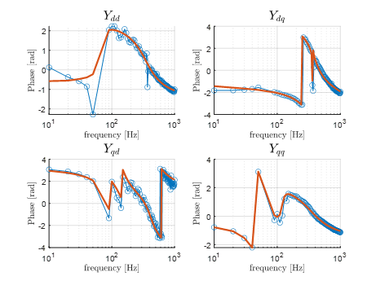
Admittance estimation: Vector fitting
Example: MMC STATCOM with detailed control structure (SCR =10.0)
measurements
fitting

Slide 19
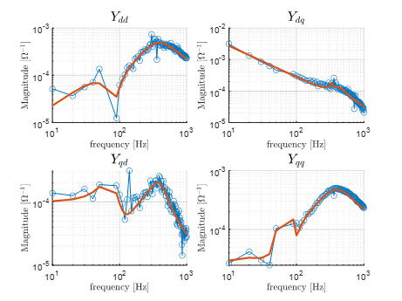
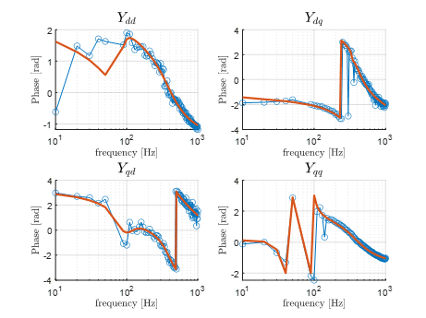
Admittance estimation: Vector fitting
Example: MMC STATCOM with detailed control structure (SCR =1.0)
measurements
fitting

Slide 20
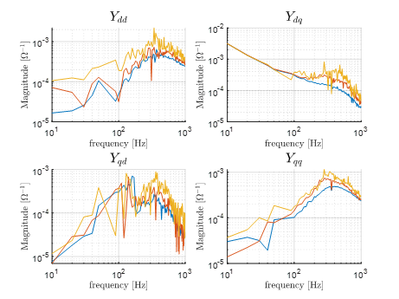
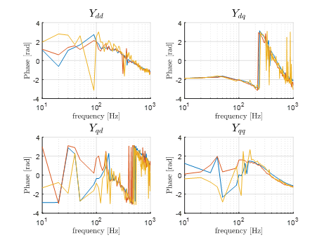
Impact of Time step for frequency sweep on admittance
The MMC STATCOM model uses a carrier with a frequency of 360 [Hz], and each arm has 44 power modules, the effective update frequency is 15,840 [Hz]. In this case, the solution time-step should be at most 63 [μs].
Time step 10 [μs]
Time step 60 [μs]
Time step 100 [μs]

Slide 21
Impact of frequency sweep time step on admittance
Example: MMC STATCOM with detailed control structure (SCR =1.0)
measurements
fitting

Slide 22
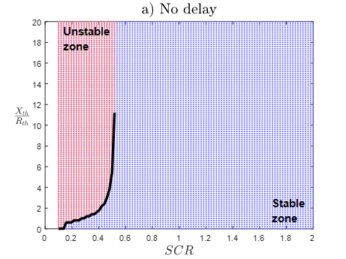
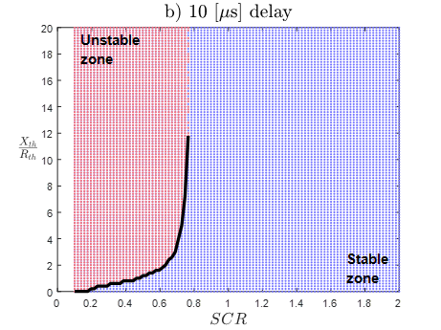
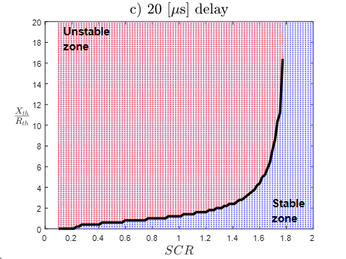
Impact of Measurement delay on stability margin
Measurement delays reduce significantly the stability margin of the STATCOM module

Slide 23
Stability analysis of power systems
Synchronous machines
STATCOM (MMC)
Wind Farm (VSC)
Networks
Loads

Slide 24
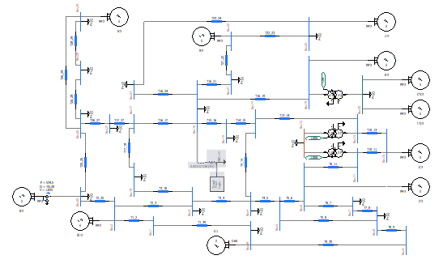
39 Bus system in PSCAD
39 Bus system in 345 [kV]
Analogue to the DigSILENT PowerFactory system
Synchronous machines with AVR, Governor and steam turbine dynamics
Lines modelled as π-circuits

Slide 25
39 Bus system in PSCAD
Dynamic response for fault on Bus 16 cleared after 180 [ms]
EMT simulation
RMS simulation

Slide 26
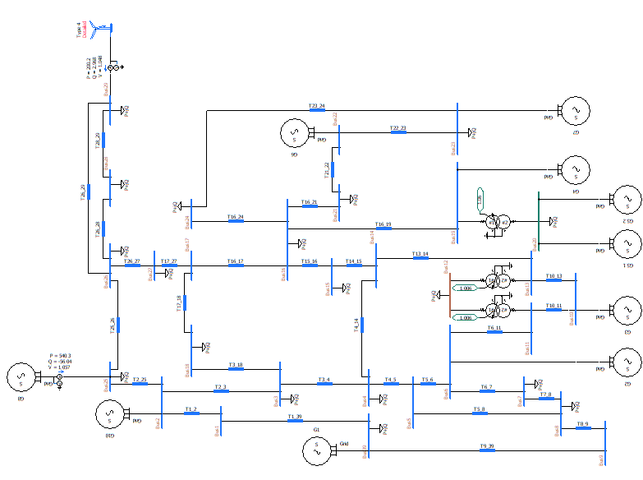
39 Bus system in PSCAD
STATCOM

Slide 27
39 Bus system in PSCAD : Test case for stability analsys

Slide 28
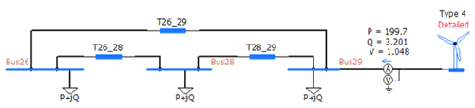
39 Bus system in PSCAD

Slide 29
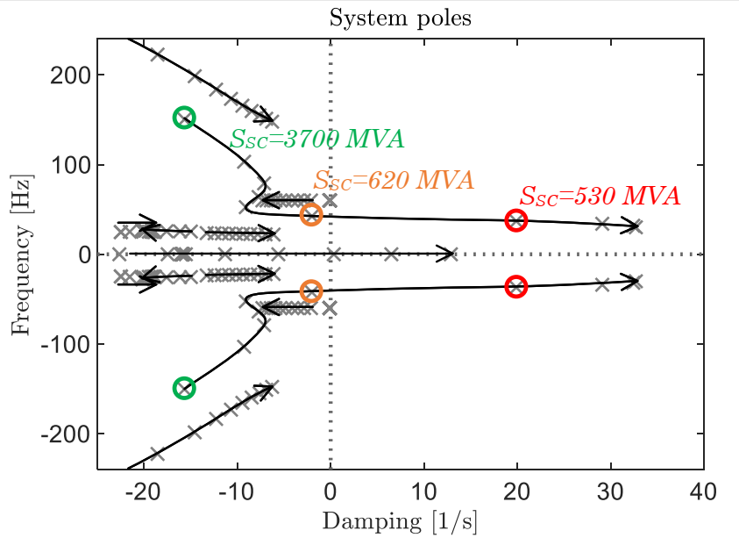
Stability analysis for varying grid strength (WF only)
Sensitivity over the grid strength at V1 by varying $Z_{th}$

Slide 30
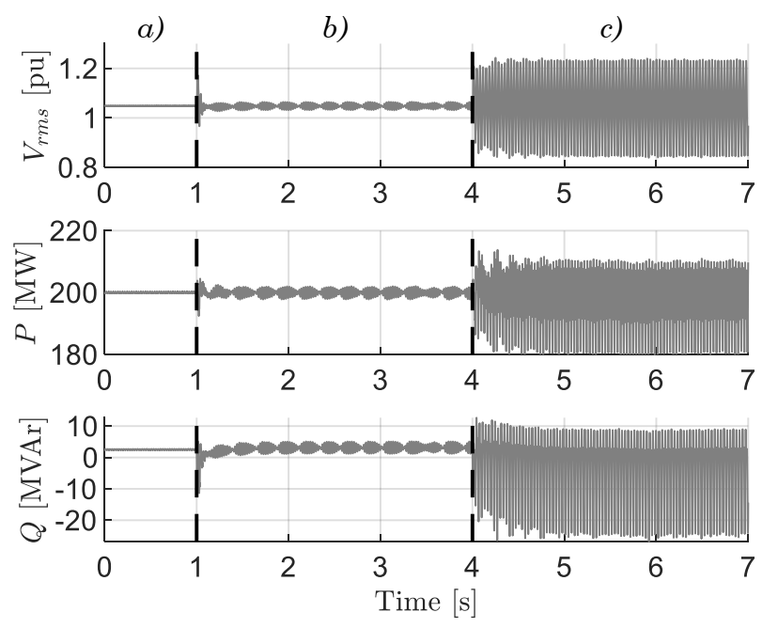
Stability analysis for varying grid strength (WF only)
Results in reduced system

Slide 31
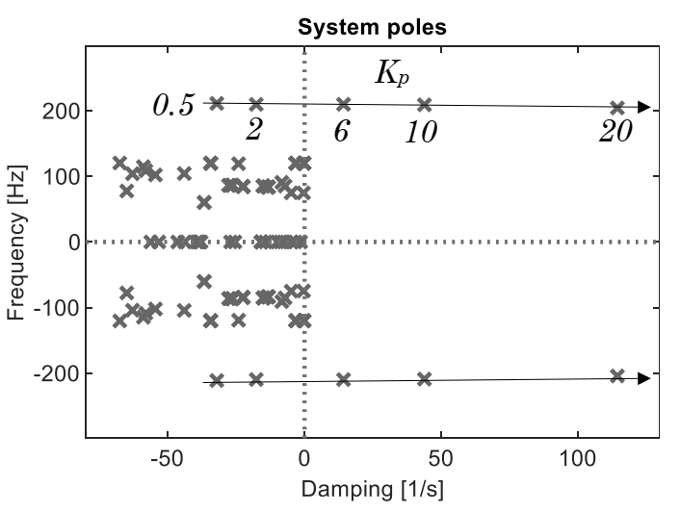
Impact of STATCOM AC voltage loop gain $k_{pv}$ on stability
31

Slide 32
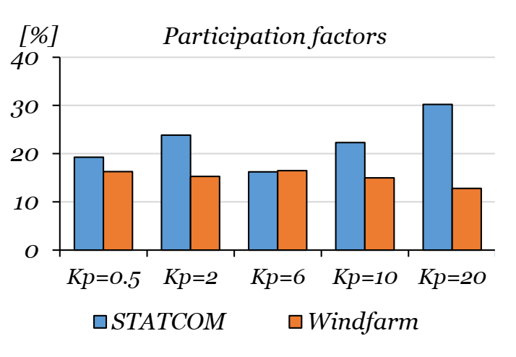
STATCOM loop gain Kpv on relative contribution to stability

Slide 33
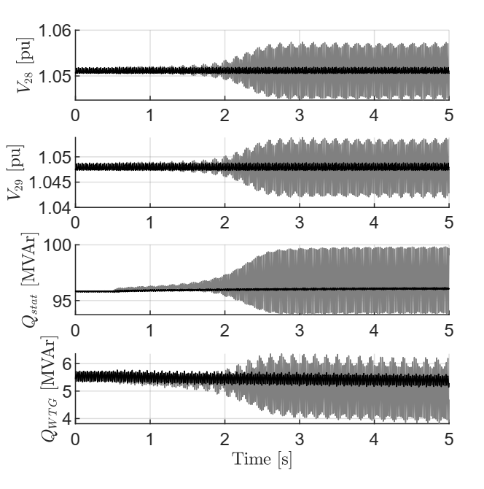
Validation in full 39 bus PSCAD model
PSCAD results full 39 bus system, changes on proportional gain

Slide 34
Insights
Impedance estimation-based stability assessment tool takes care of the detail dynamic model of MMC technology
The model is comprehensive in assessing the network stability impact of control delay, varying network strength and fault ride through (FRT) capability of these devices during network events

Slide 35
Insights
The approach has demonstrated that real network operability margin is significantly lower in low short circuit cases when compared to the same obtained through time average simplified model of these devices.
This does not model control and converter limit and saturations.

Slide 36
Recommendations
It is very much required to have detailed models of converter-based devices when performing grid connection studies in Electro-Magnetic Transient (EMT) time scale
Stability assessment studies need to be performed for varying grid strengths/short circuit level at the point of connection as well as transmission voltage levels.

Slide 37
Recommendations
TNO should insist on various other parametric sensitivity studies regarding key control schemes, interface PLL technologies etc.
The grid connection study specification should be amended with these requirements so that any connection study adheres to these specifications.

Slide 38

Researcher
Dr Nicolas Cifuentes
MEng , Universidad de Chile
PhD , Imperial College London
1. N. A. Cifuentes Otto, M. Sun, R. Gupta and B. C. Pal, "Black-Box Impedance-Based Stability Assessment of Dynamic Interactions Between Converters and Grid," in IEEE Transactions on Power Systems
2. N. Cifuentes and B. C. Pal, "A New Approach to the Fault Location Problem: Using the Fault’s Transient Intermediate Frequency Response," in IEEE Open Access Journal of Power and Energy, vol. 8, pp. 510-521, 2021,

Slide 39
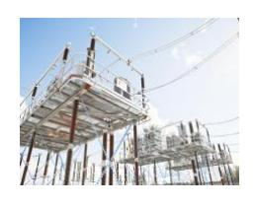
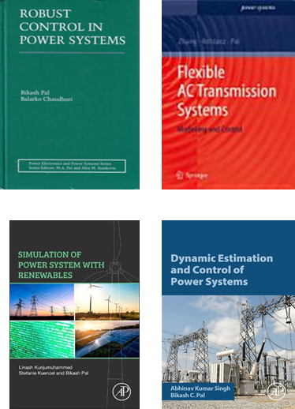


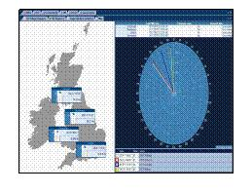


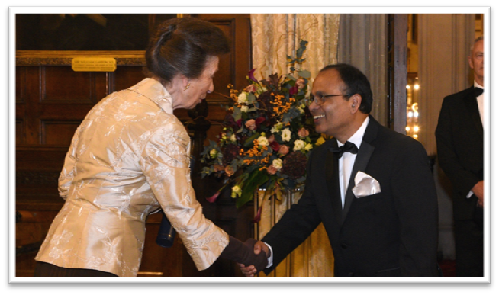

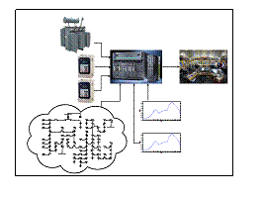







Researchers
Control
Monitoring
Dr Wu
Yanshu
Modelling
Estimation
Sai
Dr Firdous
Adeyemi
Dr Guo
Mert
Sowmya
Malek
Dr Yang
Jintao

Slide 40





Researchers
Control
Monitoring
Diptargha
Dr Wu
Onyema
Dr Kampitsis
Modelling
Estimation
Dr Yang
Dr Firdous
Adeyemi
Dr Guo
Sowmya
Mert
Kevin
Jintao
Sai
Yanshu
Malek

Slide 41

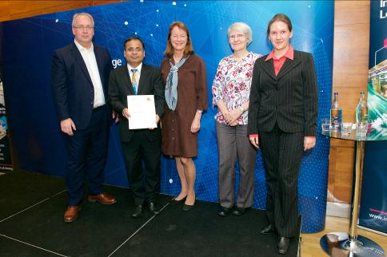


Researchers
Control
Monitoring
Diptargha
Dr Wu
Onyema
Dr Kampitsis
Modelling
Estimation
Ali
Dr Firdous
Adeyemi
Dr Guo
Sowmya
Andrea
Kevin
Jintao
Magne
Sai
Yanshu
Malek
Mert

Slide 42

Our funding supports

Slide 43
Comments or Questions

