Slide 1
Quantum Threats to Cryptography and Counter Measures
William Blair
Northern Virginia and Washington Joint Computer Society Chapter
wdblair@ieee.org
7/9/25

Slide 2
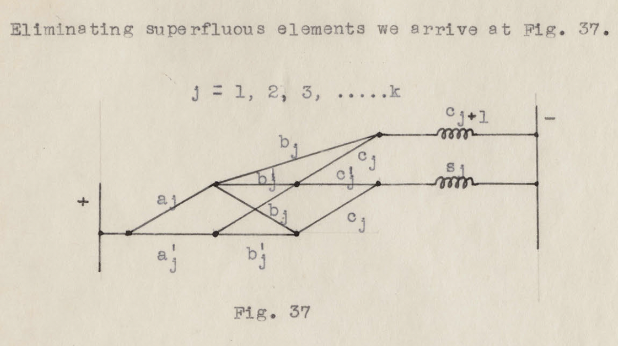
Classical Computing
Claude Shannon, A Symbolic Analysis of Relay and Switching Circuits 1940

Slide 3
Quantum Computing
Richard Feynman, Quantum Mechanical Computers 1984
It is believed that a Quantum Computer can
“efficiently simulate any physical process that occurs in Nature”
- John Preskill

Slide 4
Roadmap
Quantum Threats to Cryptography
Quantum Computing Overview
Attacks on Cryptography
  Shor’s Algorithm
  Grover’s Algorithm
Counter Measures
  Asymmetric Encryption
  Digital Signatures
    Module Learning with Errors (MLE)
    Cryptographic Hash Functions
Conclusion

Slide 5



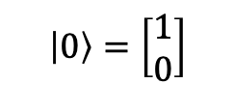

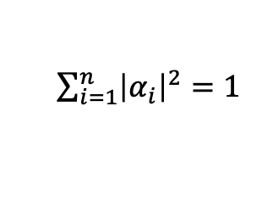


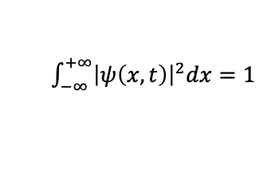




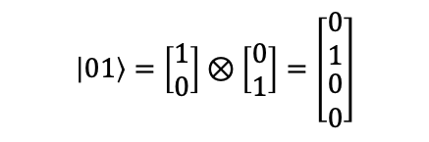



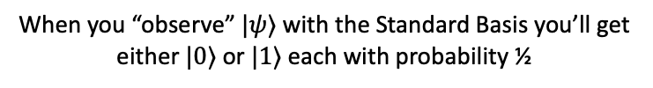
Quantum Computing Overview
Qubits
A two-dimensional unit length complex vector
bra$⋅$ket
Using Multiple Qubits
$$\left|ψ\right\rangle$$
$$\left|0\right\rangle =\left[\begin{matrix}1 \\ 0\end{matrix}\right]$$
$$\left|0\right\rangle$$
$$\left\langle ψ\right|={{\left|ψ\right\rangle }^{T}}^{∗}$$
$$\left|1\right\rangle$$
$$\left|1\right\rangle =\left[\begin{matrix}0 \\ 1\end{matrix}\right]$$
$$\left\langle ψ | ψ\right\rangle =1$$
$$\left|0⊗1\right\rangle$$
$$\left|0,1\right\rangle$$
$$\left|01\right\rangle$$
$$\left\langle 1 | 0\right\rangle =0$$
The Standard Basis
$$\left|01\right\rangle =\left[\begin{matrix}1 \\ 0\end{matrix}\right]⊗\left[\begin{matrix}0 \\ 1\end{matrix}\right]=\left[\begin{matrix}\begin{matrix}0 \\ 1\end{matrix} \\ \begin{matrix}0 \\ 0\end{matrix}\end{matrix}\right]$$
Qubits in Super Position
Restriction
$$\left|ψ\right\rangle =α_{1}v_{1}+α_{2}v_{2}+…+α_{n−1}v_{n−1} +α_{n}v_{n}$$
$\sum_{i=1}^{n}{{\left|α_{i}\right|}^{2}=1}$
Example:
$$\left|ψ\right\rangle = \frac{1}{√2}\left|0\right\rangle + \frac{1}{√2}|1⟩$$
$\int_{−∞}^{+∞}{{\left|ψ\left(x,t\right)\right|}^{2}dx=1}$
Analogy to Quantum Mechanics
[3]
When you “observe” $|ψ⟩$ with the Standard Basis you’ll get either $|0⟩$ or $|1⟩$ each with probability ½

Slide 6
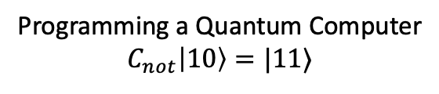



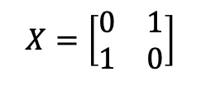
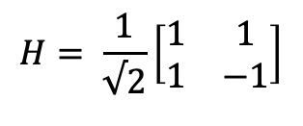



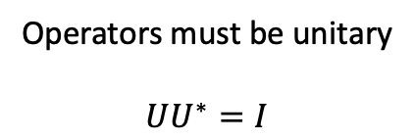





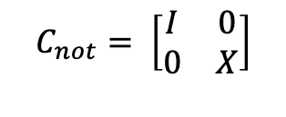

Quantum Computing Overview
Operators
$$X=\left[\begin{matrix}0 & 1 \\ 1 & 0\end{matrix}\right]$$
$$\left|1\right\rangle$$
$$\left|1\right\rangle$$
Programming a Quantum Computer
$$C_{not}\left|10\right\rangle =|11⟩$$
$$\left|0\right\rangle$$
$$\left|1⊕0\right\rangle$$
$$C_{not}= \left[\begin{matrix}I & 0 \\ 0 & X\end{matrix}\right]$$
Operators must be unitary
$$UU^{∗}=I$$
$$\left|0\right\rangle$$
H
$\left|ψ\right\rangle$ = $\frac{1}{√2}\left|0\right\rangle + \frac{1}{√2}|1⟩$
$$H^{⊗2}$$
$$H= \frac{1}{√2}\left[\begin{matrix}1 & 1 \\ 1 & −1\end{matrix}\right]$$
$$\left|0\right\rangle$$
H
$$⊗$$
$$⊗$$
$\left|ψ\right\rangle$ = $\frac{1}{√4}\left|00\right\rangle + \frac{1}{√4}\left|01\right\rangle +\frac{1}{√4}\left|10\right\rangle + \frac{1}{√4}\left|11\right\rangle$
$$\left|0\right\rangle$$
H

Slide 7





Quantum Computing Overview
Functions
Let $f\left(x\right):{\left\{0,1\right\}}^{n}→\left\{0,1\right\}$ be constant or balanced (i.e., return one value or half 1s or 0s). Let $n=1$, check if $f$is balanced or constant.
$$x$$
$$x$$
$$U_{f}$$
$$y$$
$$y⊕f(x)$$
In a classical setting it’s easy to see whether $f$ is balanced by enumerating all 4 possible values of $x$ and $y$.

Slide 8
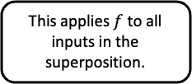





Quantum Computing Overview
Functions (Deutsch’s Algorithm)
Let $f\left(x\right):{\left\{0,1\right\}}^{n}→\left\{0,1\right\}$ be constant or balanced (i.e., return one value or half 1s or 0s). Let $n=1$, check if $f$is balanced or constant.
$$\left|x\right\rangle$$
H
H
$$\left|x′\right\rangle$$
The Hadamard gates allow us to create a superposition of all possible inputs.
Measuring this superposition once reveals whether $f$ is constant or balanced.
$$U_{f}$$
$$\left|y\right\rangle$$
This applies $f$ to all inputs in the superposition.
H
$$\left|y⊕f\left(x\right)\right\rangle$$
It may be tempting to think the QC can foresee all possible outcomes, but we’re just using Nature to realize, compute on, and sample from superpositions to learn about $f$.

Slide 9






Quantum Computing Overview
Functions (Classical Computing)
Let $f\left(x\right):{\left\{0,1\right\}}^{n}→\left\{0,1\right\}$ be constant or balanced (i.e., return one value or half 1s or 0s). Now we have $2^{n}$ choices for $x$.
In the classical setting, we can repeatedly sample the output of $U_{f}$ with random inputs.
$$x,x′←^{R}{\left\{0,1\right\}}^{n}$$
$$\operatorname{Pr}\left(f\left(x^{′}\right)=1\right|f\left(x\right)=0 ∧f is balanced)= \frac{1}{2} ×\frac{1}{2}= \frac{1}{4}$$
$$\operatorname{Pr}\left(f\left(x^{′}\right)=0\right|f\left(x\right)=1 ∧f is balanced)= \frac{1}{2} ×\frac{1}{2}= \frac{1}{4}$$
$$\operatorname{Pr}\left(f\left(x^{′}\right)≠f\left(x\right)\right|f is balanced)=1 − \left(\frac{1}{4}+\frac{1}{4}\right)= \frac{1}{2}$$
To check if $f$ is balanced, evaluate $f$ on two random inputs and fix $y=0$and claim $f$ is constant if $f\left(x\right)=f\left(x^{′}\right)$ and balanced otherwise.
$$\operatorname{Pr}\left(failure\right|k trials)=1 − {\left(\frac{1}{2}\right)}^{k}= \frac{1}{2^{k} }$$
Running 30 trials of this experiment gives you a one in a billion chance of failure.
$$x$$
$$x$$
$$U_{f}$$
$$y$$
$$y⊕f(x)$$

Slide 10






Quantum Computing Overview
Speed Up (Deutsch-Jozsa Algorithm)
Let $f\left(x\right):{\left\{0,1\right\}}^{n}→\left\{0,1\right\}$ be constant or balanced (i.e., return one value or half 1s or 0s)
$$\left|0\right\rangle$$
$$H^{⊗n}$$
$$H^{⊗n}$$
$$U_{f}$$
$$\left|1\right\rangle$$
H
$$\left|y⊕f\left(x\right)\right\rangle$$
The ability to create, compute over, and sample superpositions like in the $n=1$ case allows us to determine if $f$ is constant or balanced in a single query.
This is a good speedup over the classical case, but both algorithms are still $O\left(1\right)$ (i.e., constant time)

Slide 11



Attacks on Cryptography
Peter Shor, Algorithms for Quantum Computation: Discrete Logarithms and Factoring 1994
$$|\text{5340342433}⟩$$
$$|\text{5990905837313316253}⟩$$
Shor
$$|\text{1121820541}⟩$$
Allows an adversary to efficiently recover private keys from public keys for RSA, Elliptic Curves, and break key sharing approaches like Diffie Hellman
With reasonable probability (i.e., can repeat constant number of times to increase probability of success)
In contrast to Deutch’s Algorithm, this is an exponential speedup compared to finding prime factors with a classical computer.

Slide 12










Attacks on Cryptography
Shor’s Algorithm: TLS Example
QC
QC

Slide 13



Attacks on Cryptography
Lov Grover, A Fast Quantum Mechanical Algorithm for Database Search, 1996
$$|\text{ace}\text{6724}\text{fb}\text{227}\text{aa}\text{3}\text{e}\text{0}\text{e}\text{6}\text{eb}\text{4211}\text{f}\text{2}\text{a}\text{3}\text{b}\text{67}⟩$$
Grover
$$\left|\text{AES} \text{Key}\right||…⟩$$
Obtains a quadratic speedup compared to classical brute force
Less of a speed up compared to Shor’s Algorithm
Similar pre-image attack on cryptographic hash functions
Can be mitigated by doubling the key size for AES
$2^{128×2/2}=2^{128}$ which is still intractably large for brute force

Slide 14
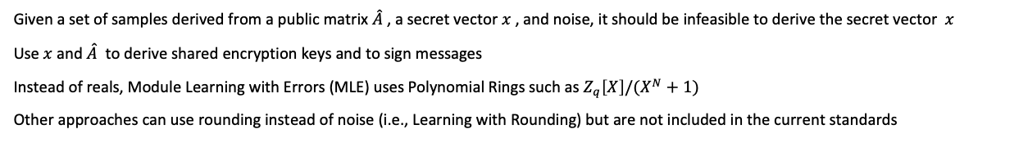
Counter Measures
Module Learning with Errors (MLE)
Need to encrypt information asymmetrically
  Without a loss of generality, deriving ephemeral keys between parties works as well
  Must be based on problems believed to be quantum resistant
Need to produce digital signatures
Solution: Module Learning with Errors
Given a set of samples derived from a public matrix $\hat{A}$ , a secret vector $x$, and noise, it should be infeasible to derive the secret vector $x$
Use $x$ and $\hat{A}$ to derive shared encryption keys and to sign messages
Instead of reals, Module Learning with Errors (MLE) uses Polynomial Rings such as $Z_{q}\left[X\right]/(X^{N}+1)$
Other approaches can use rounding instead of noise (i.e., Learning with Rounding) but are not included in the current standards

Slide 15
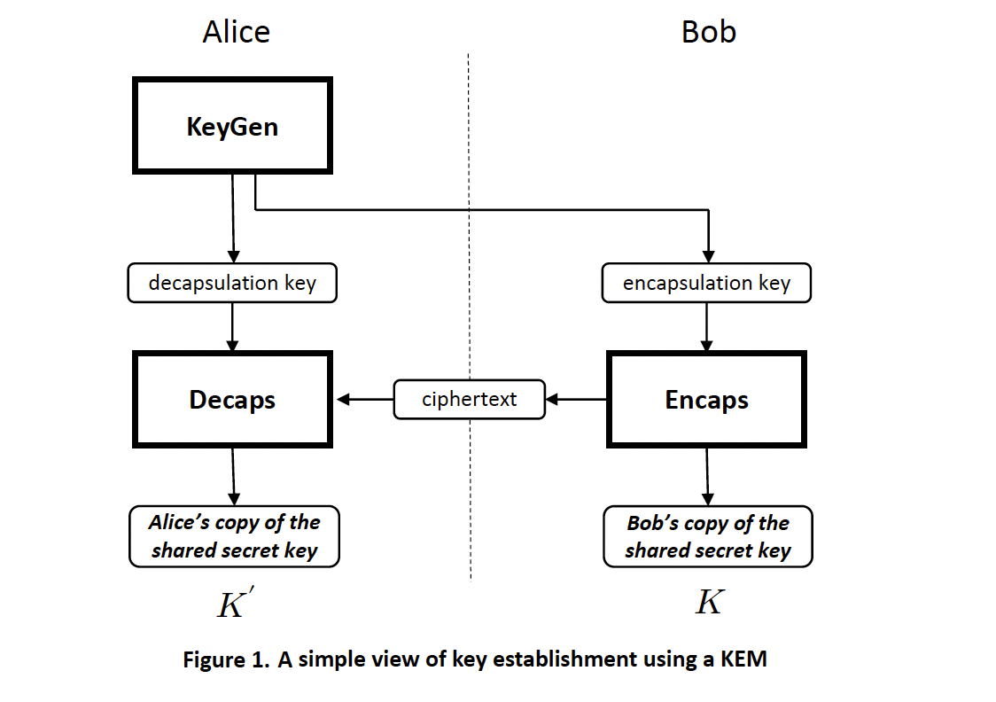

Quantum Resistant Asymmetric Encryption
ML-KEM “CRYSTALS-Kyber: A CCA-Secure Module-Lattice-Based KEM”
Quinn
Alice sends Bob a key that allows them to agree on a shared symmetric key.
QC
encapsulation key
ciphertext
Quinn cannot learn $K′$ from intercepted transmissions.
https://csrc.nist.gov/pubs/fips/203/final

Slide 16
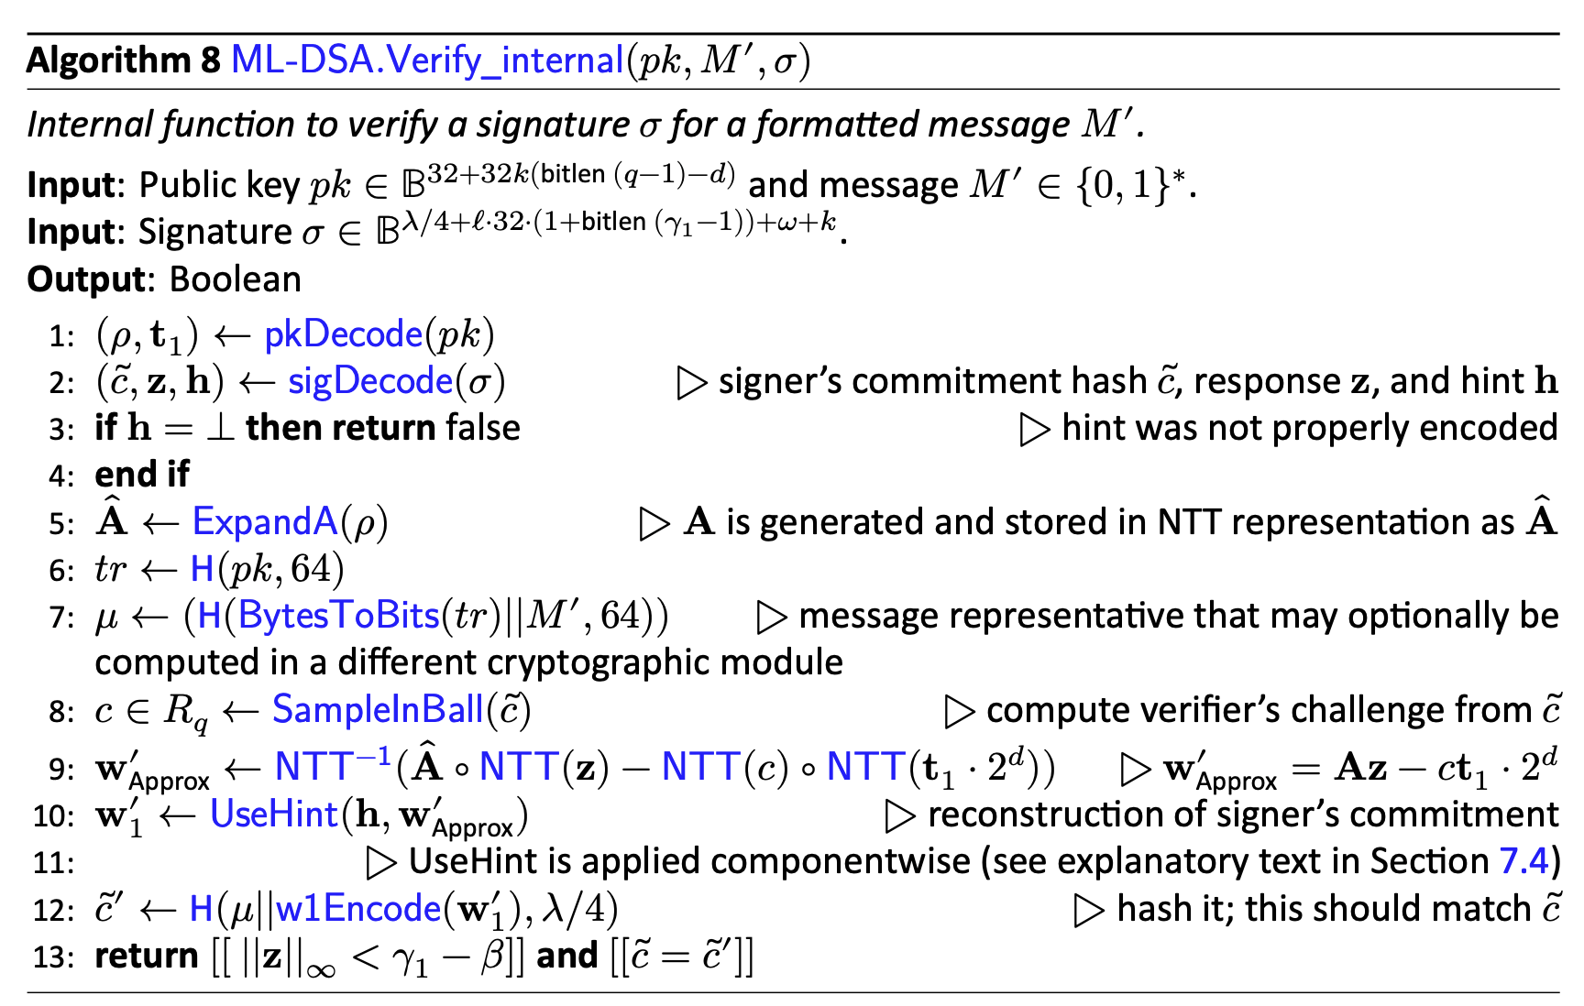
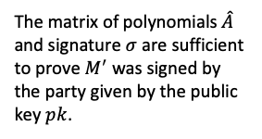
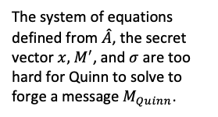
Quantum Resistant Digital Signatures
ML-DSA (CRYSTALS-Dilithium)
Quinn
QC
The system of equations defined from $\hat{A}$, the secret vector $x,$ $M^{′}$, and $σ$ are too hard for Quinn to solve to forge a message $M_{Quinn}$.
The matrix of polynomials $\hat{A}$ and signature $σ$ are sufficient to prove $M^{′}$ was signed by the party given by the public key $pk$.
https://nvlpubs.nist.gov/nistpubs/FIPS/NIST.FIPS.204.pdf

Slide 17





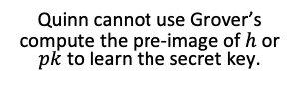
Quantum Resistant Digital Signatures
Cryptographic Hash Functions
Leslie Lamport, “Constructing Digital Signatures from a One Way Function” 1979 (Lamport Signatures)
Leighton and Micali “Large Provably Fast and Secure Digital Signature Schemes Based on Secure Hash Functions” 1995 (LMS)
eXtended Merkle Signature Scheme (XMSS) (NIST SP 800-208)
SPHINCS (NIST SLH-DSA)
Repeatedly hash message data with a secret key to sign $h=H(H(H\left(secret | \left|f(m)\right)||…\right)||…)$
Give the the verifier enough information to recover the public key $pk$from a signature $h$ for a given message $m$. Let $h=h_{3}$ below
$$pk$$
Quinn
$$h_{1,2}$$
$$h_{3,4}$$
Quinn cannot use Grover’s compute the pre-image of $h$ or $pk$ to learn the secret key.
QC
$$h_{3}$$
$$h_{4}$$

Slide 18
Conclusion
Overview and References
Overview of Quantum Computing
Attacks on Cryptography
Post-Quantum Cryptography Approaches
Resources
  John Preskill
    https://www.preskill.caltech.edu/ph229/
  Scott Aaronson
    https://scottaaronson.blog
  Peter Shor
    https://math.mit.edu/~shor/435-LN/
  Rahul Simha
    https://www2.seas.gwu.edu/~simhaweb/quantum/

Slide 19
References
Claude Shannon, A Symbolic Analysis of Relay and Switching Circuits, MS Thesis, MIT 1940
Richard Feynman, Simulating Physics with Computers, International Journal of Theoretical Physics 1982 (Based on 1981 MIT talk)
Richard Feynman, Quantum Mechanical Computers, Optics News, 1985 (Based on 1984 talk)
David J. Griffiths and Darrell F. Schroeter, Introduction to Quantum Mechanics, Cambridge University Press 2018
David Deutsch, Quantum Theory, the Church-Turing Principle and the Universal Quantum Computer, Proceedings of the Royal Society of London, 1985
David Deutsch and Richard Jozsa, Rapid Solutions of Problems by Quantum Computation, Proceedings of the Royal Society of London, 1992
Peter Shor, Algorithms for Quantum Computation: Discrete Logarithm and Factoring, IEEE Annual Symposium on the Fundamentals of Computer Science (FOCS), 1994
Lov K Grover, A Fast Quantum Mechanical Algorithm for Database Search, ACM Symposium on the Theory of Computing (STOC) 1996
Sanjeev Arora, Rong Ge, New Algorithms for Learning in Presence of Errors, International Colloquium on Automata, Languages, and Programming 2011
J Bos et al. CRYSTALS-Kyber: A CCA-Secure Module-Lattice-Based KEM, IEEE European Symposium on Security and Privacy (EuroS&P) 2018
FIPS-203 Module-Lattice-Based Key-Encapsulation Mechanism Standard, NIST 2024
L Ducas, Crystals–Dilithium: Digital Signatures from Module Lattices. IACR Transactions on Symmetric Cryptology 2018
FIPS-204 Module-Lattice-Based Digital Signature Standard, NIST 2024
Leslie Lamport, Constructing Digital Signatures from a One Way Function, SRI International 1979
Leighton and Micali, Large Provably Fast and Secure Digital Signature Schemes Based on Secure Hash Functions, US Patent 1995
SP 800-208 Recommendation for Stateful Hash-Based Signature Schemes, NIST 2020
FIPS 205 SLH-DSA Stateless Hash-Based Digital Signature Standard, NIST 2024

