Slide 1
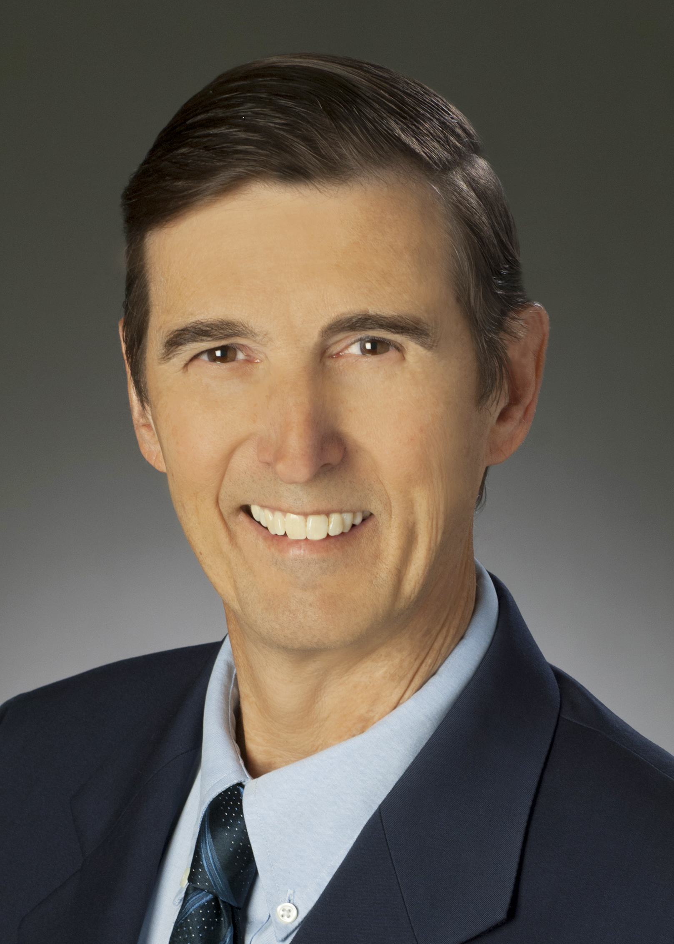
John Treichler CTO Applied Signal Technology
Tuesday
4 Nov 2025
3:30 – 4:30 PM MST
Sorensen Molecular Biotechnology
Building (SMBB) Auditorium, Room 2650, University
of Utah, Salt Lake City, UT
IEEE Signal Processing and Communications Society
The Worst Day of my Professional Engineering Life or How I Learned
to Love Multipath Propagation
John Treichler received his BA and MEE degrees from Rice University, Houston, TX in 1970 and his PhDEE from Stanford in 1977. He served as a line officer aboard destroyers in the US Navy from 1970 to 1974. In 1977 he joined ARGOSystems in Sunnyvale CA and then helped found Applied Signal Technology, Inc. in 1984 after serving for a year as an Associate Professor of Electrical Engineering at Cornell University.
Applied Signal Technology, now a business unit of RTX, Inc, designs and builds advanced signal
processing equipment. For three years he was the president of the business unit and continues to serve as its Chief Technical Officer. He was elected a Fellow of the Institute of Electrical and Electronics
Engineers (IEEE) in 1991. He was awarded the IEEE Signal Processing Society’s Technical Achievement
Award in 2000 and its first Industrial Leader Award in 2016. He is the Past President of the IEEE
Foundation, and in 2016 he was elected a member of the National Academy of Engineering. In 2019 he
received the IEEE Signal Processing Society’s Norbert Wiener Society Award.
Abstract: This presentation is dual-threaded. The technical portion is about the problem of recovering
communications signals in the presence of multipath propagation that, unless corrected, fatally
degrades signal quality. The human portion of the story is about a young engineer asked to solve a hard,
but important, problem but who stumbles on the way toward that goal
IEEE Utah Section Signal Processing and Communication Society Chapter

